Slide 1
Archdiocesan Update
New Initiatives, Resources and Plans

Slide 2
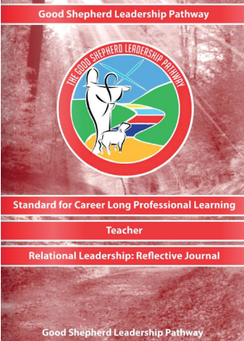
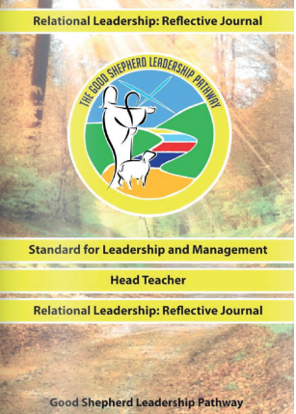
Good Shepherd Leadership Journals
SCES

Slide 3
Good Shepherd Leadership Pathway

Slide 4
Good Shepherd Leadership Pathway

Slide 5
Good Shepherd Leadership Journals
SCES

Slide 6
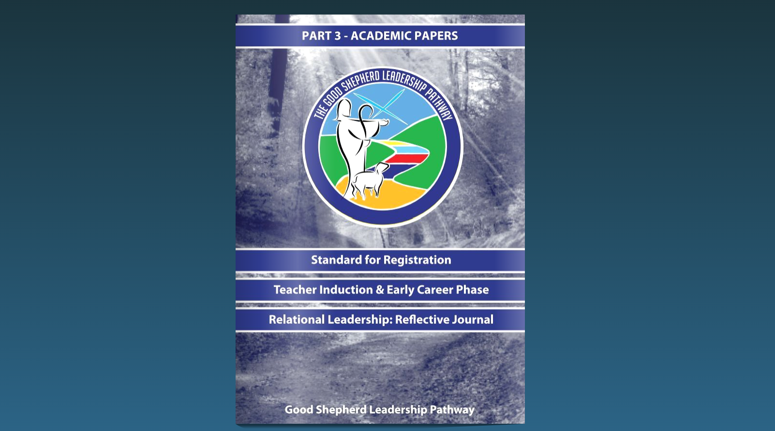
Reflective Journal
Prayer Journal
Academic Papers

Slide 7
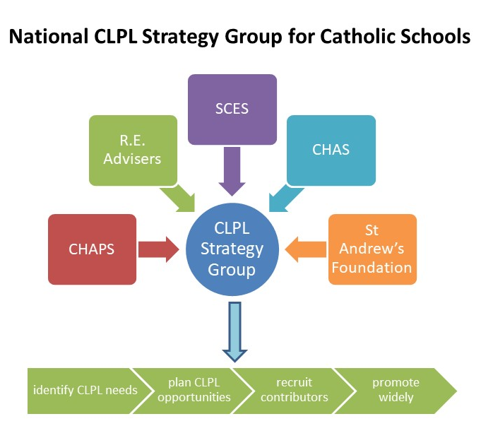
Career Long Professional Learning
The national strategy group for Career Long Professional Learning in Catholic Schools has continued to identify key areas of support for teachers.
The SCES website now has a page dedicated to CLPL with a post: “Everything you need for planning CLPL in a Catholic school”
(sces.org.uk/professional-learning-journey/)
On this page you will find links to all of the support materials that have been created for schools in this area.
CLPL process for Teachers in Catholic Schools (Power point)
National Strategy for CLPL: ‘Companions on the Journey’ pathway for Career Long Professional Learning (CLPL).
Explanation of the 6 CLPL areas for Catholic Schools
CLPL Case Studies
Professional Review and Development within a Catholic School— a resource to support staff as they prepare for their PRD
CLPL 101—Resources, Articles and Blogs to Guide Teachers’ Career Long Professional Learning in a Catholic School
CLPL Calendar of Activities

Slide 8
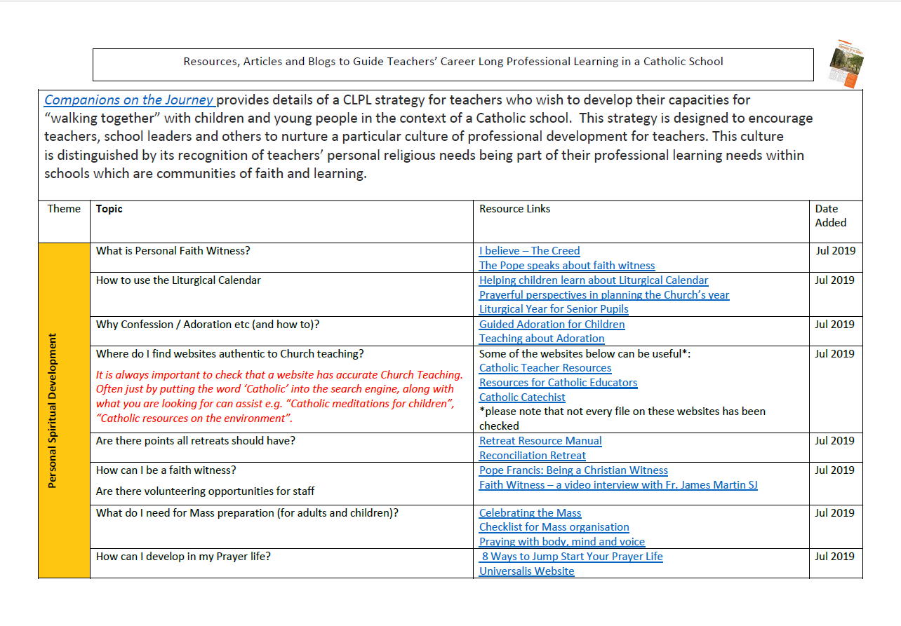
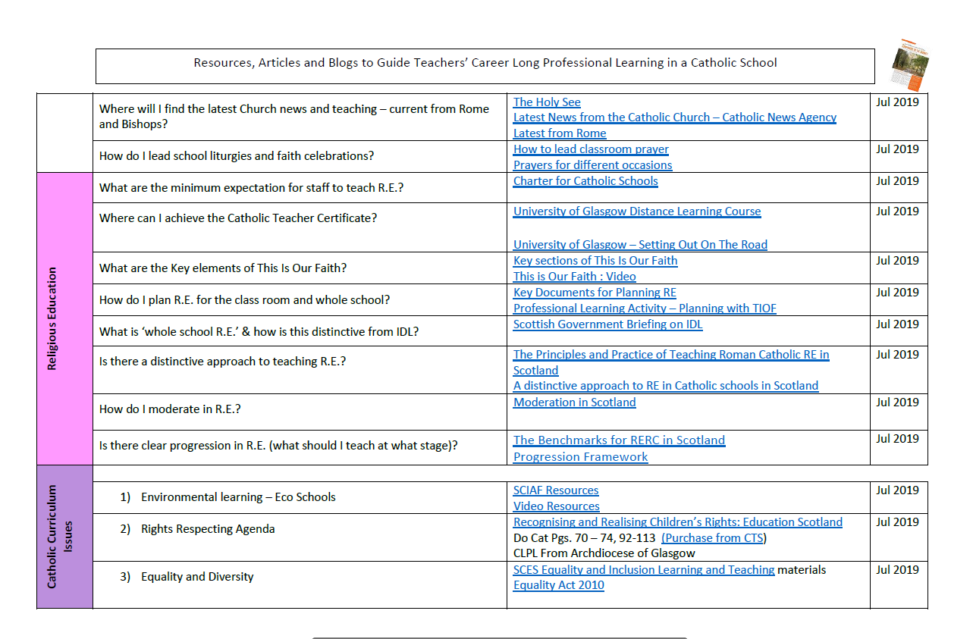
SCES: Teaching/Career Long Professional Learning/Everything you need…

Slide 9
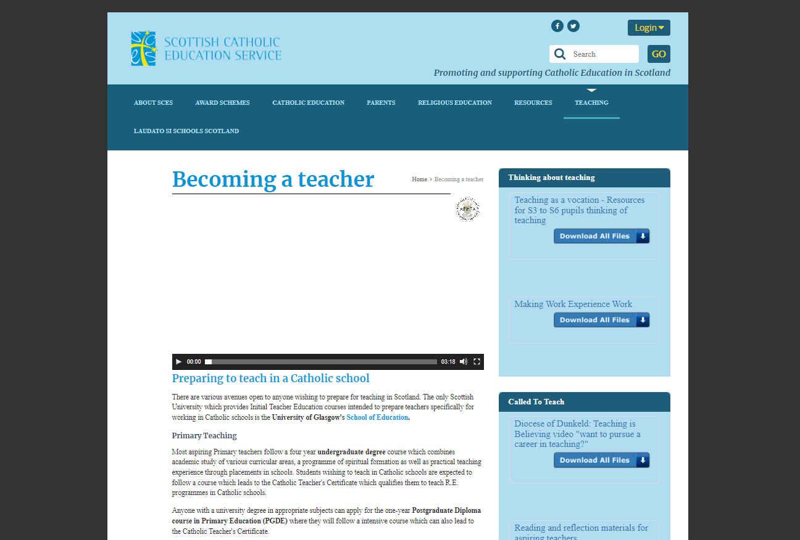
SCES: Teaching/Becoming a Teacher

Slide 10
SCES: Religious Education/Covid 19 RE & Spiritual Support

Slide 12
Archdiocesan Update
New Initiatives, Resources and Plans

Slide 14
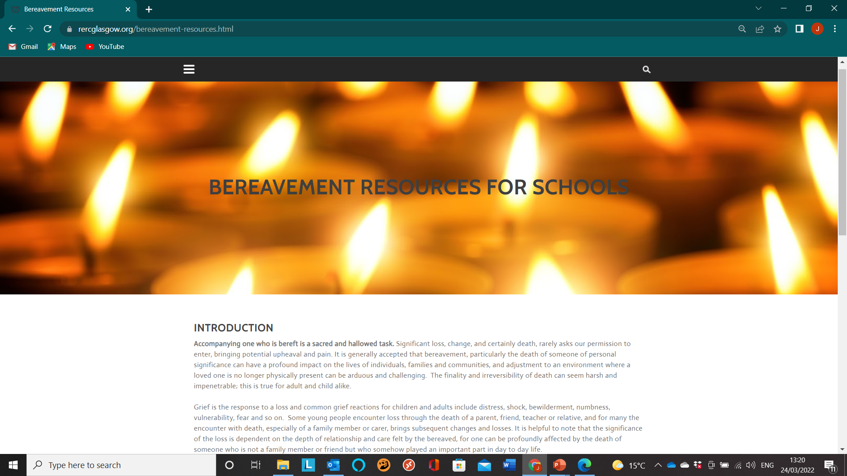
Rercglasgow.org: Bereavement Resources

Slide 15
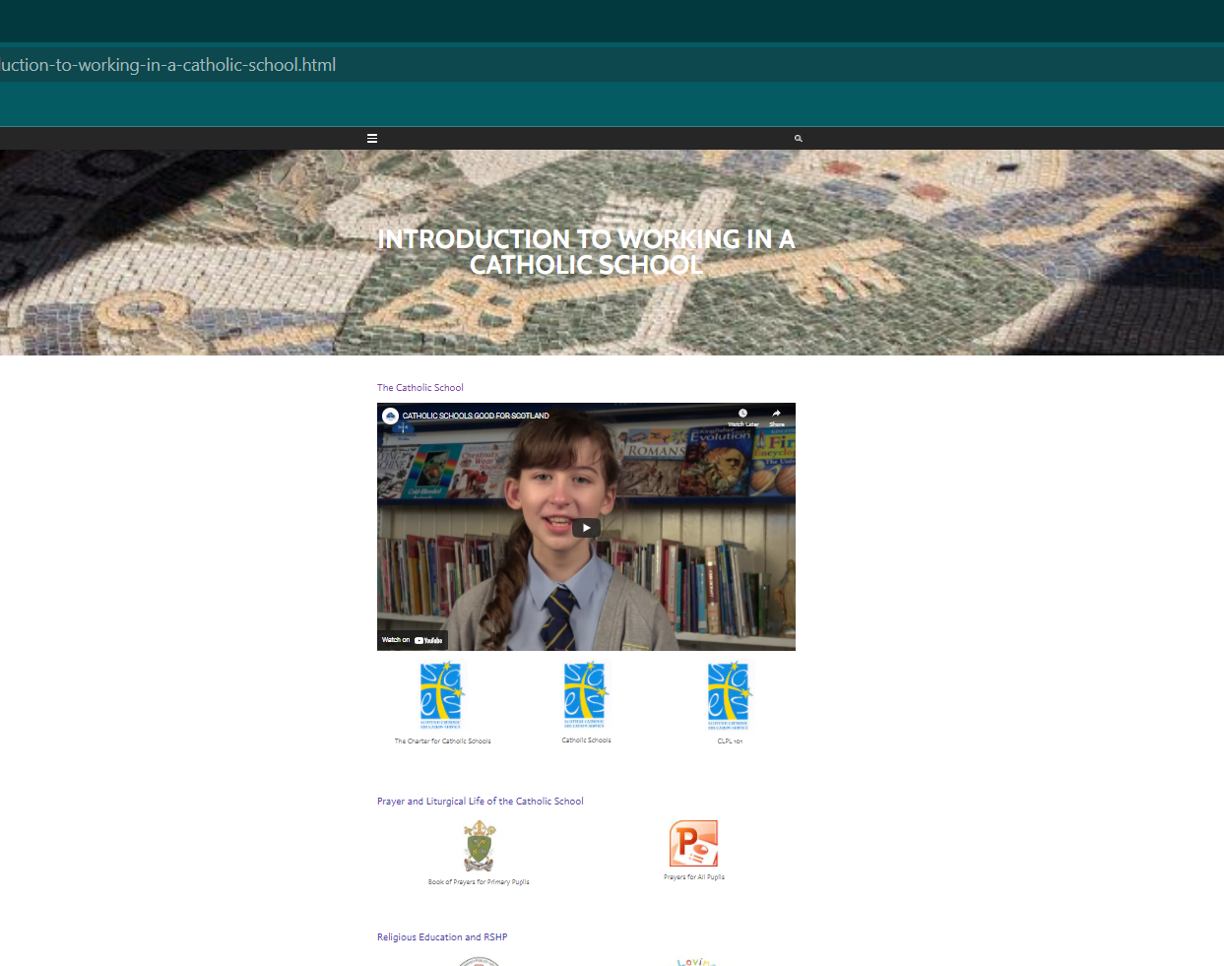
Rercglasgow.org:
Intro to Working in a Catholic School

Slide 16
rercglasgow.org:
Supporting Sacramental Prep at Home

Slide 17
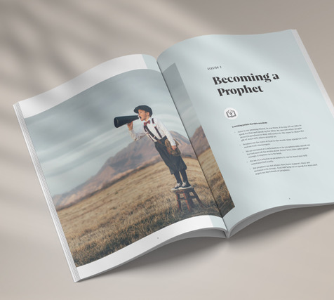
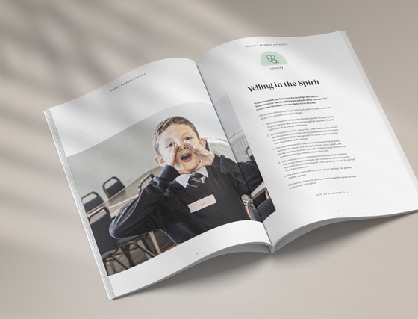
Confirmation Retreat

Slide 18
