Slide 1
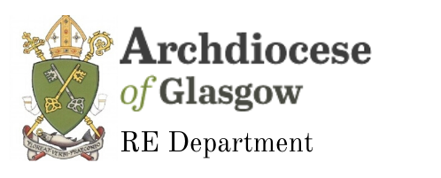
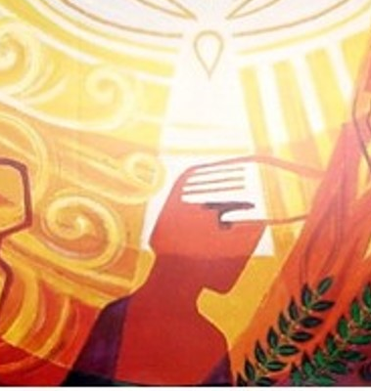

Confirmation
Pupil Catechesis Session One
Notes:
Welcome to session one of our online catechesis for Confirmation. My name is Joanna and I am going to take you through today’s lesson.

Slide 2
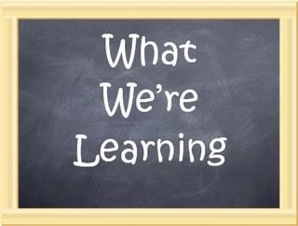
develop our understanding of the use of oil in the Sacraments
explore what it means to become initiated into the Catholic Church
Notes:
In school you have been learning about the Seven Sacraments and your journey of initiation into the Church. In today’s session we are going to:
➢ develop our understanding of the use of oil in the Sacraments ➢ explore what it means to become initiated into the Catholic Church

Slide 3
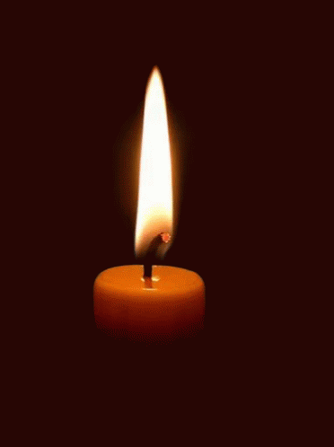
Time of Prayer
Notes:
We are now going to take a few moments to pray before we begin our lesson today. Make sure you are sitting comfortably, take a few moments to prepare yourself for prayer and then join me in making the sign of the cross.
In the Name of the Father and of the Son and of the Holy Spirit Amen.
God Our Father, You are with us as we gather in prayer. Open our hearts as we listen to your word and help us as to prepare well to receive the Sacrament of Reconciliation. Amen
After Jesus had risen from the dead he appeared to his disciples to give them an important message. We are going to listen to a short passage from Matthew’s Gospel that explains this to us now.
Reading: Matthew 28:16-20
¹⁶ The eleven disciples went to the hill in Galilee where Jesus had told them to go. ¹⁷ When they saw him, they worshiped him, even though some of them doubted. ¹⁸ Jesus drew near and said to them, “I have been given all authority in heaven and on earth. ¹⁹ Go, then, to all peoples everywhere and make them my disciples: baptize them in the name of the Father, the Son, and the Holy Spirit, ²⁰ and teach them to obey everything I have commanded you. And I will be with you always, to the end of the age.”
All say together: Come, Holy Spirit, fill the hearts of the faithful. Enkindle in us the fire of your love. Send forth your Spirit and we shall be created and you shall renew the face of the earth. In the name of the Father and of the Son and of the Holy Spirit, Amen.

Slide 4
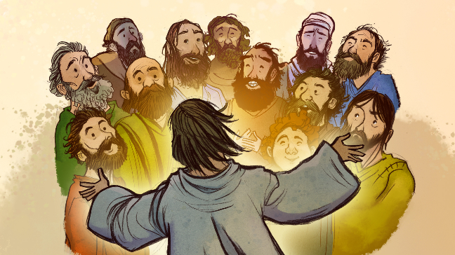
Notes:
In the passage we just listened to we heard Jesus talking to his disciples. Before he ascended into Heaven, Jesus made a promise to his friends. He said: “I am with you always, yes, till the end of time” (Matthew 28:20) Jesus’ promise was not only for the Apostles but also for everyone who would become members of the Church. That includes you! Jesus sent us the Holy Spirit to be with us and to guide us.
The small Christian communities that were formed after Pentecost gathered together regularly to pray and listen to the teachings of the Apostles. They were the Church and as the numbers increased some of their leaders took the Good News to other countries. Gradually, with the help of the Holy Spirit, the Church began to spread throughout the world.
Today we are the Church, the followers of Jesus. We have been given the same mission as the Apostles – to make the Good News of God’s love known to all people. In the Church we all have a responsibility to help build God’s Kingdom in our world. The Holy Spirit guides us and helps us to do this.
In this passage we hear Jesus telling them to continue his work on earth. He asks them to teach and spread the Good News, to Baptise people and forgive sins. The Twelve Apostles were the first priests and Bishops of the Catholic Church and since then the Church has always had special leaders. Take a few moments to think of those leaders now. Perhaps you could remember to include them in your prayers.

Slide 5
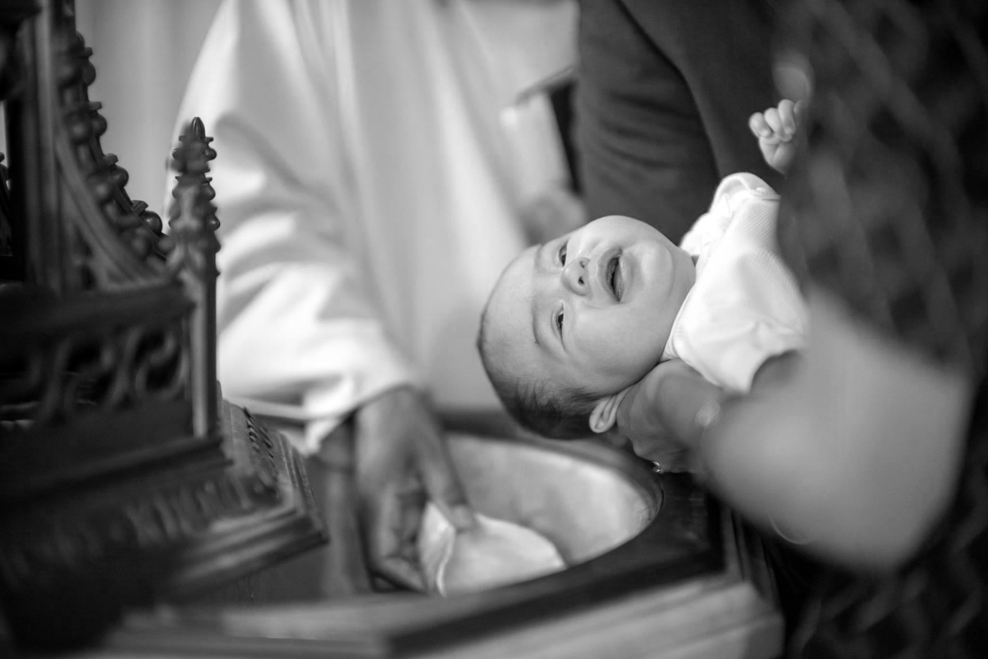
Baptism and Confirmation
Notes:
At Baptism, we are anointed with oil and this anointing identifies us as children of God. We are going to take a few moments now to think about what it means to be a child of God.
Think about your own family. Would you say that you are similar to your parents or siblings? Perhaps you look similar to them or enjoy similar things, or perhaps your have the same gifts and talents. Do your parents expect you to behave a certain way? Do they expect you to help around the house or support your siblings?
Now think about your school community. What are your school values? Although you and your classmates will have lots of similarities and differences you all belong to the same community and because of this you will all use your gifts and talents to help and support each other. You will also have class and school rules and are you will be expected to behave a certain way as a pupil of your school.
Our Identity as a child of God is a little like this. It means that we belong to our Church community. As part of that community we share the same beliefs and use the gifts and talents that God has given us to help and support one another. As children of God, we all try to carry on Jesus’ work on earth. This means we try to do our best to live the way he taught us, by loving God and loving others – our faith then can be seen in our actions and the way we treat others.
Through the sacrament of Confirmation God confirms this life of faith that we received at Baptism through the Holy Spirit. But we are not left on this journey alone, in the Sacrament of Confirmation, we also receive an outpouring of the gifts of the Holy Spirit which will help us on our journey towards holiness as a child of God, helping us to build God’s Kingdom.

Slide 6
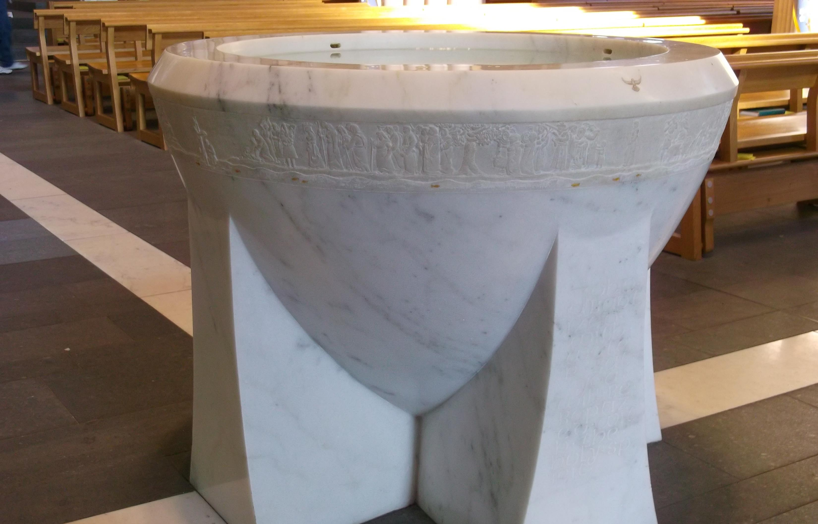
Notes:
At this point in your preparation you would normally visit the church and gather around the Baptismal Font.
We gather at the Baptismal font because our Journey of Initiation into the church begins at Baptism. Through Baptism, we are welcomed into the Church family.
During your Confirmation Mass the congregation will be sprinkled with holy water to remind us that the journey of initiation began at Baptism and is continuing now at Confirmation.
At our Baptism, the priest baptised us “in the name of the Father and of the Son and of the Holy Spirit”. We are reminded of this every time we bless ourselves and make the sign of the Cross. This is especially true when we bless ourselves with holy water as we enter the church.

Slide 7
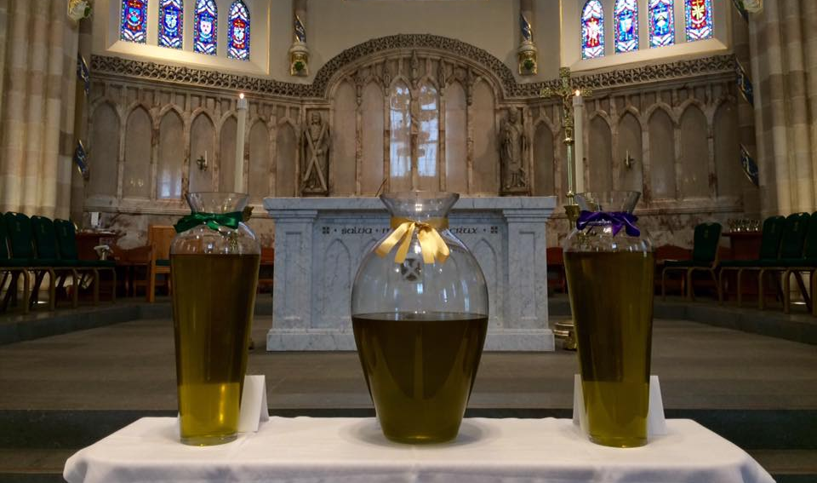
The Oil of Chrism
Notes:
At Confirmation you will be anointed with the oil of Chrism.
The Oil of Chrism is consecrated at the Chrism Mass which takes place each year on Holy Thursday.
On Holy Thursday morning, the bishop, joined by the priests of the diocese, gather at the Cathedral to celebrate the Chrism Mass. Here the bishop blesses three oils the Oil of Catechumens, the Oil of the Infirm, and Holy Chrism which will be used in the celebration of the sacraments throughout the diocese for the year.
The Oil of Chrism is used in the Sacraments of Baptism, Confirmation and Holy Orders. It is a mixture of olive oil and balsam, an aromatic oil.

Slide 8
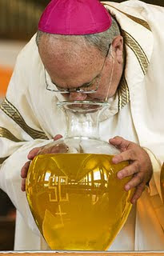
The Blessing of the Oil of Chrism
Notes:
The blessing of the Holy Chrism is different from that of the other oils. Here the bishop breathes over the vessel of chrism, a gesture which symbolizes both the Holy Spirit coming down to consecrate this oil, and the life-giving nature of the sacraments it is used in.
When the Chrism and the Sign of the Cross are used for the anointing at Baptism and Confirmation, it means that we are special: we belong to Jesus’ family, the Church Family and we have special work to do for God.

Slide 9
Activity
Take a few moments to think about the ways that you can build up God’s Kingdom at home, in school and in your parish community.
Try to think of three suggestions for each.
Notes:
Take a few moments now to write down ways that you could build up God’s kingdom at home, in school and in your parish community (3 suggestions for each).

