Slide 1

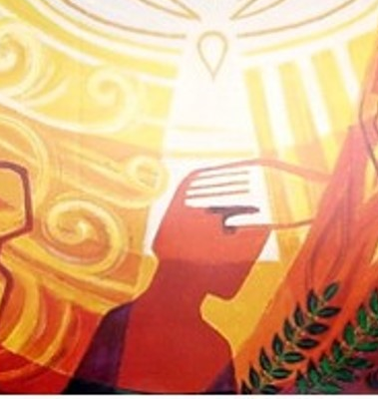

Confirmation
Pupil Catechesis Session Three
Notes:
Welcome to session three of our online catechesis for Confirmation. My name is Joanna and I am going to take you through today’s lesson.

Slide 2
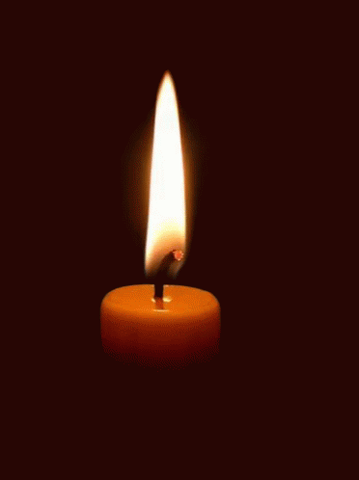
Time of Prayer
Notes:
We are now going to take a few moments to pray before we begin our lesson today. Make sure you are sitting comfortably, take a few moments to prepare yourself for prayer and then join me in making the sign of the cross.
In the Name of the Father and of the Son and of the Holy Spirit Amen.
God Our Father, You are with us as we gather in prayer. Open our hearts as we listen to your word and help us as to prepare well to receive the Sacrament of Reconciliation. Amen
We are going to listen to a short passage from the Acts of the Apostles.
Reading: Pentecost Acts 2: 1-13
The Coming of the Holy Spirit
2 When the day of Pentecost came, all the believers were gathered together in one place. ² Suddenly there was a noise from the sky which sounded like a strong wind blowing, and it filled the whole house where they were sitting. ³ Then they saw what looked like tongues of fire which spread out and touched each person there. ⁴ They were all filled with the Holy Spirit and began to talk in other languages, as the Spirit enabled them to speak.
⁵ There were Jews living in Jerusalem, religious people who had come from every country in the world. ⁶ When they heard this noise, a large crowd gathered. They were all excited, because all of them heard the believers talking in their own languages. ⁷ In amazement and wonder they exclaimed, “These people who are talking like this are Galileans! ⁸ How is it, then, that all of us hear them speaking in our own native languages? ⁹ Amazed and confused, they kept asking each other, “What does this mean?”
¹³ But others made fun of the believers, saying, “These people are drunk!”
All say together:
Come, Holy Spirit, fill the hearts of the faithful. Enkindle in us the fire of your love. Send forth your Spirit and we shall be created and you shall renew the face of the earth.
In the name of the Father and of the Son and of the Holy Spirit, Amen.
All say together: Come, Holy Spirit, fill the hearts of the faithful. Enkindle in us the fire of your love. Send forth your Spirit and we shall be created and you shall renew the face of the earth. In the name of the Father and of the Son and of the Holy Spirit, Amen.

Slide 3
In today’s session we will:
explore the ways that the Holy Spirit is represented in scripture and art
discover how the gifts and fruits of the Holy Spirit are present in our lives
Notes:
In school, you have been learning about the gifts and fruits of the Holy Spirit. In today’s session, we are going to:
explore the ways that the Holy Spirit is represented in scripture and art
create our own prayers and illustrations of the Holy Spirit
discover how the gifts and fruits of the Holy Spirit are present in our lives

Slide 4
Acts 2:3
Then they saw what looked like tongues of fire which spread out and touched each person there
Acts 2:2
Suddenly there was a noise from the sky which sounded like a strong wind blowing, and it filled the whole house where they were sitting.
John 20:18-22
Then he breathed on them and said, “Receive the Holy Spirit.
Notes:
Today we heard the story of Pentecost in our scripture reading. The followers of Jesus who were present at Pentecost used the symbols of wind and fire to help them explain what they had experienced on that day.
Another symbol that has been used to describe/explain the Holy Spirit is ‘breath’. The Holy Spirit is sometimes referred to as ‘The Breath of God’.
On the screen you will see three examples of scripture passages that mention the Holy Spirit:

Slide 5
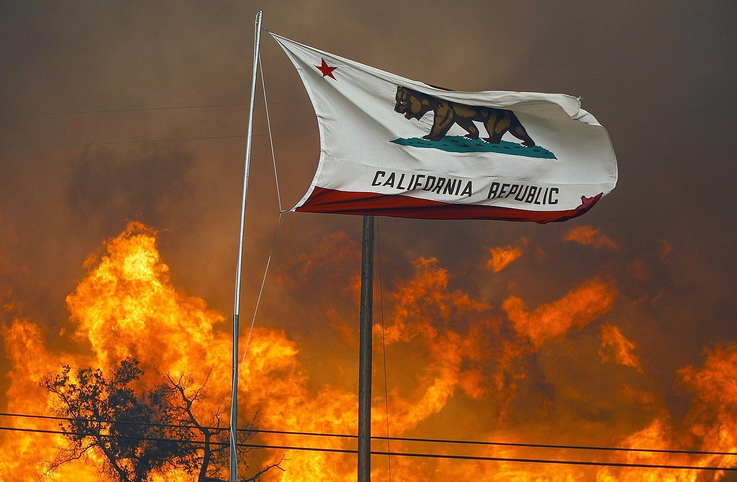
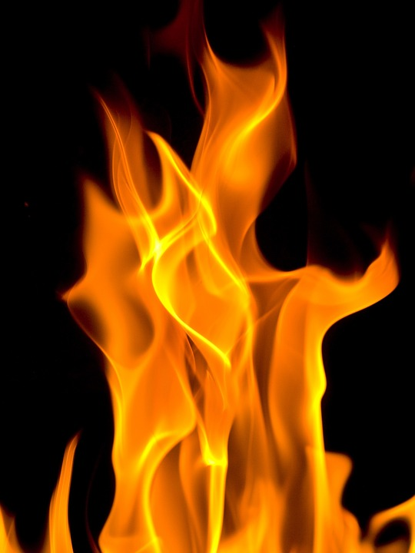
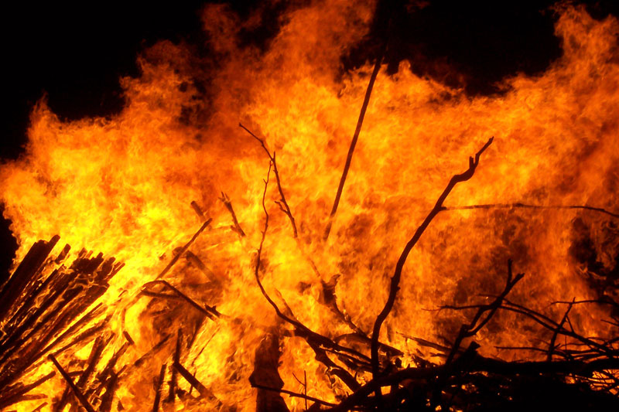
Fire
Notes:
We are now going to take some time to think about the properties of fire, wind and breath. On a piece of paper write down as many words as you can think of to describe fire e.g. powerful,

Slide 6
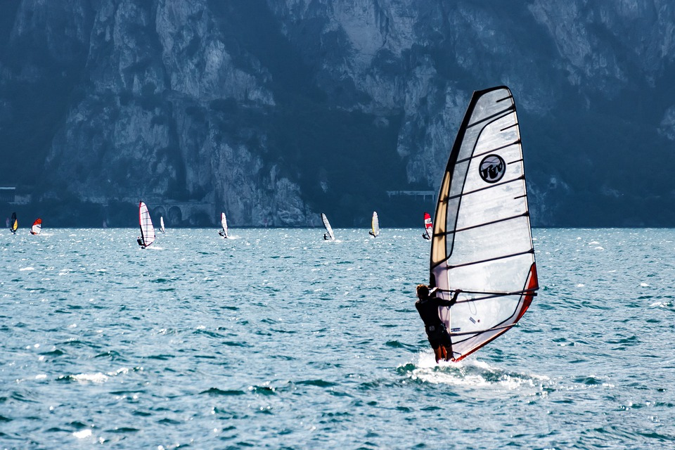

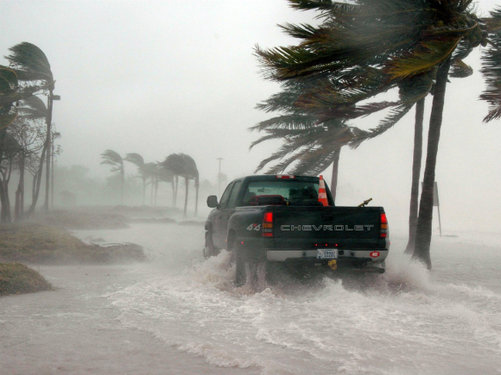
Wind
Notes:
Now do the same for wind.

Slide 7
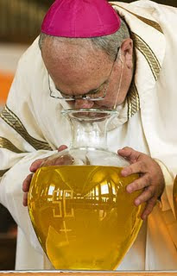
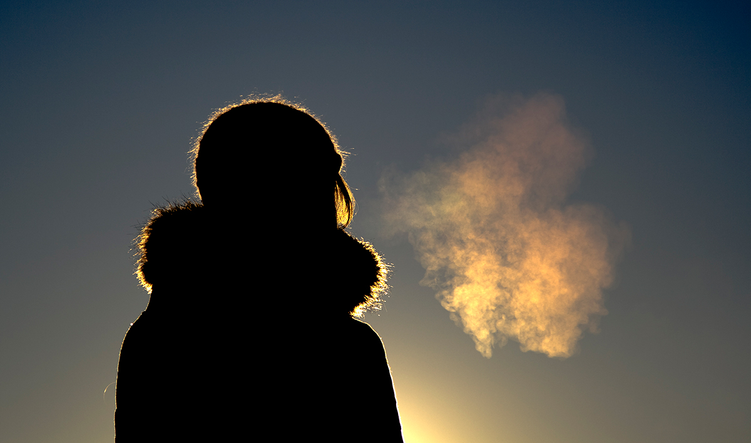
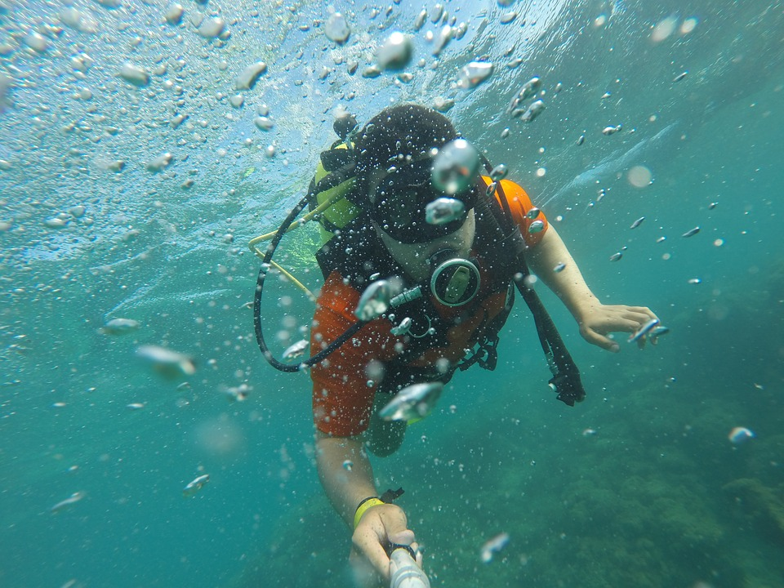
Breath
Notes:
And the same for breath.
Look back over the words that you have written. Think back to the scripture extracts we heard earlier: tongues of fire which spread out and touched each person there, strong wind blowing that filled the whole house.
Can you relate any of the words that you have written down to what you have been learning about the Holy Spirit? Take a few moments to think about that now.

Slide 8
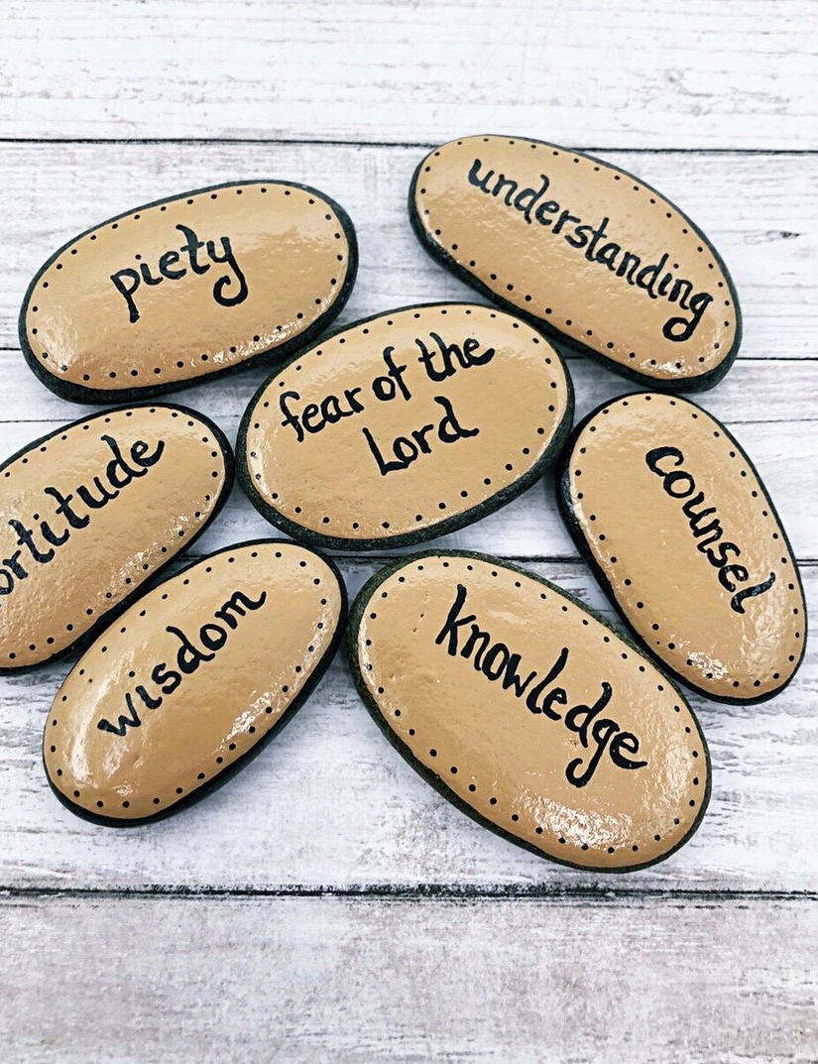
The Gifts of the Holy Spirit
Notes:
When the Gifts of the Holy Spirit are alive and working in us they begin to bear fruit in our lives.

Slide 9
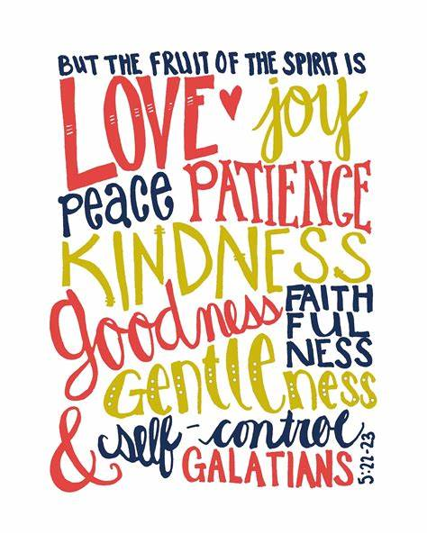
Fruits of the Holy Spirit
Notes:
This can be seen in our actions, the way we treat others and generally how we live our lives. These characteristics are known as the Fruits of the Holy Spirit.

Slide 10
Notes:
Look at the image on the screen. You can see the trinity: Father, Son and Holy Spirit at the roots, the gifts of the holy spirit on the stump of the tree and the fruits of the holy spirit with the leaves. In your own words describe what you think this image is trying to communicate.

Slide 11
Breathe in me, O Holy Spirit, that my thoughts
may all be holy.
Act in me, O Holy Spirit, that my work too, may be holy.
Draw my heart, O Holy Spirit, that I love but what is holy.
Strengthen me, O Holy Spirit, to defend all that is holy.
Guard me, then, O Holy Spirit that I may always be holy.
Amen.
Glory be to the Father…
Notes:
In the name of the Father and of the Son and of the Holy Spirit, Amen.
The candle is lit while a catechist says the following:
As we light this candle we remember that we belong to the Church. We remember that Jesus Christ is our light who is always with us. We are his followers.
Invite the pupils to be still and reflect on what they have learned in today’s session.
All :
Breathe in me, O Holy Spirit, that my thoughts may all be holy.
Act in me, O Holy Spirit, that my work too, may be holy.
Draw my heart, O Holy Spirit, that I love but what is holy.
Strengthen me, O Holy Spirit, to defend all that is holy.
Guard me, then, O Holy Spirit that I may always be holy.
Amen.
Glory be to the Father, and to the Son and to the Holy Spirit, as it was in the beginning, is now, and ever shall be. World without end, Amen.

