Slide 1
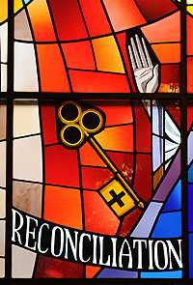

Reconciliation
Parish Catechesis Session Two
Notes:
Welcome to Lesson Two.

Slide 2

That God loves us so much
How to make a good confession
Notes:
Today we are learning that God LOVES US SO MUCH! And how to make a good confession.

Slide 3
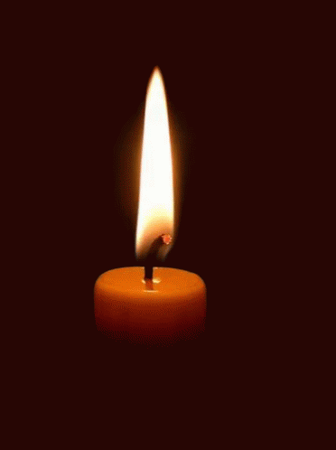
Time of Prayer
Notes:
We are now going to take a few moments to pray before we begin our lesson today. Make sure you are sitting comfortably, take a few moments to prepare yourself for prayer and then join me in making the sign of the cross.
In the Name of the Father and of the Son and of the Holy Spirit Amen.
God Our Father, You are with us as we gather in prayer. Open our hearts as we listen to your word and help us as to prepare well to receive the Sacrament of Reconciliation. Amen
Let’s Pray the Our FATHER TOGETHER.
In the name of the Father and of the Son and of the Holy Spirit Amen.

Slide 4
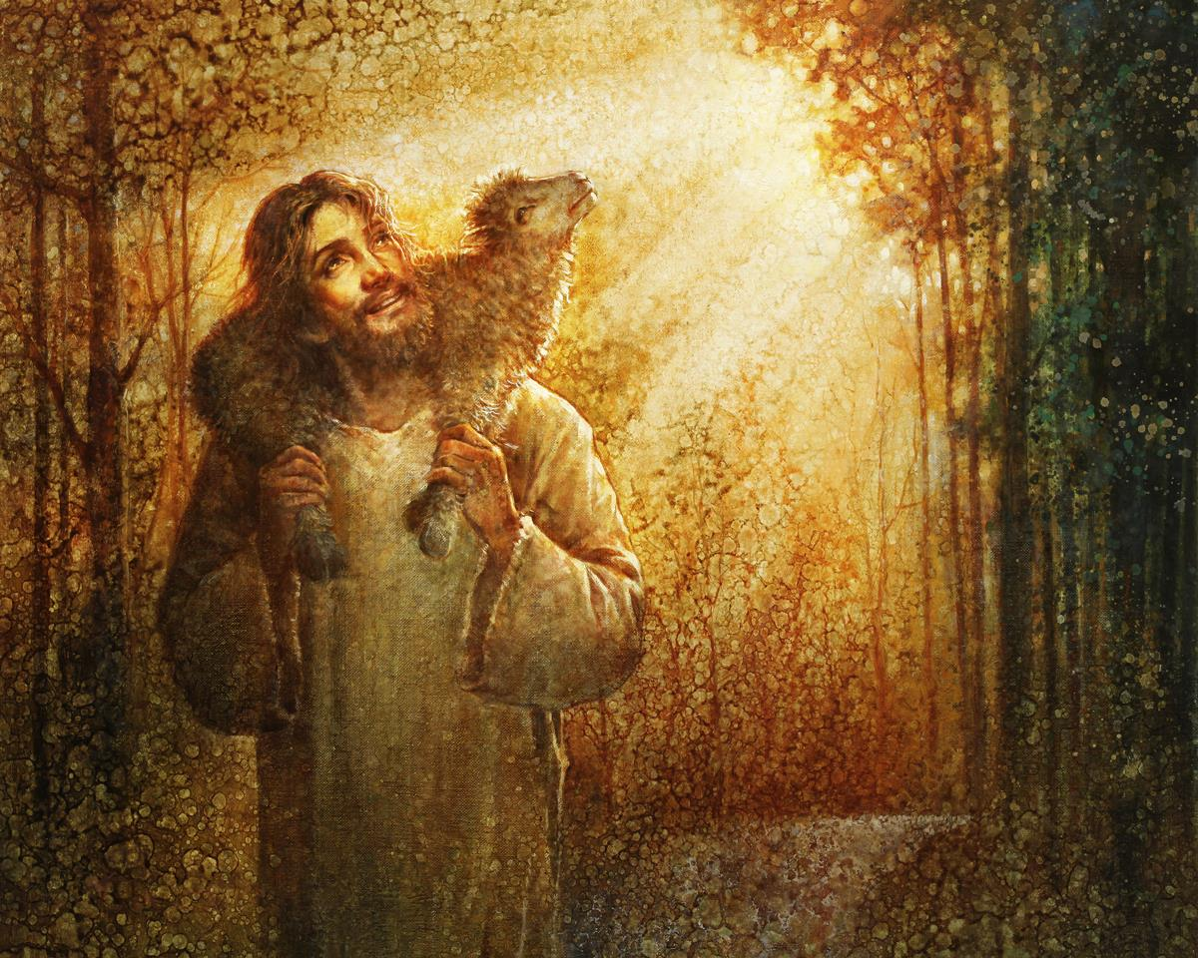

Notes:
Today we are going to listen to the story of the Good Shepherd. Click the video on the next slide to hear the story and an explanation of what it means for us.

Slide 5


Slide 6
Notes:
In the video we heard that God loves us so much that no matter what we have done he always rejoices when we return to him. How exciting to think that each time we go to confession God is rejoicing in heaven. And we should also be rejoicing because God has forgiven us and we have a fresh start to try to be a good follower of Jesus.

Slide 7

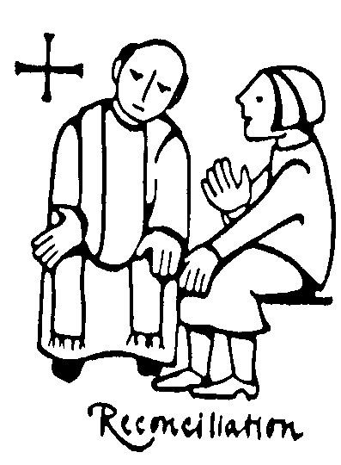
Preparing for Confession
Notes:
Before we go make our Reconciliation or confession, it is important that we take time to think through the things that we have done that perhaps we shouldn’t have and even the things that we should have done but haven’t.
We can also ask the Holy Spirit to help us to make a good confession. This can just be a simple prayer using your own words, asking the Holy Spirit to guide you and to help you make a good confession.
Watch the video on the next slide about Going to Confession.

Slide 8


Slide 9
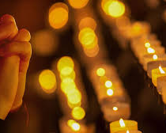
Write a short prayer that you can pray after you have received the Sacrament of Reconciliation.
Notes:
Think about the story of the Good Shepherd and how much God loves you. Perhaps you could thank God for loving you and for giving you a fresh start.

Slide 10
Time of Prayer
Notes:
We are now going to bring our lesson to a close in prayer. We will pray the Act of Sorrow together.
In the Name of the Father and of the Son and of the Holy Spirit Amen.
Act of Sorrow
In the name of the Father and of the Son and of the Holy Spirit Amen.

