Slide 1
The Eucharistic sacrifice
The Real Presence of Christ

Slide 2
Sacrifice
Write down what the word 'sacrifice’ means to you.
Can you give any examples of sacrifice?
We often associate the word ‘sacrifice’ with the practice of giving something up – making a sacrifice.
But where did this idea come from?
The Biblical concept of sacrifice means more than our common idea.

Slide 3
Abraham and Isaac
Read Genesis 22:1-18
What is Abraham required to do for the sacrifice?
What details of the story remind us of the sacrifice of Jesus?
The only son | Victim is innocent
The carrying of wood
Sacrifice on a hill | The lamb

Slide 4
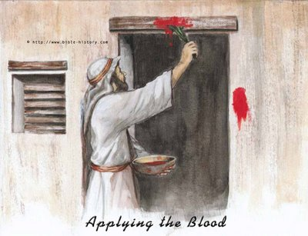
The Passover Meal
Instituted whilst the Hebrews were slaves in Egypt.
A lamb should be sacrificed.
It should be eaten with unleavened bread and have its blood smeared on the doorposts.
This ensured that the angel of death would pass over the houses of the Hebrews.
This feast was to be celebrated every year as a remembrance.

Slide 5
The Last Supper
Read Luke 22:14-23
Think:
What elements make the Last Supper a Passover meal?
How does the betrayal of Jesus relate to the Passover?

Slide 6
The Temple
The practice of animal sacrifice continued throughout the history of Israel until the era of Christ.
The Jerusalem temple became the focus of Jewish worship and sacrifice.
The sacrifices were performed by a priest for the forgiveness of the sins of the people.
They were a sign of the people giving up their old sinful practices and returning to God.
Jesus answered them, “Destroy this temple, and in three days I will raise it up.” The Jews then said, “It has taken forty-six years to build this temple, and will you raise it up in three days?” But he spoke of the temple of his body. (John 2:19-21)

Slide 7
The crucifixion
All at once, Jesus is:
The Temple – the sacrifice takes place within His own body.
The Priest – He offers the sacrifice to God the Father.
The Sacrificial Victim – He is the Lamb to be sacrificed.

Slide 8
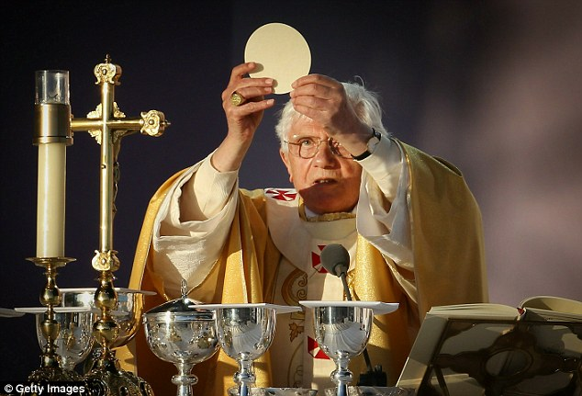
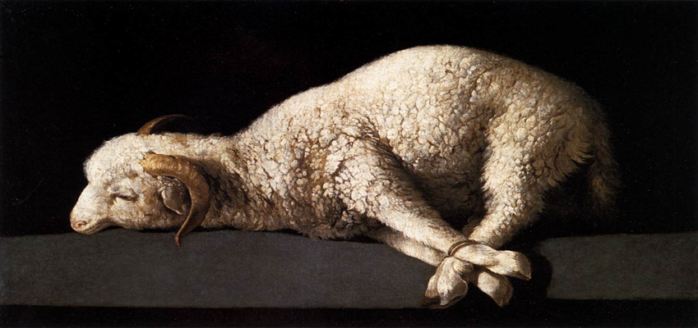
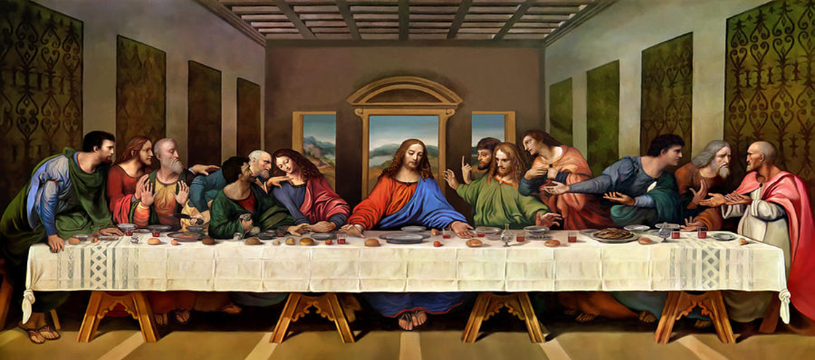
The Sacrifice of the MASs
What elements of the Mass reflect those of:
The Passover?
The Temple Sacrifice?
The Last Supper?
The Crucifixion?
The Mass is, in fact, a re-presentation of the sacrificial events of Christ’s life – what we call ‘The Paschal Mystery.’
“Do this in memory of me.” (Lk 22:18)

Slide 9
The Memory of Christ’s Sacrifice
The Christian Community has always celebrated the memory in this way:
“And they devoted themselves to the apostles’ teaching and fellowship, to the breaking of bread and the prayers.” (Acts 2:42)
“And day by day, attending the temple together and breaking bread in their homes, they partook of food with glad and generous hearts…” Acts 2:46

