Slide 1

The Sacraments of Initiation

Slide 2
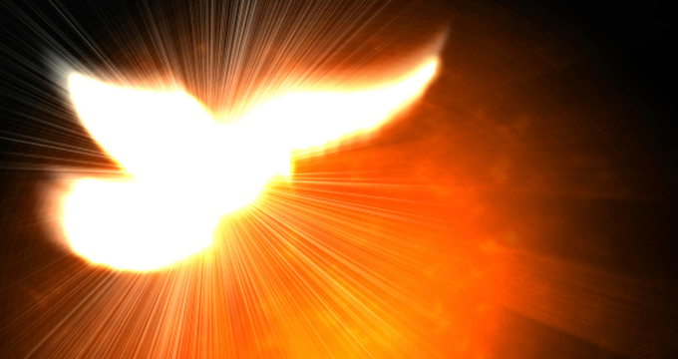
Come, Holy Spirit, fill the hearts of the faithful. Enkindle in us the fire of your love. Send forth your Spirit and we shall be created and you shall renew the face of the earth.

Slide 3
In today’s session we will:
revise the Sacraments of Initiation, specifically Baptism and Confirmation
develop our understanding of the use of oil in the Sacraments
explore what it means to become initiated into the Catholic Church

Slide 4
Initiation means becoming a member
Baptism, Confirmation and Holy Communion are the Sacraments of Initiation
These Sacraments are connected in a special way because they are about becoming a member of the Church Family
The Journey of Initiation is a journey through the three Sacraments towards full membership of the Church Family
The Journey of Initiation is a journey we make together and not on our own

Slide 5

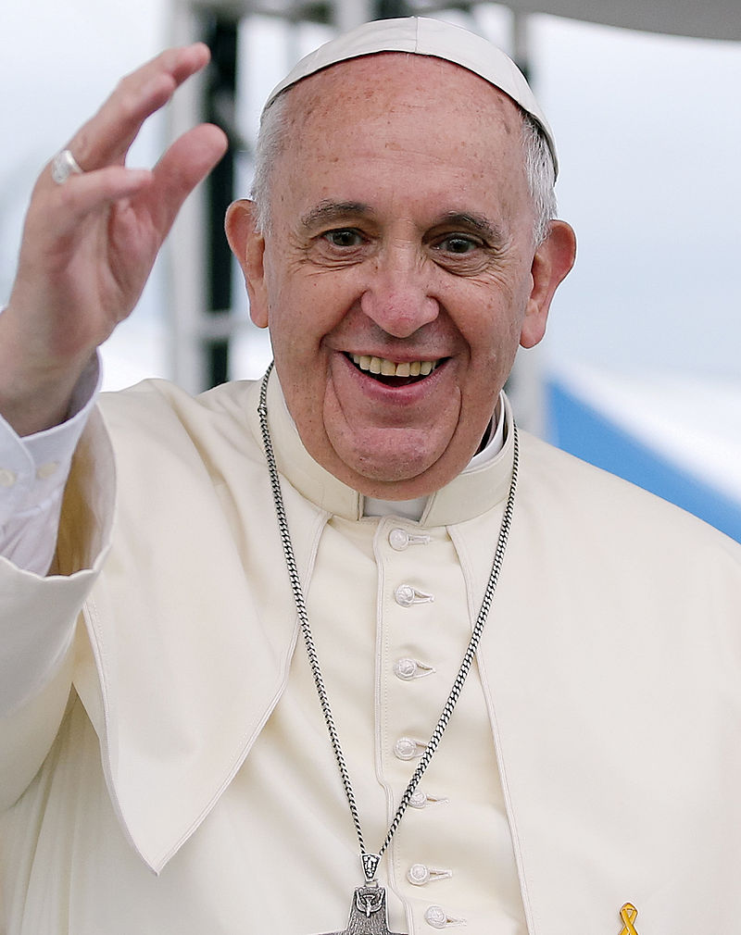
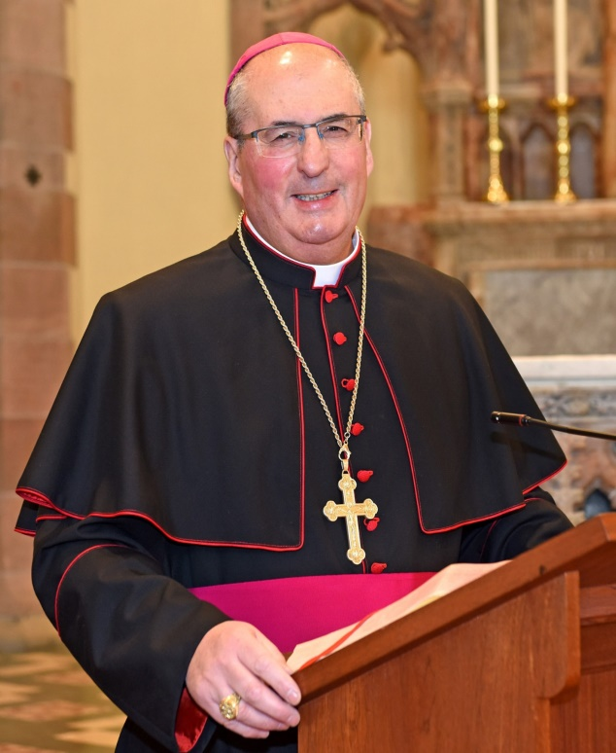
Guess Who?
Insert photo of parish priest

Slide 6
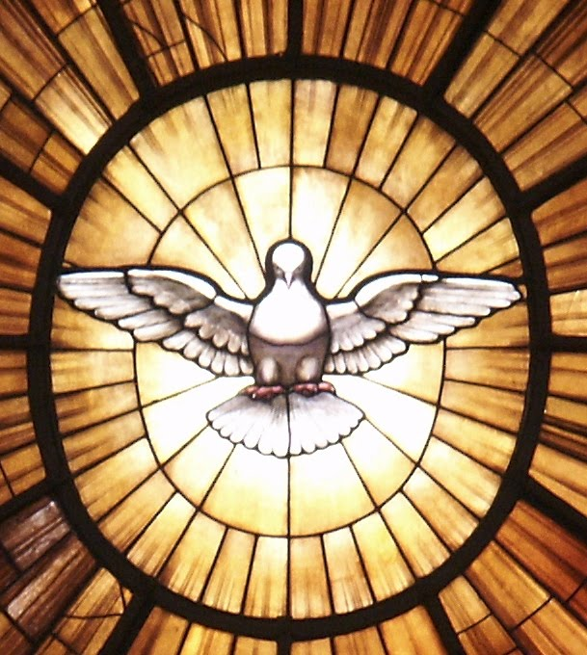
Pope
Cardinal
Archbishop
Bishop
Priest
Deacon
Laity

Slide 7
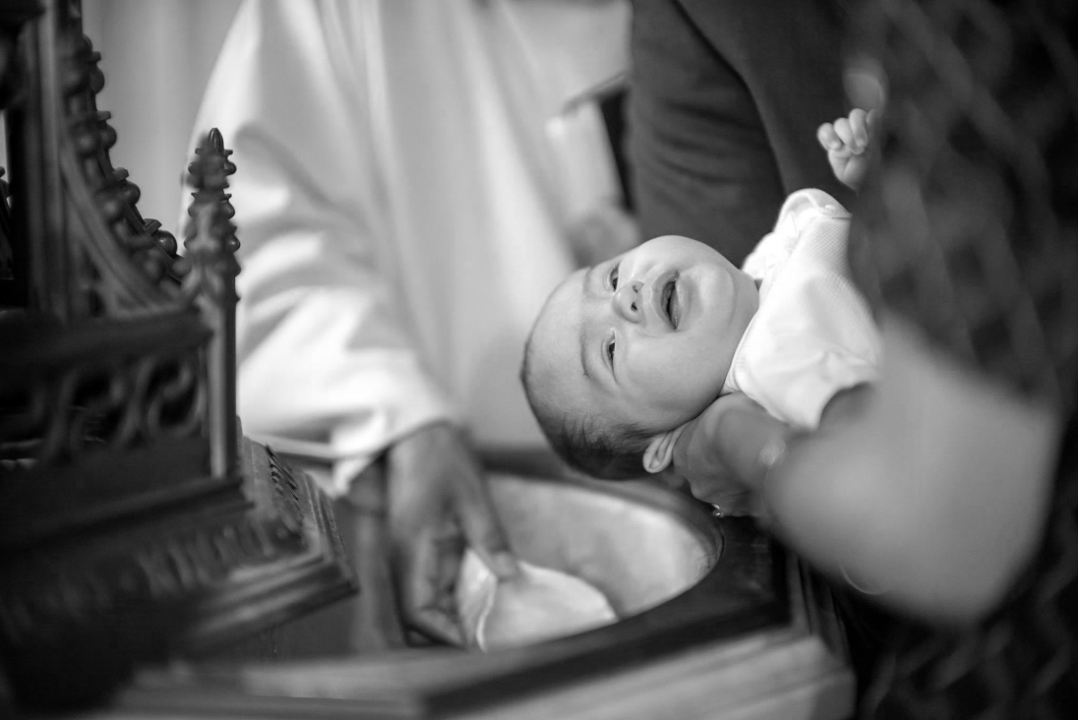
Baptism and Confirmation

Slide 8



Building up the Kingdom of God

Slide 9
The Sacraments of Initiation

