Slide 1
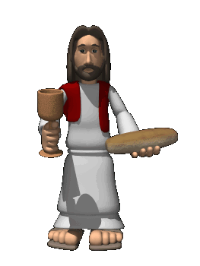
Еυκαιστια Our Eucharist
One of the most obvious (but overlooked) points in any Eucharistic celebration is our physical coming together. WE make the effort to go to a church that may be near/far from our house and we join others who have the same focus. There is strength in numbers, and we can both inspire others by our participation and be inspired… we should not underestimate our effort or doubt its significance!
There are TWO main moments to the community celebration of thanksgiving:
The Liturgy of the
Word.
2. The Liturgy of the
Eucharist.

Slide 2
The Liturgy of the Word
We have (been dragged / dragged ourselves) out of bed, and made the (quick / long) journey to the Parish of St. “X”. We take our usual seat – same bench, same side, sitting beside the same people – and then think: “Oh God I hope its no THAT priest who goes on and on and on and on…”
If that sounds familiar, perhaps our challenge is more to do with focus and preparation than presentation…. But we will get to that later.
Before the readings are proclaimed, there are FOUR distinct actions:
The Opening Rite: sign of the cross / greeting - welcome
The Penitential Rite: we recognise our sinfulness and ask for forgiveness.
We praise God in the hymn of GLORIA.
The Collect: the opening prayer.

Slide 3
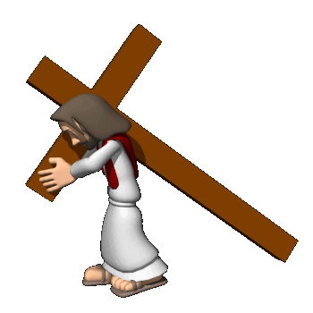
The Opening Rite
The SIGN OF THE CROSS. St. Paul reminds us that: “For the message about Christ's death on the cross is nonsense to those who are being lost; but for us who are being saved it is God's power.” (I Cor 1: 18)
We use the Trinitarian formula: Father, Son and Holy Spirit to begin our moment of prayer and this reminds us that God (Father, Son & Holy Spirit) is the focus, reason and power behind our coming together.
We don’t come together in the name of the parish priest, the Bishop or even the Pope!
Want to try something different? We bless ourselves with our right hand finger-tips: forehead, chest, left shoulder, right shoulder and join hands…. Try this
Place your thumb over the first finger of your right hand. (Forms a cross). Now doing the same actions as above, touch your forehead, chest and shoulders with the thumb of your right hand. When you finish, “Amen” kiss the cross! (Mexican tradition)

Slide 4
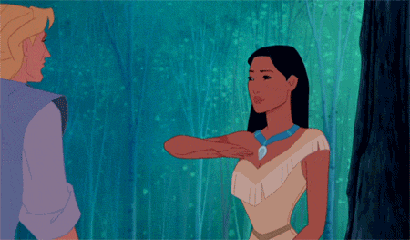
Our Greeting
When we meet someone, what do we normally say to them?
Hello, how do you do. My name is… // Good to see you again…. // Look who it is!
Well HELLOOOOOO there… // What’s up? // Aw’right?
The Eucharist is no different. Although the greeting is a bit more formal, the Priest who represents Christ (from the Latin “alter Christus” = other Christ) in the Eucharistic celebration, wishes to all present that “The Lord be with you” to which the people now reply “AND WITH YOUR SPIRIT”.
Try a few “common” greetings with one another. Note body language, smiles, openness, hugs?, high fives? Does HOW we are greeted affect how we in turn greet the other person?
Click on the hyperlink to see how “greeting” can impact….
www.youtube.com/watch?v=74Ejl-JdsmU

Slide 5
The Penitential Rite Click the icon to listen to the song.
We have gathered together in the presence of Father, Son and Holy Spirit, remembering the words of Jesus: “Whenever two or three are gathered in my name…I am there.” We have come together, greeted each other in the Lord’s name and now we recognise that we are not standing in God’s house on merit, we don’t deserve to be here…. On the contrary - we are sinners…. God is good and we are imperfect. So we confess our sinfulness through the Kyrie Eleison - Greek for “Lord have mercy.”
This “confessing” of our sinfulness, DOES NOT replace individual confession. This is the community’s moment, where we talk in “general” terms about the forms our weakness takes:
“In my thoughts and in my words, in what I have done and in what I have failed to do”. Notice that we don’t say anything specific. We mention HOW but not WHAT.
A “good” confession states the sins committed and a CLEAR intention NOT to repeat the same sins, but to change your behaviour. “Turn away from sin and believe in the Gospel…”

Slide 6
After recognising our sinfulness in the Penitential Rite, we move on to the great HYMN of praise called the Gloria.
This Latin phrase means: “Glory to God in the Highest” and while preferably SUNG, it can be said by the congregation.
There are TWO moments of the liturgical year when the church omits the singing (or saying) of the Gloria: LENT and ADVENT.
The reason for this is to highlight its solemnity and importance by reserving it for the Easter Vigil celebration and the Christmas Eve celebration. In both these celebrations the singing (or saying) of the Gloria can be accompanied with bells being rung.

Slide 7
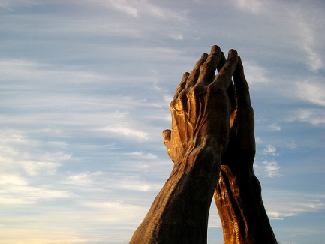
Collect (Opening Prayer)
This prayer is the last action before the readers come forward to proclaim the Word of God.
The prayer normally reflects the theme of the celebration, and if there is a particular saint remembered, he/she is named in the prayer.
Task: You are the priest. You are to role-play the Opening Rite (welcome and greeting) of a celebration. Remember your body language, tone of voice and words are important to direct the people’s focus on what we are about to celebrate.
Prepare an introduction for:
A wedding…….. A funeral……. A graduation….
A birthday…….. A feast day…. Mother’s day….
Your Intro: Sign of the cross/ greeting / welcome.

