Slide 1
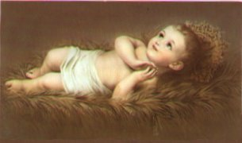
Advent and Christmastide
An Overview-Primary 1-7

Slide 2
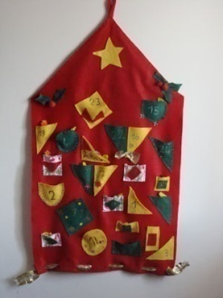
General Themes
Liturgical Colour for Advent- Purple
Liturgical Colour for Christmastide –White
Advent Wreath
Advent Calendar
Christmas is a Special Time for Christians
The Story of the Nativity
The Angelus
Participation in Prayer Services

Slide 3
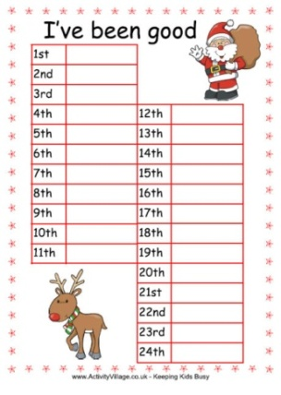
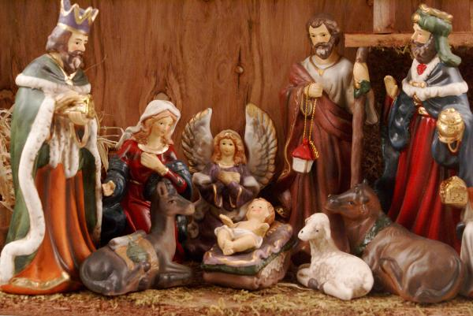
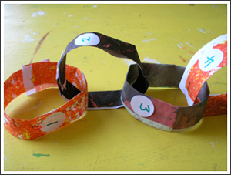
Primary 1
Know that Advent is a special time when we prepare for Jesus’ birth
Make an Advent chain and an Advent chart
Know the figures and setting of the Christmas narrative
Complete The Christmas Nativity Workbook

Slide 4
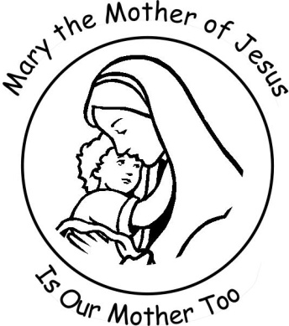
Primary 2
Know that Mary and Joseph prepared for the birth of Jesus
Know that heaven and earth rejoiced together at the birth of Jesus
Make shepherd and angel figures
Complete Mary the Mother of Jesus Workbook

Slide 5
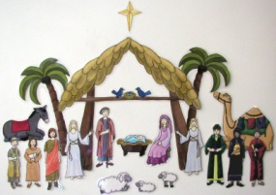
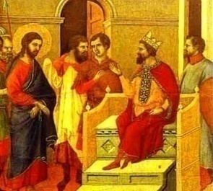
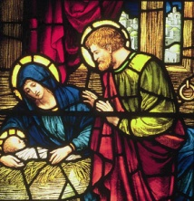
Primary 3
Know that Joseph said “Yes” to God
Recount the Story of Herod
Reflect on Joseph’s way of following God compared to Herod’s way
Examine how we too can choose to follow Joseph’s way or Herod’s way
Caring for the wider community at Advent
Complete Christmas Story Workbook

Slide 6
Primary 4
Know the place of the Magi in the Christmas narrative
Understand that the Wise men knew that the star was a sign of a special person being born
Know that a prophet in the Old Testament had written that the saviour would be born in Bethlehem
State the significance of the gifts of gold, frankincense and myrrh

Slide 7
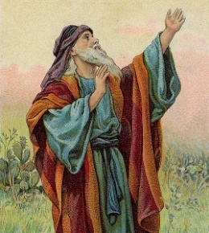
Primary 5
Recognise that Mary is honoured as the first of all believers
Know that Jesus is truly divine and truly human
Know that prophets foretold Jesus’ birth
Read and recount Christmas scriptures
Develop an understanding of the Catholic Church by exploring the role of lay organisations and religious orders

Slide 8
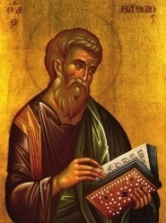
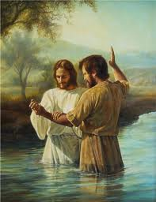
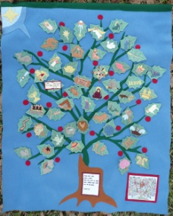
Primary 6
Read Gospel of Matthew to learn about Jesus as “son of David”, “son of Abraham” and “Emmanuel
Know that John the Baptist prepared the way for the Messiah
Know that we too are called to proclaim Jesus as our Saviour
Recognise the symbols on the "Jesse Tree"

Slide 9
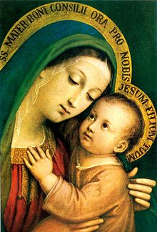
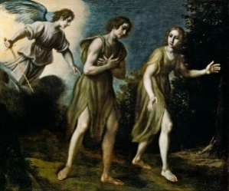
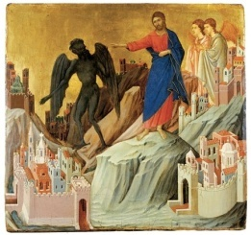
Primary 7
Recognise Mary’s Significance within Catholic Tradition
Explore the call to forgiveness and reconciliation
Reflect on how the decisions of our conscience affect our relationship with God and others
Study the 5th, 6th and 9th Commandments

