Slide 1
October and Mary
St. Andrew’s Primary
Bearsden

Slide 2
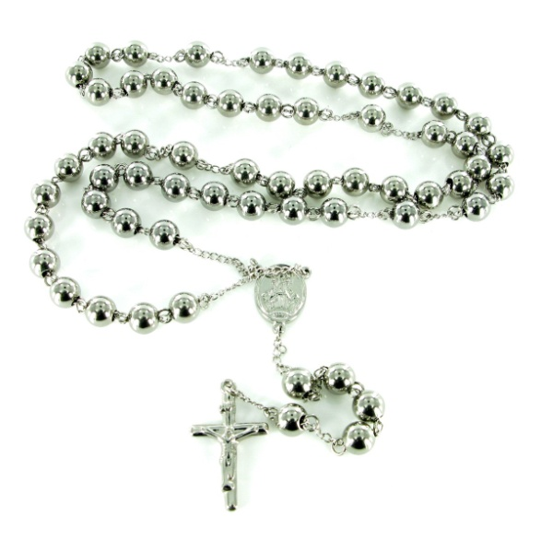
During October we honour Mary our Mother
In October we celebrate the feast of the Holy Rosary
Talk to your partner.
Tell them what you know about the Rosary
Report back to the whole group.

Slide 3
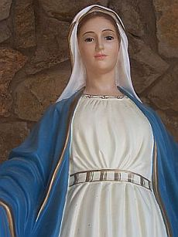
Why do we honour Mary?
Mary is the mother of God
She is our mother
She said ‘yes’ to God

Slide 4
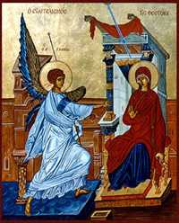
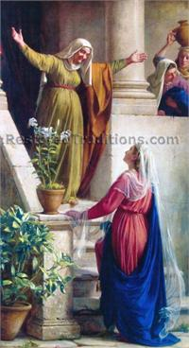
What do we know about Mary?
The Annunciation
Mary visits Elizabeth

Slide 5
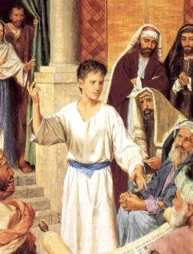
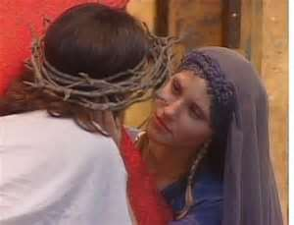
Mary looked after Jesus
She was worried when he was lost
She was there when her Son died on the cross

Slide 6
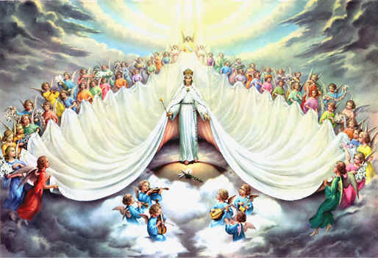
Mary was assumed body & soul into Heaven
Queen of Heaven

Slide 7
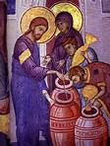
Mary intercedes for us
The wedding feast at Cana

Slide 8
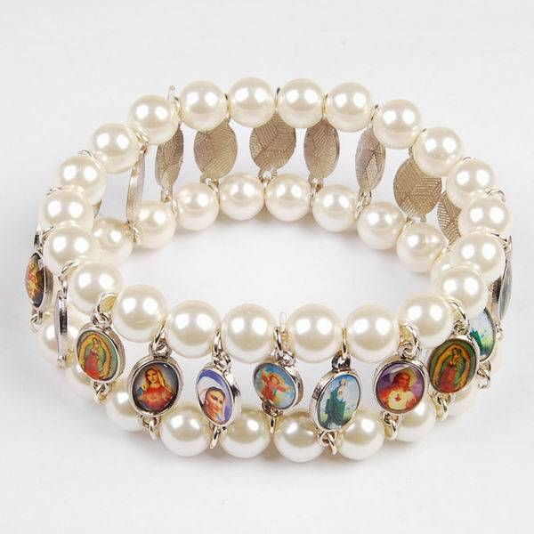
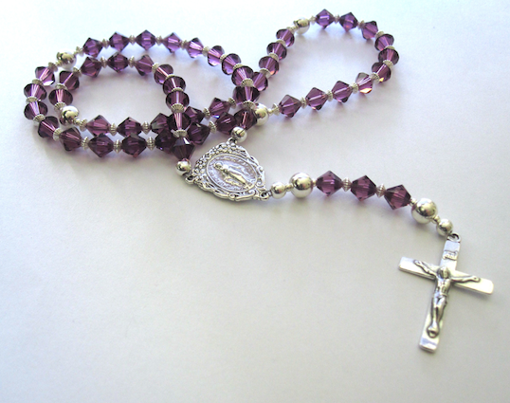
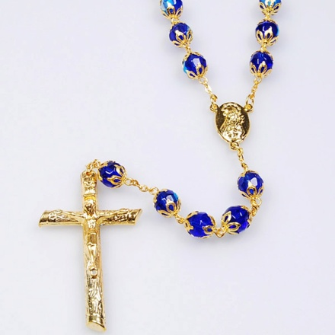
Let us say the Rosary together

