Slide 1
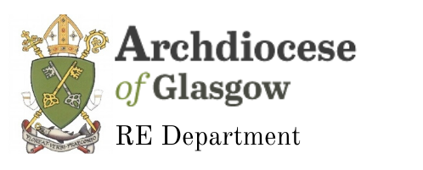
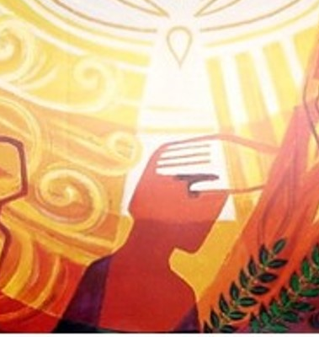

Confirmation
Pupil Catechesis Session Two
Notes:
Welcome to session Two of our online catechesis for Confirmation. My name is Joanna and I am going to take you through today’s lesson.

Slide 2
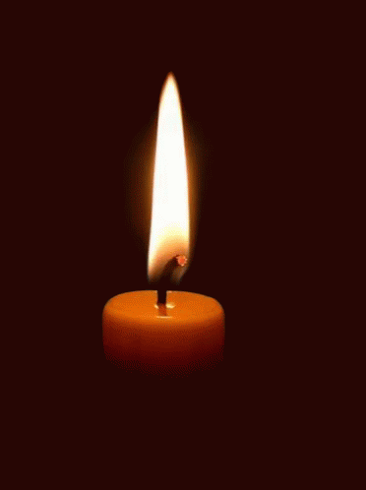
Time of Prayer
Notes:
We are now going to take a few moments to pray before we begin our lesson today. Make sure you are sitting comfortably, take a few moments to prepare yourself for prayer and then join me in making the sign of the cross.
In the Name of the Father and of the Son and of the Holy Spirit Amen.
God Our Father, You are with us as we gather in prayer. Open our hearts as we listen to your word and help us as to prepare well to receive the Sacrament of Reconciliation. Amen
We are going to listen to a short passage from the Acts of the Apostles.
Reading: Acts 10: 37-43
Acts 10:37-43
New International Version - UK
³⁷ You know what has happened throughout the province of Judea, beginning in Galilee after the baptism that John preached – ³⁸ how God anointed Jesus of Nazareth with the Holy Spirit and power, and how he went around doing good and healing all who were under the power of the devil, because God was with him.
³⁹ ‘We are witnesses of everything he did in the country of the Jews and in Jerusalem. They killed him by hanging him on a cross, ⁴⁰ but God raised him from the dead on the third day and caused him to be seen. ⁴¹ He was not seen by all the people, but by witnesses whom God had already chosen – by us who ate and drank with him after he rose from the dead. ⁴² He commanded us to preach to the people and to testify that he is the one whom God appointed as judge of the living and the dead. ⁴³ All the prophets testify about him that everyone who believes in him receives forgiveness of sins through his name.’
All say together: Come, Holy Spirit, fill the hearts of the faithful. Enkindle in us the fire of your love. Send forth your Spirit and we shall be created and you shall renew the face of the earth. In the name of the Father and of the Son and of the Holy Spirit, Amen.

Slide 3
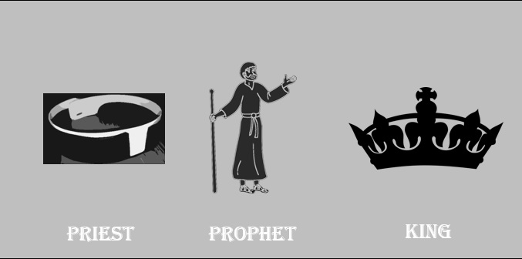
In today’s session we will:
explore what it means to be anointed
find out more about the anointing that will take place at Confirmation
discover how we can be priests, prophets and kings in our daily lives and specifically in our parish community
Notes:
In school you have been learning about Anointing and the titles Priest, Prophet and King. In today’s session we are going to:
explore what it means to be anointed
find out more about the anointing that will take place at Confirmation
discover how we can be priests, prophets and kings in our daily lives and specifically in our parish community

Slide 4
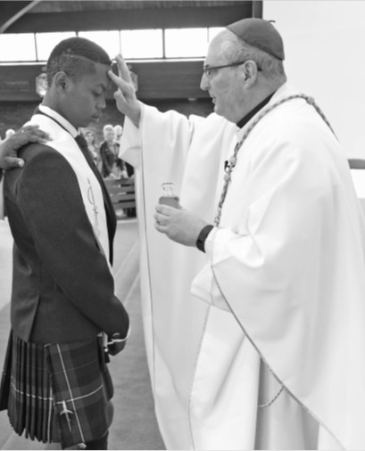
Anointed
In the Old Testament anointing a person with oil was a sign of the presence of the Spirit of God, giving the person the power to do some special and important work.
Notes:
In the Old Testament anointing a person with oil was a sign of the presence of the Spirit of God, giving the person the power to do some special and important work.
Priest, prophets and kings were anointed.

Slide 5
The God of power and Father of our Lord Jesus Christ has freed you from sin and brought you to new life through water and the Holy Spirit. He now anoints you with the chrism of salvation, so that, united with his people you may remain for ever a member of Christ who is Priest, Prophet and King.
Notes:
Read aloud the words of the Baptismal Prayer:
The God of power and Father of our Lord Jesus Christ has freed you from sin and brought you to new life through water and the Holy Spirit. He now anoints you with the chrism of salvation, so that, united with his people you may remain for ever a member of Christ who is Priest, Prophet and King.
At your Baptism you were anointed with the Oil of Chrism and at Confirmation you will be anointed with Chrism again. This is a sign that you are being given the gift of the Holy Spirit and that you have special work to do for God.
Focus on the last sentence of the prayer. Explain to the children that as they are anointed with the oil of Chrism they are ‘sealed with the Holy Spirit’ and they are marked forever as a child of God (they will have been learning about the indelible/permanent mark of the Sacrament in week 1 of their school lessons).
Reflect on the previous day’s discussion about identity and specifically their identity as a child of God. The children will have been learning about the titles priest, prophet and king in week 2 of their school lessons. They will also have explored how they can live out those titles in their lives. Distribute the titles priest, prophet and king and their definitions and in small groups ask the pupils to match the title to its definition (Appendix G).

Slide 6
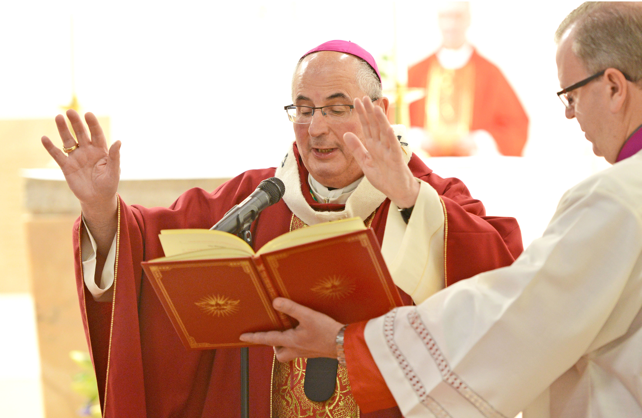
Laying on of Hands
In the Old Testament the laying on of hands was also a sign that a person was being chosen specially to do God’s work. It was a sign that the strength and love of God was being communicated through the person giving the blessing.
Notes:
In the Old Testament the laying on of hands was also a sign that a person was being chosen specially to do God’s work. It was a sign that the strength and love of God was being communicated through the person giving the blessing.

Slide 7
All powerful God, the Father of our Lord Jesus Christ, by water and the Holy Spirit you freed your sons and daughters from sin and gave them new life. Send your Holy Spirit upon them to be their helper and guide.
Give them the spirit of wisdom and understanding, the spirit of right judgement and courage, the spirit of knowledge and reverence.
Fill them with the spirit of wonder and awe in your presence.
We ask this through Christ our Lord.
Amen
Notes:
In Confirmation, the Bishop lays his hands over the group he is Confirming and says: All powerful God, the Father of our Lord Jesus Christ, by water and the Holy Spirit you freed your sons and daughters from sin and gave them new life. Send your Holy Spirit upon them to be their helper and guide.
Give them the spirit of wisdom and understanding, the spirit of right judgement and courage, the spirit of knowledge and reverence.
Fill them with the spirit of wonder and awe in your presence.
We ask this through Christ our Lord.
Amen
Discuss the words of the prayer with the children. Do they recognise any of the words? The gifts of the Holy Spirit?
Explain to the children that we need the gifts of the Holy Spirit to strengthen us in living out the roles of priest, prophet and king and that we can, and should, regularly pray to the Holy Spirit to help us.

Slide 8
Activity
Write a prayer to the Holy Spirit. Pray especially for the gifts that you will need to live as a Child of God.

