Slide 1
First Friday Devotion to the Sacred Heart of Jesus

Slide 2
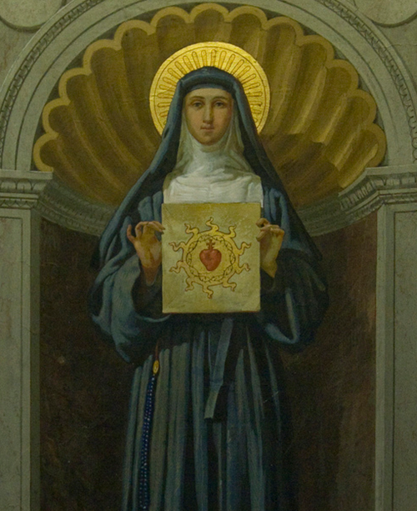
We can learn more about the Sacred Heart of Jesus through the visions of Saint Margaret Mary Alacoque and the
twelve promises Jesus made to anyone who practised devotions to
His Sacred Heart.
Notes:
While some saints referenced the Heart of Jesus in their writings centuries earlier, in 1673, a French Visitandine (Visitation) nun named Margaret Mary Alacoque had visions of Jesus, wherein he asked the Church to honor His Most Sacred Heart. In particular, Jesus asked the faithful to “receive Communion on the First Fridays, for nine consecutive months.” The request was connected to a specific promise made to all who venerated and promoted devotion to the Sacred Heart. After Margaret Mary’s death, the First Friday practice steadily spread in the Church but it greatly increased in popularity when Margaret Mary was canonized a saint in 1920 by Pope Benedict XV.
2. Why nine consecutive months?
The number nine is traditionally associated with a novena and finds its origin in the nine days that the apostles spent in prayer before Pentecost. A novena provides an extended amount of time for preparation and interior renewal.
We can learn more about the Sacred Heart of Jesus through the 12 promises that were given to St Margaret Mary.

Slide 3
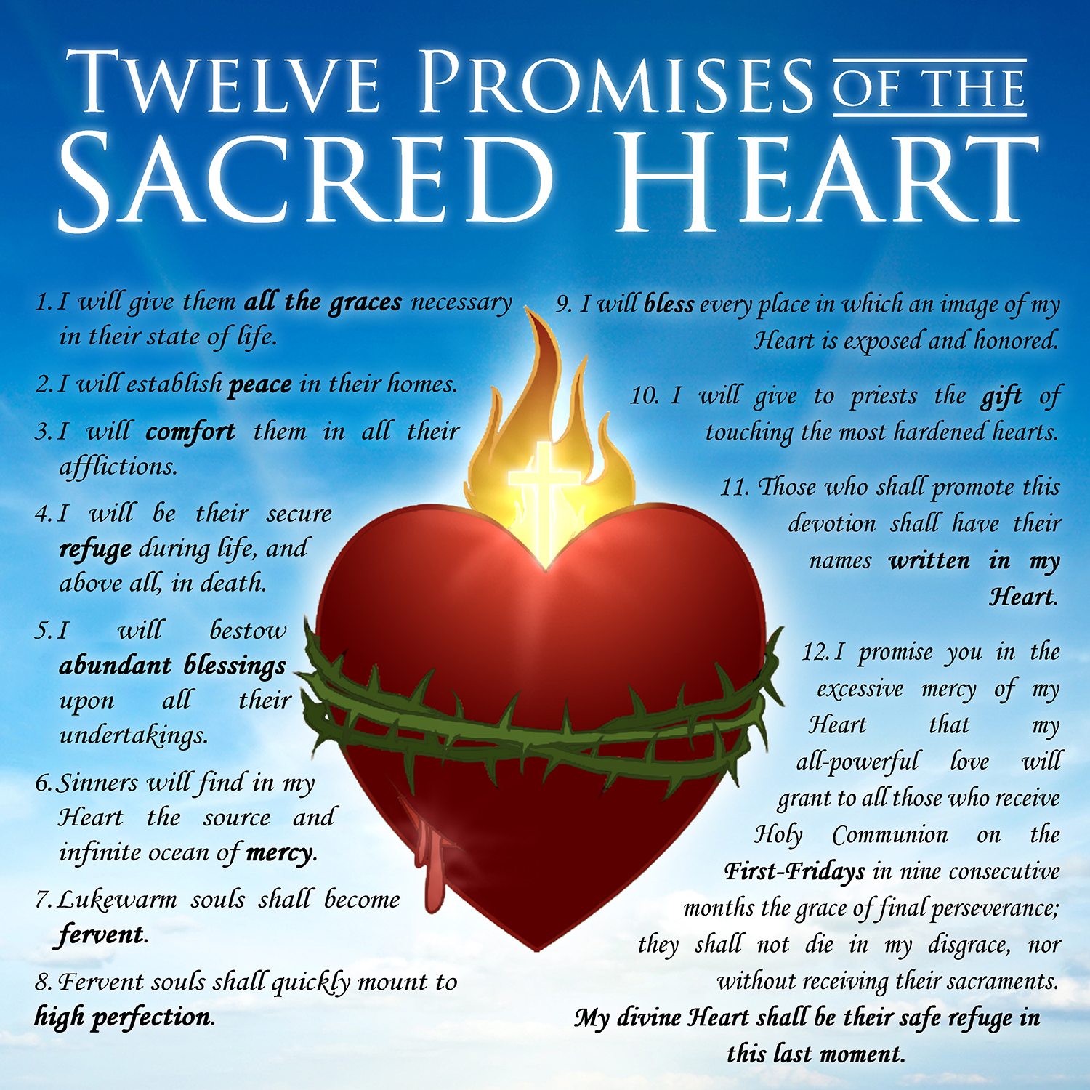

Slide 4
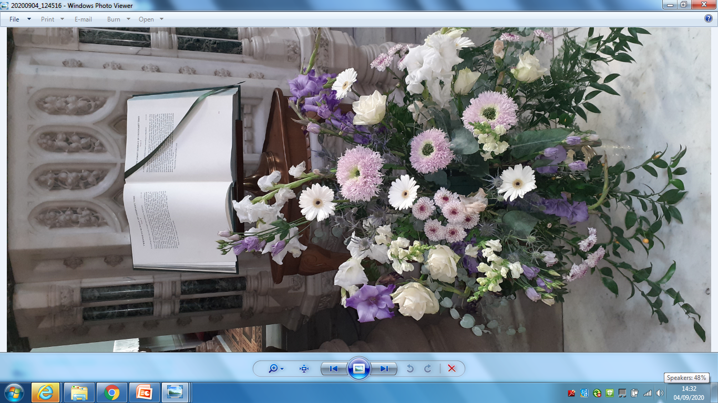
The tradition of First Friday Mass as a dedication to the Sacred Heart of Jesus is well established in schools. At this time, due to current restrictions, we cannot come together as a school community in our local parish as we would exceed the permitted numbers.
For now, we will continue our devotions to the Sacred Heart in school through prayer until we can be together at Mass.
The Word
of god

Slide 5
I. O my Jesus, you have said: 'Truly I say to you, ask and you will receive, seek and you will find, knock and it will be opened to you. ' Behold I knock, I seek and ask for the grace of everyone here and their intentions. Our Father... . Hail Mary... . Glory Be to the Father... .
Sacred Heart of Jesus, I place all my trust in you.
II. O my Jesus, you have said: 'Truly I say to you, if you ask anything of the Father in my name, he will give it to you. ' Behold, in your name, I ask the Father for the grace of everyone here and their intentions. Our Father... Hail Mary... . Glory Be To the Father... .
Sacred Heart of Jesus, I place all my trust in you.
III. O my Jesus, you have said: 'Truly I say to you, heaven and earth will pass away but my words will not pass away. ' Encouraged by your infallible words I now ask for the grace of everyone here and their intentions. Our Father... . Hail Mary... . Glory Be to the Father...
Sacred Heart of Jesus, I place all my trust in you.
O Sacred Heart of Jesus, for whom it is impossible not to have compassion on the afflicted, have pity on us miserable sinners and grant us the grace which we ask of you, through the Sorrowful and Immaculate Heart of Mary, your tender Mother and ours. Hail, Holy Queen
St. Joseph, foster father of Jesus, pray for us.
Please click on the speaker to play soundfile or read devotion together

Slide 6
Primary 5 upwards are invited to pray

