Slide 1
Let’s Celebrate!

Slide 2
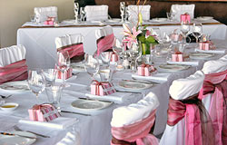
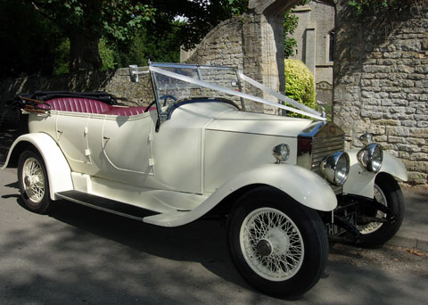
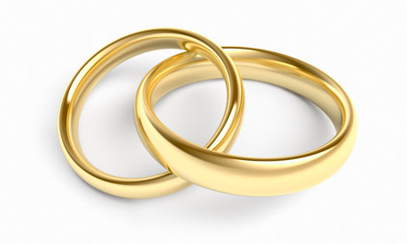
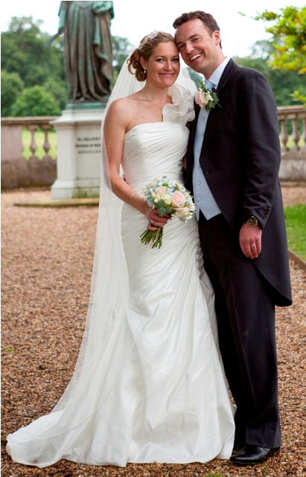
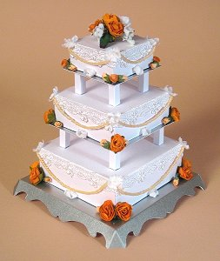
What do you think is being celebrated?

Slide 3
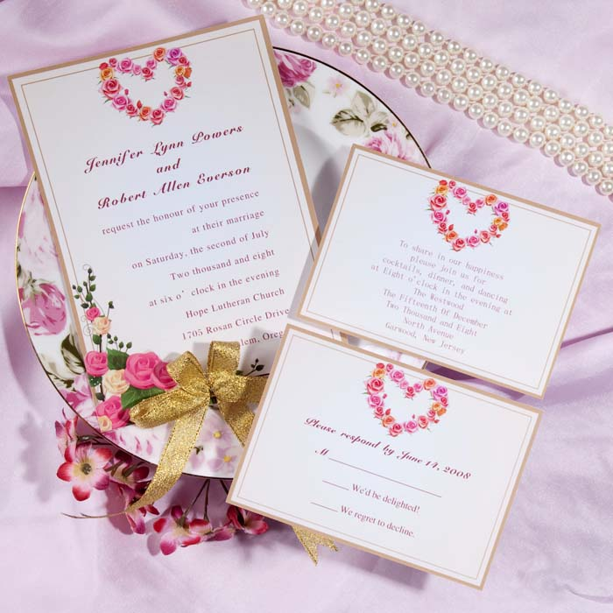
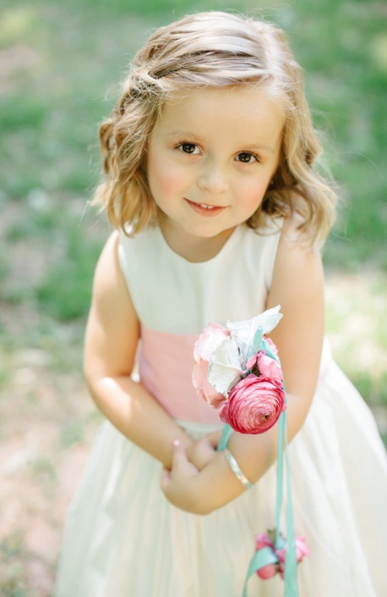
Have you ever been to a wedding?
Did you have a special job?

Slide 4
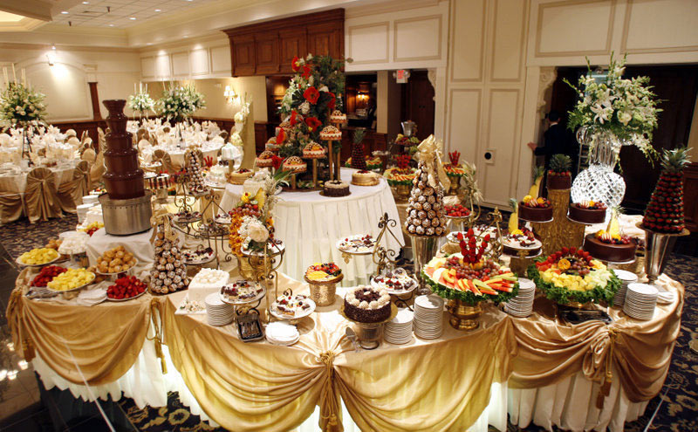
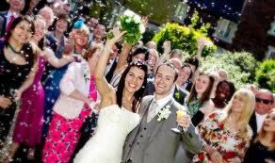
What did you have to eat?
What was your favourite part of the day?

Slide 5
We are now going to watch a short cartoon about a wedding during the time of Jesus
http://www.youtube.com/watch?v=PApIBQVovd0
(click on the link above to go directly to the video.)

