Slide 1
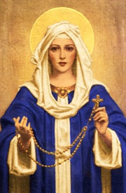
Our Lady of the Rosary
Tuesday 8th October
Primary 3

Slide 2
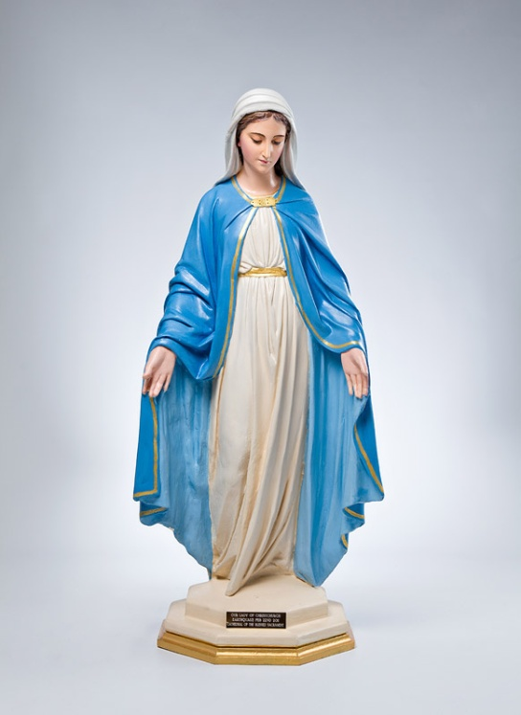
To our altar we bring the statue of Mary.
Mary did what God wanted her to do.

Slide 3
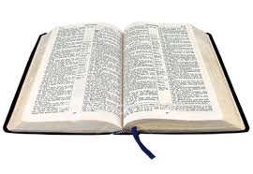
We bring a bible.
Mary listened and said ‘YES’

Slide 4
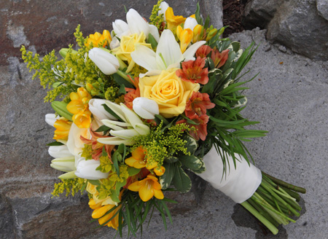
We bring flowers to show our love for Mary.

Slide 5
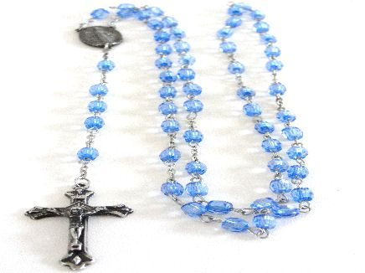
We bring Rosary beads as they honour Mary, the mother of Jesus.

Slide 7
Mary, Our Mother
Mary, our mother, the Lord is with you.
Guide us, protect us in all that we do.
Angel Gabriel said to you,
‘You will be mother of Jesus.’
Mary, our mother, the Lord is with you.
Guide us, protect us in all that we do.

Slide 8
With Elizabeth you rejoiced,
‘I will be mother of Jesus.’
Mary, our mother, the Lord is with you.
Guide us, protect us in all that we do.

Slide 9
In a manger in Bethlehem.
You became mother of Jesus.
Mary, our mother, the Lord is with you.
Guide us protect us in all that we do.

Slide 10
In the temple your baby was blessed,
Glad to be mother of Jesus.
Mary, our mother, the Lord is with you.
Guide us protect us in all that we do.

Slide 11
In the temple you found your son,
proud to be mother of Jesus.
Mary, our mother, the Lord is with you.
Guide us protect us in all that we do.

Slide 12
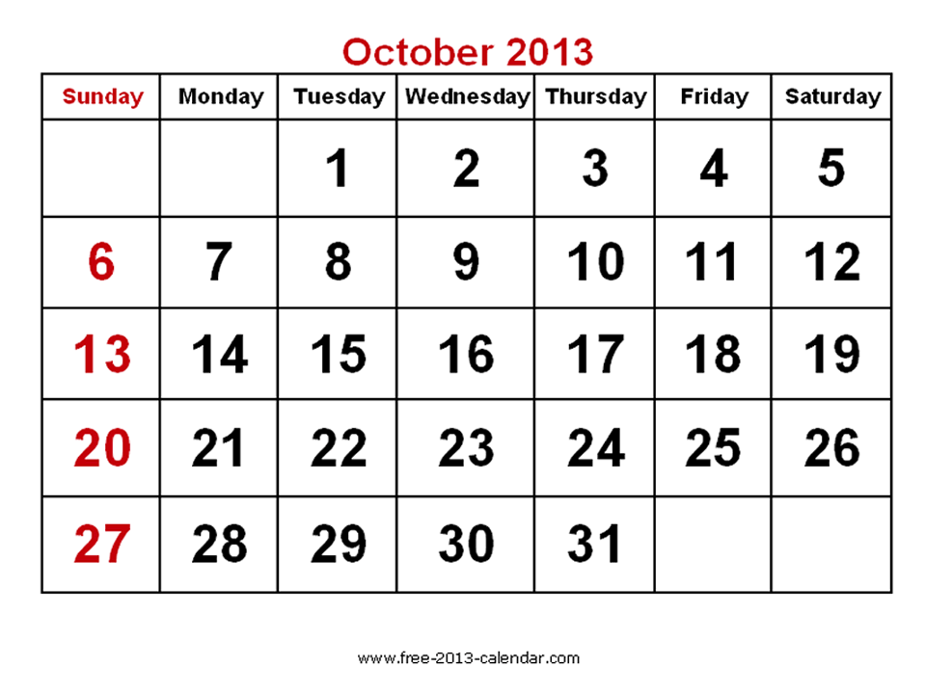

Slide 13
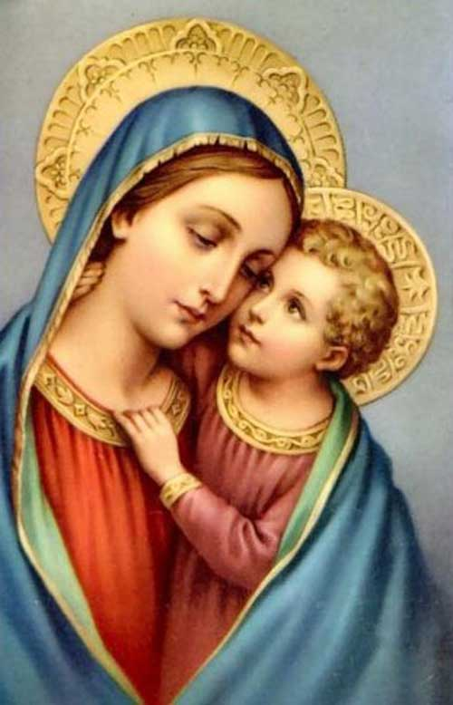

Slide 14
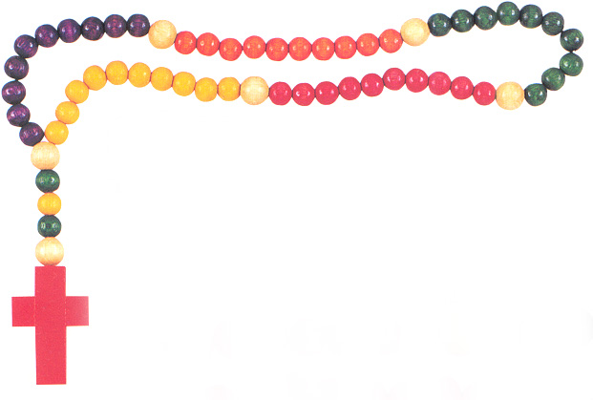
Rosary Beads

Slide 15
THE MYSTERIES OF THE ROSARY
Joyful Mysteries
Sorrowful Mysteries
Glorious Mysteries
Luminous Mysteries

Slide 16
THE
JOYFUL
MYSTERIES

Slide 17
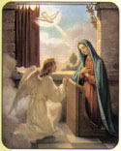
The Annunciation

Slide 18
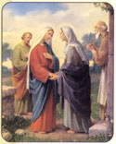
The Visitation

Slide 19
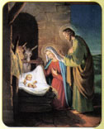
The Birth of Jesus

Slide 20
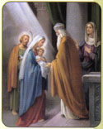
The Presentation of Jesus

Slide 21
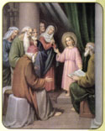
Jesus is found in the Temple

Slide 22
THE
SORROWFUL
MYSTERIES

Slide 23
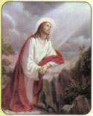
Jesus’ Agony in the Garden

Slide 24
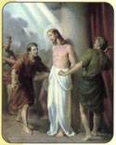
Jesus is whipped

Slide 25
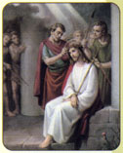
Jesus is crowned with thorns

Slide 26
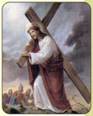
Jesus carries his cross

Slide 27
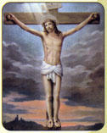
Jesus dies on the cross

Slide 28
THE
GLORIOUS
MYSTERIES

Slide 29
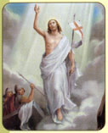
Jesus rises from the dead

Slide 30
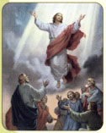
Jesus returns to Heaven

Slide 31
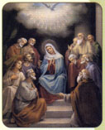
The Holy Spirit descends

Slide 32
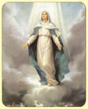
Mary is assumed to Heaven

Slide 33
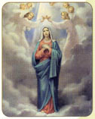
Mary is crowned as our Queen

Slide 34
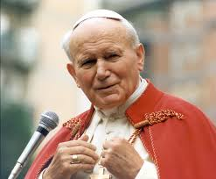
Pope John Paul II

Slide 35
THE
LUMINOUS
MYSTERIES

Slide 36
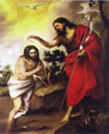
The Baptism of the Lord

Slide 37
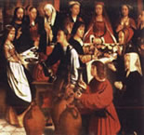
The Wedding at Cana

Slide 38
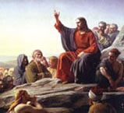
The Proclamation of the Kingdom

Slide 39
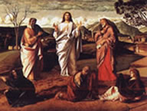
The Transfiguration

Slide 40
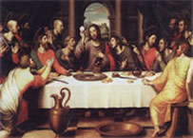
The Institution of the Eucharist

Slide 41
Our Father
Our Father, Who art in heaven
Hallowed be Thy Name;
Thy kingdom come,
Thy will be done,
on earth as it is in heaven.
Give us this day our daily bread,
and forgive us our trepasses,
as we forgive those who trepass against us;
and lead us not into temptation,
but deliver us from evil.
Amen

Slide 42
Hail Mary
Hail Mary full of grace.
The Lord is with thee.
Blessed art thou amongst women,
and blessed is the fruit of thy womb, Jesus.
Holy Mary, Mother of God,
pray for us sinners,
now and at the hour of our death.
Amen.
(1)

Slide 43
Hail Mary
Hail Mary full of grace.
The Lord is with thee.
Blessed art thou amongst women,
and blessed is the fruit of thy womb, Jesus.
Holy Mary, Mother of God,
pray for us sinners,
now and at the hour of our death.
Amen.
(2)

Slide 44
Hail Mary
Hail Mary full of grace.
The Lord is with thee.
Blessed art thou amongst women,
and blessed is the fruit of thy womb, Jesus.
Holy Mary, Mother of God,
pray for us sinners,
now and at the hour of our death.
Amen.
(3)

Slide 45
Hail Mary
Hail Mary full of grace.
The Lord is with thee.
Blessed art thou amongst women,
and blessed is the fruit of thy womb, Jesus.
Holy Mary, Mother of God,
pray for us sinners,
now and at the hour of our death.
Amen.
(4)

Slide 46
Hail Mary
Hail Mary full of grace.
The Lord is with thee.
Blessed art thou amongst women,
and blessed is the fruit of thy womb, Jesus.
Holy Mary, Mother of God,
pray for us sinners,
now and at the hour of our death.
Amen.
(5)

Slide 47
Hail Mary
Hail Mary full of grace.
The Lord is with thee.
Blessed art thou amongst women,
and blessed is the fruit of thy womb, Jesus.
Holy Mary, Mother of God,
pray for us sinners,
now and at the hour of our death.
Amen.
(6)

Slide 48
Hail Mary
Hail Mary full of grace.
The Lord is with thee.
Blessed art thou amongst women,
and blessed is the fruit of thy womb, Jesus.
Holy Mary, Mother of God,
pray for us sinners,
now and at the hour of our death.
Amen.
(7)

Slide 49
Hail Mary
Hail Mary full of grace.
The Lord is with thee.
Blessed art thou amongst women,
and blessed is the fruit of thy womb, Jesus.
Holy Mary, Mother of God,
pray for us sinners,
now and at the hour of our death.
Amen.
(8)

Slide 50
Hail Mary
Hail Mary full of grace.
The Lord is with thee.
Blessed art thou amongst women,
and blessed is the fruit of thy womb, Jesus.
Holy Mary, Mother of God,
pray for us sinners,
now and at the hour of our death.
Amen.
(9)

Slide 51
Hail Mary
Hail Mary full of grace.
The Lord is with thee.
Blessed art thou amongst women,
and blessed is the fruit of thy womb, Jesus.
Holy Mary, Mother of God,
pray for us sinners,
now and at the hour of our death.
Amen.
(10)

Slide 52
Glory Be
Glory be to the Father,
and to the Son,
and to the Holy Spirit,
as it was in the beginning,
is now, and ever shall be,
world without end.
Amen.

Slide 53
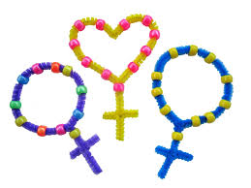
Each class will receive their own rosary beads which they can use everyday during the special month of October.

Slide 54
As I kneel before you
As I kneel before you
As I bow my head in prayer
Take this day, make it yours
And fill me with your love.
Ave Maria,
Gratia plena,
Dominus tecum,
Benedicta tu.

Slide 55
All I have I give you,
Every dream and wish are yours,
Mother of Christ, Mother of mine,
Present them to my Lord.
Ave Maria,
Gratia plena,
Dominus tecum,
Benedicta tu.

Slide 56
As I kneel before you
And I see your smiling face.
Ev’ry thought, ev’ry word
Is lost in your embrace.
Ave Maria,
Gratia plena,
Dominus tecum,
Benedicta tu.

Slide 57
Thank you for taking part in our Assembly today.
‘Our Lady of the Rosary’

