Slide 1
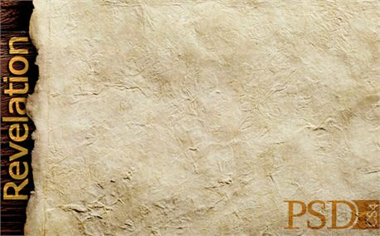
Passover

Slide 2
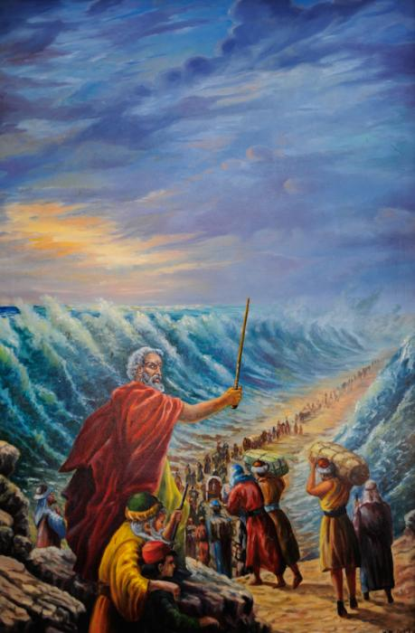
Passover is a holiday
celebrated in the Jewish
Religion. It last
The Passover recalls the
time when Moses
helped the Jews escape
slavery in ancient Egypt.
It also celebrates
springtime, a time of
renewal and rebirth.

Slide 3
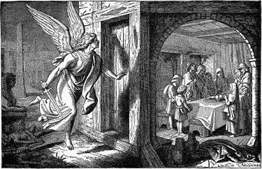
The name ‘Passover’ makes reference to the fact that the Angel of Death passed over the homes of the Israelites.

Slide 4
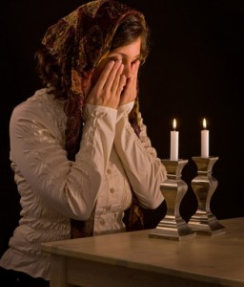
Jewish people begin the feast of Passover by lighting the ‘Passover Candle’.

Slide 5
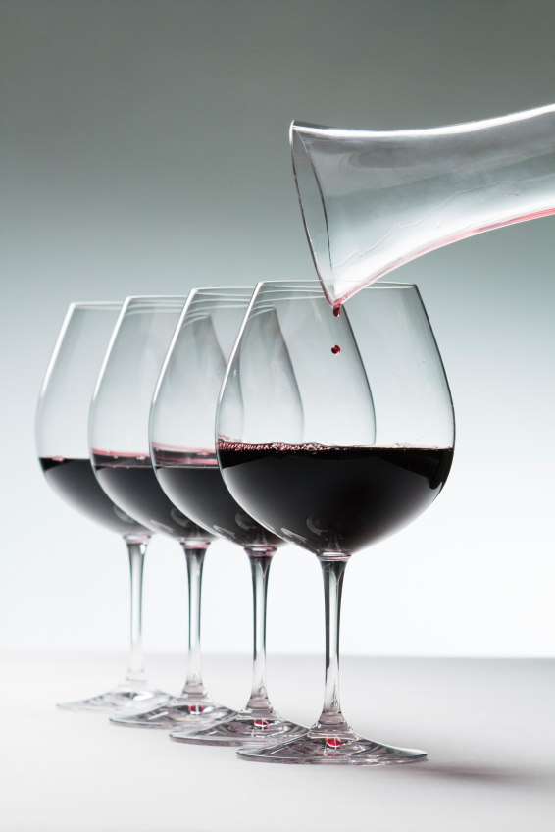
4 Glasses of Wine are drunk.
They symbolise:
Sanctification
The plagues
Redemption
Praise

Slide 6
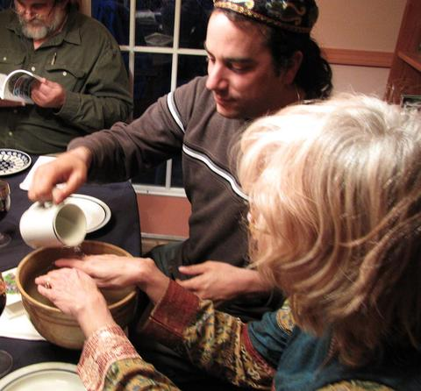
They then wash their hands.

Slide 7
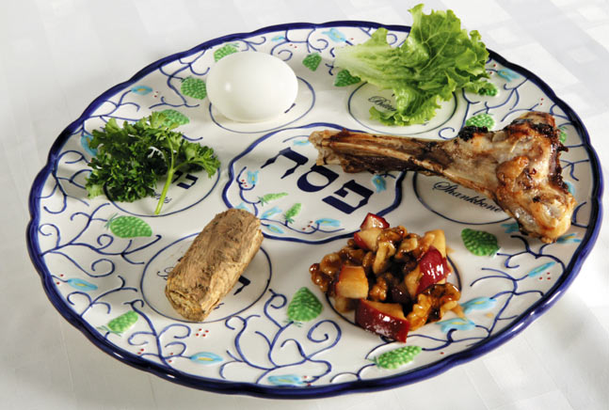
The Seder Plate
On this evening the Jews eat from a ‘Seder Plate’ each item is placed in a particular order and represents something relating to the first Passover.

Slide 8
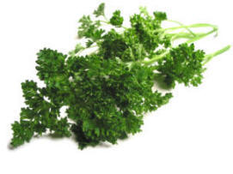
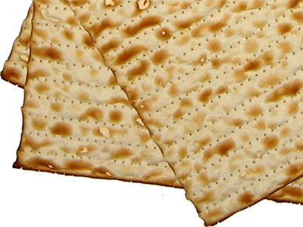
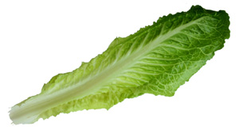
Parsley is dipped into a bowl of salt water which represents the tears and pain of the Israelites.
The Matzah represents the unleavened bread (Mana) which God sent to the Israelites while they were in the desert.
The Maror (a bitter herb) represents the bitterness the Israelites felt while in captivity.

Slide 9
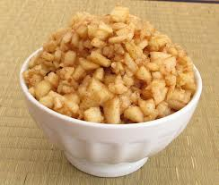
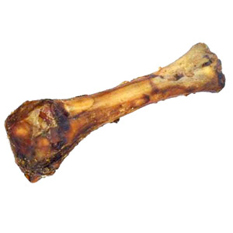
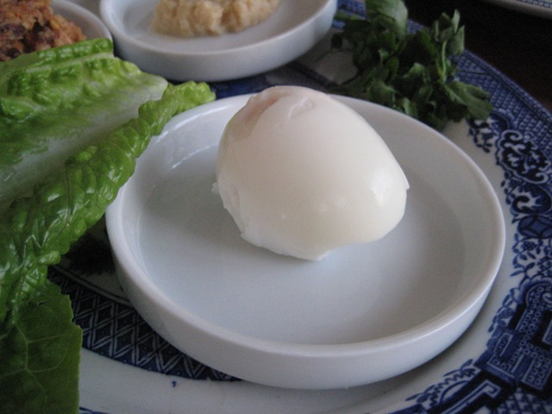
Charoset is sweet and has a paste like consistency it includes apples, nuts, wine and cinnamon.
It symbolises the mortar the Israelites used during their years in slavery.
The roasted shank bone represents the lamb eaten by the Israelites at the first Passover.
This is not eaten but presented on the plate again the following night.
Beitzah is a roasted egg. This represents the circle of life.

Slide 10
Passover Message for Catholics
As the blood of the Passover lamb which marked the door of Israelites homes marking them as God’s own people and protecting them form the Angel of Death……
Jesus’ was the lamb who spilt his blood sealing a new covenant which marks us all as children of God. So now we too can be ‘passed over’ by death and live eternal lives in Heaven.

