Slide 1
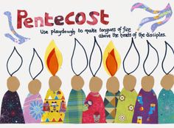
What does this picture make you think about? Talk to your family about Pentecost

Slide 2
PENTECOST
FACT FILE

Slide 3
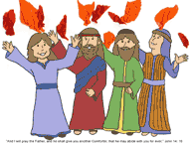
What Happened?
Write three facts you know about Pentecost

Slide 4
Read/Listen to the story of Pentecost
After Jesus went back to Heaven the Apostles and Mary went back to the upper room where they had eaten the Last Supper. They were very frightened as they worried that they would also be crucified, or killed by the Romans. They were also excited as Jesus had promised not to leave them alone and that he would send the Holy Spirit to be with them for all time.
Suddenly a sound like the blowing of a strong wind came from heaven and filled the whole house where they were sitting.
Next they saw flames that separated and came to rest above the heads of everyone in the room. The fire which had come into the room was the Holy Spirit. He gave them the gift of being able to speak in different languages. It was pretty exciting and things got a bit noisy.
There were people of many different countries staying in Jerusalem from all over and many of them spoke different languages. These people ran over to see what all the noise was about and were surprised to hear their own languages spoken throughout this group. Things must have sounded crazy! Imagine all these people speaking many different languages at the same time and shouting out praises to God excited that something amazing from God had just happened to them. The Apostles told everyone about God and praised Him.

Slide 5
Holy Spirit of fire, flame everlasting, so bright and clear, speak this day in our hearts. Lighten our darkness and purge us of fear, Holy Spirit of fire. The wind can blow or be still, or water be parched by the sun. A fire can die into dust: but here the eternal Spirit of God tells us a new world’s begun.
Holy Spirit of love, strong are the faithful who trust your pow’r. Love who conquer our will, teach us the words of the gospel of peace, Holy Spirit of love. The wind can blow or be still, or water be parched by the sun. A fire can die into dust: but here the eternal Spirit of God tells us a new world’s begun.
Read, or sing with your family

Slide 6
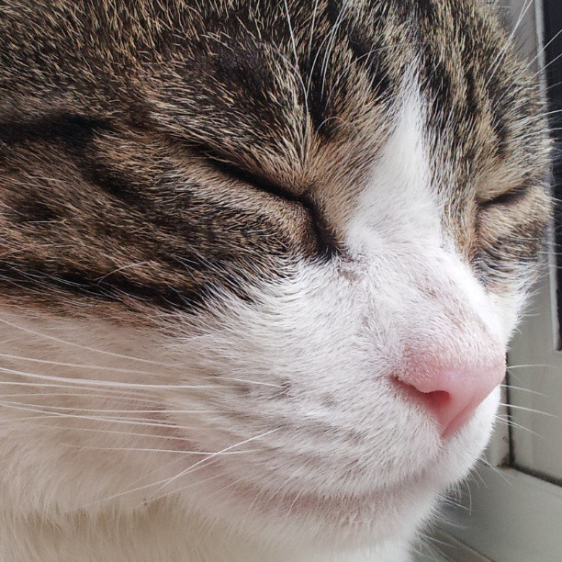
What must it have been like
To have been there?
Close your eyes
Imagine you are with the Apostles:
Hear?
See?
Feel?

Slide 7
.
BEFORE | AFTER
Hiding Frightened Worried Terrified | Brave Courageous Happy Joyful
Think about what kind of foolower of Jesus you want to be. Think of one thing you do to show that you are filled with the Sprit.

Slide 8
Let us pray:
Come, Holy Spirit, fill the hearts of your faithful. And kindle in them the fire of your love. Send forth your Spirit and they shall be created. And you will renew the face of the earth.

