Slide 1
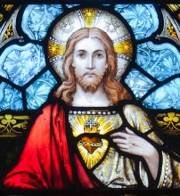
Prayer to the Sacred Heart
Lord Jesus Christ, you became one of us to reveal to us how much your Father loves us. You reached out in love to the sinner and humble of heart. Your heart was full of compassion for the sick and disabled, for the bereaved, for the oppressed and the poor.
Be with us in our weakness and help us to raise our hearts and minds to you in trust. Give us loving hearts like yours so that we too may spread your love in the circles in which we move. Make our hearts gentle and humble so that we may have compassion for those who are less fortunate than ourselves.
Bless us with hearts that are always ready to forgive.
Amen.

