Slide 1
S6: Faith and Reason
St. John Paul II
Notes:
Unit starter:
PP slide 1. The underlying theme of this unit is the nature of the relationship between science and religion. On the first slide of the PowerPoint is a quote for Saint John Paul II which attempts to answer this question: “Faith and reason are like two wings on which the human spirit rises to the contemplation of truth.”
You should explore the nature of a bird with the class. Can a bird fly with only one wing? We need both faith and reason to fully understand the truth and meaning of creation. Not one or the other. You could ask students what their understanding is of the relationship between science and religion. How does the world portray the relationship between science and religion?

Slide 2
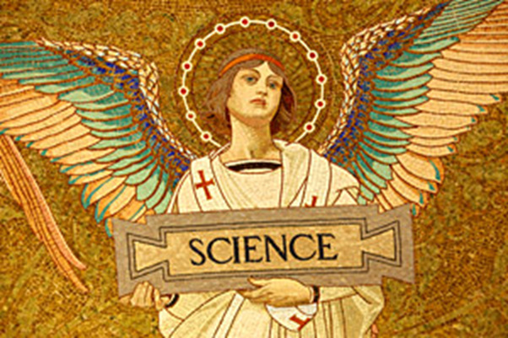
Relationship Models for Science and Religion
Conflict
Dialogue
Integration
Independence
Notes:
Conflict Model: Science and Religion are ‘at war’ – they have different methods of examining the same evidence, and draw incompatible conclusions from this.
Dialogue Model: There are comparisons of method between science and religion
Scientific study is not as objective as was once believed
Religious methods are more rational than was once believed
Both science and religion can offer different viewpoints on issues to resolve them – e.g. working together to discuss moral issues in various areas: environment, medicine (euthanasia) and scientific research (genetic engineering), etc
Integration Model: Sometimes called “mutual support” model
Religion gives science the proper perspective / viewpoint to study the world from
Using (real) science and linking to religion
Independence Model:
Both religion and science are looking at different aspects of reality / life and should not overlap.
Religion shouldn’t try and ‘use’ science, and science shouldn’t try and tackle religious questions / ultimate reality questions
However, some argue that we do not experience life as neatly divided into separate compartments; we experience it in wholeness and interconnectedness before we develop particular disciplines to study different aspects of it.
Summary
Conflict: Science and Religion do not mix at all – both argue the other is fundamentally wrong
Dialogue: there is a place for both religion and science in dealing with issues from different perspectives. Both look at the same world, and use different methods of investigation
Integration: Use science to support religion / review scientific findings in light of religious ones – link the two together
Independence: both science and religion are valid, but investigate different areas of life. They should not interfere with each other.

Slide 3
Science
The Purpose of Science
Science attempts to produce accurate explanations of how the natural world works, what its components are, and how the world got to be the way it is now. At a very basic level, science seeks to uncover the truth about the natural world and how it came into existence.
Notes:
Think, Pair, Share.
Pupil instruction: Re-read the above quote on your own, think about its meaning then share your thoughts with your neighbour.
T,P,S could lead into a class discussion based on the underlined words/phrases above: “Accurate”, “Uncovering truth”, “natural world”, “how”. All of these words and phrases tell us what science is and what areas of knowledge it is equipped to answer questions about.

Slide 4
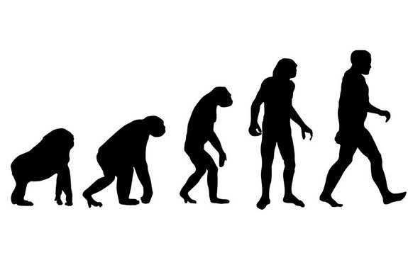
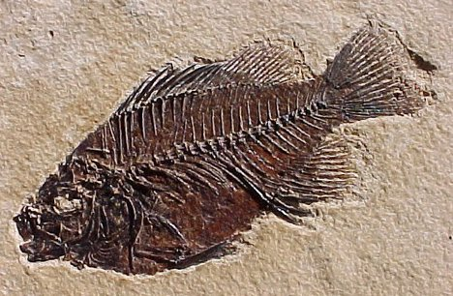
There are many scientific attempts to explain the world…
Notes:
The images above don’t form an exhaustive list of scientific explanations of the world. But give us a few concrete examples of the ways in which science attempts to make sense of creation.
Ask what students already know about these images. See student workbook for accompanying co-operative learning activity.

Slide 5
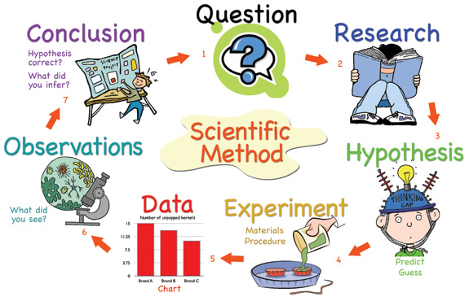
By what means does science attempt to explain the world?
https://www.youtube.com/watch?v=SMGRe824kak
Notes:
Previous Learning recall – Most students will be familiar with the scientific method from other areas of study around the school.
The Scientific Method is an organized way that helps scientists (or anyone!) answer a question or begin to solve a problem
We should also remember that modern science and the scientific method of experimentation and observation came from Catholic monks, such as St. Albert the Great and Gregor Mendel. Religion and science are not enemies.
Follow the Youtube link for a 4 minute video which explains the Scientific Method further.

Slide 6
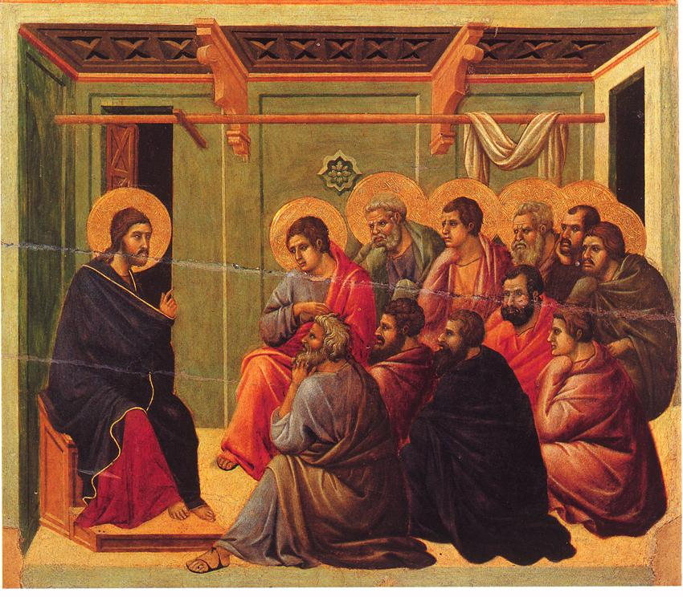
The Second Vatican Council and Gaudium et Spes
Notes:
The Second Vatican Council and Gaudium et Spes
The image is of the Vatican Flag
We know from previous learning that a church council is a massive gathering of many Church representatives (and non-Catholic observers) who are called together by the Pope to address an issue or any number of issues that may be presenting a challenge to the faithful. The culmination of these councils is a written letter that explains the faith, interprets scriptures, or settles disputed topics of faith and morals. They never contradict the Bible but apply principles found in the Bible to modern-day situations and problems as well as giving more understanding to essential core beliefs of the Catholic faith.
Gaudium et Spes (Joy and Hope), the Pastoral Constitution on the Church in the Modern World, was one of the four Apostolic Constitutions resulting from the Second Vatican Council. The document is an overview of the Catholic Church's teachings about humanity's relationship to society, especially in reference to economics, poverty, social justice, culture, science, technology and ecumenism.
See student workbook.
Sacred Tradition
The image is of Christ teaching the disciples – passing on sacred tradition
Sacred Tradition comes from Christ. It's the full, living gift of Christ to the Apostles, faithfully handed down through each generation. It is through Tradition that the Holy Spirit makes the Risen Lord present among us, offering us the very same saving Word and Sacraments that he gave to the Apostles!
Understanding Catholic Tradition is essential to understanding the Catholic Church and the Catholic Christian faith.
Tradition is "handed down"
The word "tradition" actually means handing down something to another person.

Slide 7
Whole Class Re-Cap
Do I know and understand some of the ways in which science attempts to explain the world?
Can I explain my own understanding of the relationship between science and religion?
Notes:
Success criteria for Learning Intention 1

Slide 8
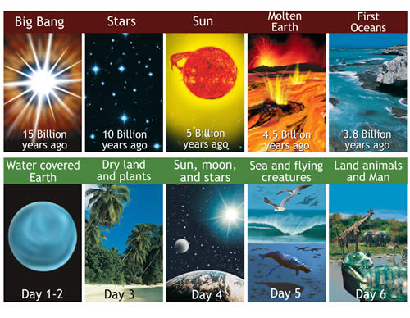
How does the Bible explain creation?
Notes:
Written exercise in student workbook.
As a class, ask students to identify ways in which they think God could still be speaking to us today through the Genesis creation accounts.
Areas for discussion might include:
Unique nature of human beings
Humans as co-creators
Relationship between a) God and man b) human beings with each other and c) human beings and the created world.

Slide 9
Gaudium et Spes
Individually, or in discussion with others, you are invited to choose and reflect upon an aspect of teaching as found within chapters 5 and 6 of Gaudium et Spes.
Notes:
There are four quotes for students to choose from in the student workbook.. There is a specific question to be considered for each quote.

