Slide 1
Saints
Teachers’ Resource
Notes:
This resource has been developed to allow teachers and children to have a catalogue of saints images and stories to hand. It should be used as a tool to enhance teaching (on special feast days, reading/ listening exercises, Confirmation preparation, slideshows etc.).
In reading the lives of the saints, we see that the saints each reflect, in a unique way, a special facet or virtue of God Himself. Learning about Catholic saints and their lives can inspire us to reach the summit of perfection that God wills for each of us.
Also included is a shortened version of The Litany of Saints prayer. This can be read as a whole class or school activity.

Slide 2
Litany of the Saints
Lord, have mercy Lord, have mercy
Christ, have mercy Christ, have mercy
Lord, have mercy Lord, have mercy
Notes:
In reading the lives of the saints, we see that the saints each reflect, in a unique way, a special facet or virtue of God Himself. Learning about Catholic saints and their lives can inspire us to reach the summit of perfection that God wills for each of us.
This resource has been developed to allow teachers and children to have a catalogue of saints images and stories to hand. It should be used as a tool to enhance teaching (on special feast days, reading/ listening exercises, Confirmation preparation, slideshow s etc.)

Slide 3
Holy Mary, Mother of God, Pray for us
Saint Michael, Pray for us
Saint Gabriel, Pray for us
Saint Raphael, Pray for us Holy angels of God, Pray for us Saint John the Baptist, Pray for us Saint Joseph, Pray for us Saint Peter and Paul, Pray for us Saint Andrew, Pray for us Saint John, Pray for us
Saint Mary Magdalene, Pray for us Saint Stephen, Pray for us Saint Ignatius of Antioch, Pray for us
Saint Lawrence, Pray for us
Saint Perpetua and Saint Felicity, Pray for us
Notes:
In reading the lives of the saints, we see that the saints each reflect, in a unique way, a special facet or virtue of God Himself. Learning about Catholic saints and their lives can inspire us to reach the summit of perfection that God wills for each of us.
This resource has been developed to allow teachers and children to have a catalogue of saints images and stories to hand. It should be used as a tool to enhance teaching (on special feast days, reading/ listening exercises, Confirmation preparation, slideshow s etc.)

Slide 4
Saint Agnes, Pray for us Saint Gregory, Pray for us Saint Augustine, Pray for us Saint Athanasius, Pray for us Saint Basil, Pray for us Saint Martin, Pray for us Saint Benedict, Pray for us Saint Francis and Saint Dominic, Pray for us Saint Francis Xavier, Pray for us Saint John Vianney, Pray for us Saint Catherine, Pray for us Saint Teresa of Jesus, Pray for us (other names of saints may be added.)
All holy men and women, Pray for us

Slide 5
Lord, be merciful, Lord, save your people
From all evil, Lord, save your people
From every sin, Lord, save your people
From everlasting death, Lord, save your people
By your coming as man, Lord, save your people
By your death and rising to new life, Lord, save your people
By your gift of the Holy Spirit, Lord, save your people

Slide 6
Be merciful to us sinners, Lord, hear our prayer
Guide and protect your holy Church, Lord, hear our prayer Keep the pope and all the clergy in faithful service, Lord, hear our prayer Bring all people together in trust and peace, Lord, hear our prayer Strengthen us in your service, Lord, hear our prayer Jesus, Son of the loving God , Lord, hear our prayer
Christ, hear us, Christ hear us
Lord Jesus, hear our prayers, Lord Jesus, hear our prayer

Slide 7
Let us pray,
God of our ancestors who set their hearts on you, of those who fell asleep in peace, and of those who won the martyrs' violent crown: we are surrounded by these witnesses as by clouds of fragrant incense. In this age we would be counted in this communion of all the saints; keep us always in their good and blessed company. In their midst we make every prayer through Christ who is our Lord for ever and ever.
Amen

Slide 8
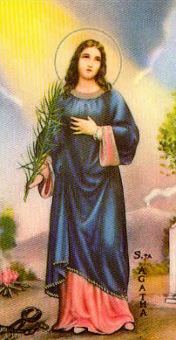
St Agatha
Saint Agatha is the patroness of nurses, foundry workers, miners, jewellers, and Alpine guides. She is invoked against fire, earthquakes, famine, thunderstorms, and volcanic eruptions. In Italy, her feast day is celebrated with fireworks.
According to some stories, Agatha was born in Sicily of noble parents in the third century. Her loveliness and kindness came to the attention of Quintian, governor of Sicily. He put her into prison for being a Christian, and there she underwent the extreme tortures that finally killed her. Art shows her holding a plate, a candle, or a house in flames.
It is certain that Agatha was a martyr. She probably died during the persecutions under the emperor Decius between 240 and 251. Agatha’s name came to be included in the canon of the Roman Mass. She is honoured for her courage in suffering and in remaining pure for the sake of Christ
February 5th
Patron Saint of Nurses

Slide 9
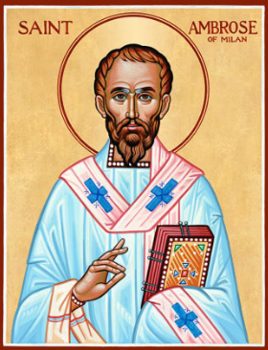
St Ambrose
Ambrose, who was governor of Milan, attended the election of the new bishop. During the election, fighting broke out when people could not agree. Ambrose stood up and pleaded for peace in the assembly. During his speech a voice cried out, “Ambrose for bishop!” Ambrose was shocked. The crowd continued to shout. Ambrose begged them not to elect him, but he could not silence them.
Ambrose was well prepared for the office of bishop. He came from a wealthy Roman family. Not only had Ambrose received the finest education in Rome, he had been raised in a good Christian household. His sister became a nun. Ambrose had followed in his father's footsteps when he entered political life. After his election as bishop he immediately gave a share of his family's money to the poor and encouraged others to do so. When conflicts arose with the ruling family, Ambrose told the people, “The emperor is in the Church, not above it.” Even the rulers must obey the laws of God.
On more than one occasion, Empress Justina sent soldiers to force Ambrose to go along with her wishes. Ambrose had to defend his cathedral against attack, but the people stood by their bishop, and the army had to back down.
December 7th
Patron Saint of Milan

Slide 10
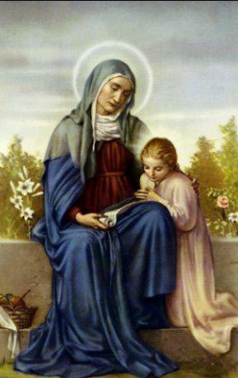
St Anne
Anne was the mother of the Blessed Virgin Mary and the grandmother of Jesus Christ.
She and her husband, Joachim, were very devoted to God. They lived in Nazareth The had no children and that was believed to be a punishment of God among the Jews. They prayed to God and begged Him to give them a child. She promised to give her child to God’s service.
Their prayers were heard even though Anne was already too old to have children. A daughter was born to Anne, and she called her Mary. Anne offered her child to God at a very early age.
Mary spent some years helping in the temple. When she returned to Nazareth the Archangel Gabriel appeared to her and told her that she would be the Mother of the Son of God.
St Anne’s name means ‘grace’. God gave her special graces, and the greatest was that she was the mother of the Mother of God. St Anne is the patron saint of mothers and of children. Her prayers Jesus and Mary are powerful.
July 26th
Patron of Mothers and Children

Slide 11
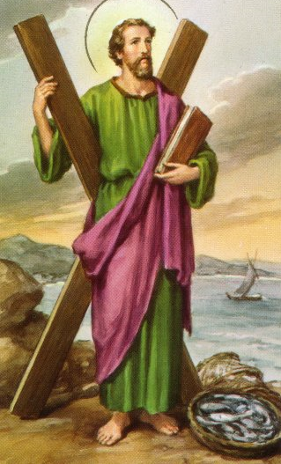
St Andrew
Andrew, like his brother Simon Peter, was a fisherman. He became a disciple of the great St John the Baptist, but when John pointed to Jesus and said, "Behold the Lamb of God!" Andrew understood that Jesus was greater. At once he left John to follow the Divine Master.
Jesus knew that Andrew was walking behind him, and turning back, he asked, "what do you seek?" When Andrew answered that he would like to know where Jesus lived, Our Lord replied, "Come and see." Andrew had been only a little time with Jesus when he realised that this was truly the Messiah.
From then on, he chose to follow Jesus. Andrew was thus the first disciple of Christ. Next, Andrew brought his brother Simon (St Peter) to Jesus and Jesus received him, too, as His disciple. He promised to make them fishers of men, and this time, they left their nets for good.
It is believed that after Our Lord ascended into Heaven, St Andrew went to Greece to preach the gospel. He is said to have been put to death on a cross, to which he was tied, not nailed. He lived two days in that state of suffering, still preaching to the people who gathered around their beloved Apostle. Two countries have chosen St Andrew as their patron – Russia and Scotland.
November 30th
Patron Saint of Fishermen

Slide 12
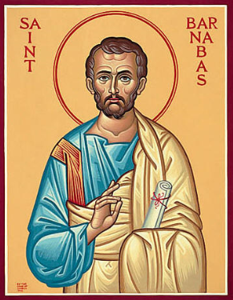
St Barnabas
We only know Scripture tells us about St Barnabas. Luke says he was “A good man, filled with the Holy Spirit and faith.” No one could ask for a better recommendation! The saint was born at Cyprus, a Jew of the tribe of Levi. His given name was Joseph, but the apostles called him Barnabas. He sold his property and donated all his money to the apostles for the poor.
Later the apostles sent him to care for the fledgling church at Antioch. He brought Paul from Tarsus to help him, and the community flourished under their leadership.
Twice Barnabas and Paul travelled to Jerusalem on behalf of the church at Antioch. He also accompanied Paul on his first missionary journey that began in Cyprus and circuited through Asia. Then Barnabas returned to Cyprus and evangelized the island.
Early Christians attributed an epistle to Barnabas, but modern scholars say he probably did not write it. Legend also says he died at Salamis in 61.
June 11th
Patron Saint of Cyprus

Slide 13
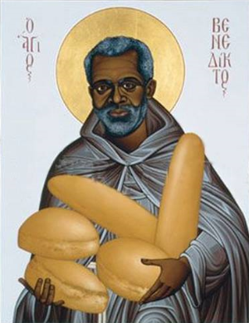
St Benedict the Moor
As a slave who was given his freedom, Benedict, also known as Benedict the Moor, devoted his life to God. Born near Messina, Italy, in 1526, he became a hermit and later superior of a community of hermits.
When the community was disbanded, Benedict became a Franciscan lay brother at Saint Mary’s Convent in Palermo.
At first he served as the cook, and later he was appointed superior. But preferring a life of service, he asked to be relieved of such responsibilities and became the cook again.
Benedict had a reputation for holiness, miracles, and generosity. He was also a skilful counsellor, and many people sought his help. He died in 1589 and is the patron saint of African Americans.
Refusing to allow his humble origins to keep him from his life’s goal, Benedict pursued God’s love and was richly rewarded. And the sting of slavery was turned into the glorious freedom of the children of God.
April 4th
Patron Saint of African Americans

Slide 14
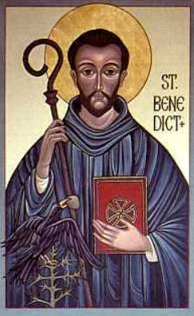
St Benedict of Nurcia
Benedict was born in Nurcia in the year 480AD to a noble family of Rome. He went to a town called Subiaco, set on a mountain forty miles from Rome. There he lived in a cave in the side of a cliff for three years. Sometimes a raven brought him food.
People heard about this holy man. Soon, more than a hundred and forty monks were living with him in a monastery at Subiaco. They were busy every day praying, clearing the land, planting crops, teaching school, feeding the poor.
Benedict’s motto was: “Pray and work.”
Benedict and his monks built a large monastery on Monte Cassino in Italy on the top of a mountain. It became the home of thousands of monks. Later, they went out to teach all through Europe. They were called Benedictines. Today they have monasteries throughout the world.
Benedict died near the altar where he received the Blessed Sacrament, while his monks held up his arms in prayer.
July 11th
Patron Saint of Students

Slide 15
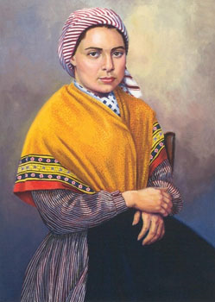
St Bernadette
St. Bernadette was born in Lourdes, France on January 7, 1844. Her parents were very poor and she was the first of nine children.
When she was fourteen, Bernadette was sent with her younger sister and a friend to gather firewood, when a very beautiful lady appeared to her above a rose bush in a grotto. The woman wore blue and white and smiled at Bernadette before making the sign of the cross with a rosary of ivory and gold. Bernadette fell to her knees, took out her own rosary and began to pray.
Bernadette said "the vision" asked her to return to the grotto each day for a fortnight. With each visit, Bernadette saw the Virgin Mary and the period of daily visions became known as holy fortnight.
Her parents were embarrassed and attempted to stop her visiting the grotto, but were unable to do so. Our Lady told Bernadette "to drink of the water of the spring, to wash in it and to eat the herb that grew there“. The next day, the grotto's muddy waters had been cleared and fresh clear water flowed. Our Lady also instructed her that "a chapel should be built and a procession formed.“
Lourdes is now a site for Catholic pilgrimage, receiving up to five million pilgrims a year. It is renowned for its healing waters curing people.
April 16th
Patron Saint of Illness and Lourdes France

Slide 16
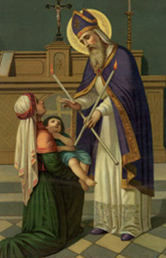
St Blaise
According to tradition, Blaise had been a doctor before he was ordained a priest. He became the bishop of Sebaste (now in central Turkey). During a period of persecution, he fled to a cave where he lived as a hermit. It is said that he cured and tamed the wild animals there. One day hunters discovered him and took him to the governor, who sentenced him to be tortured and killed. About four hundred years after his death, many stories began to be told about Blaise, and he became a popular saint, especially in France and Germany. One legend says that while Blaise was in prison, a mother brought him her small boy, who was choking on a fishbone stuck in his throat. Blaise prayed over the child, and he was healed. Every year on St. Blaise’s feast, two candles tied with ribbon in the shape of an X are used to bless throats. In the prayer the Church prays that those blessed may be delivered from diseases of the throat and from every other illness.
Blaise is one of the Fourteen Holy Helpers, saints who were patrons for almost every aspect of life. People in the Middle Ages showed devotion to these saints as a group.
February 3rd
Patron Saint of Throat Illnesses

Slide 17
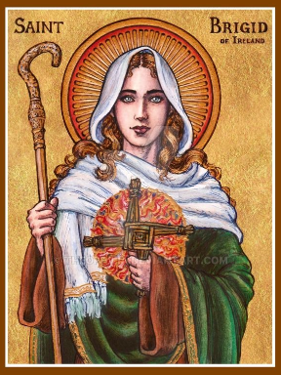
St Brigid
There are many legends about St Brigid giving true accounts of God’s interventions. Brigid was the daughter of a slave woman and a chieftain. As a girl she sensed a call to become a nun. Brigid, imitating Patrick, began to assemble nuns in communities, a historic move which enriched the church in Ireland.
In 471, Brigid founded a monastery for both women and men at Kildare. This was the first convent in Ireland, and Brigid was the abbess. Under her leadership Kildare became a centre of learning and spirituality. Her school of art fashioned both lovely utensils for worship and beautifully illustrated manuscripts.
Brigid’s hallmark was uninhibited, generous giving to anyone in need. Many of the saint’s earliest miracles seem to have rescued her from punishment for having given something to the poor that was intended for someone else. Brigid exhibited unbounded charity all her life, giving away valuables, clothing, food—anything close by—to anyone who asked.
February 1st
Patron Saint of Babies

Slide 18
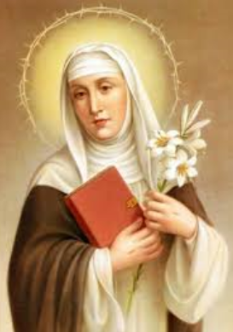
St Catherine
Catherine was born at Siena, Tuscany in Italy. Catherine was the youngest in a family of twenty-five children. When she was six years old Jesus appeared and blessed her. Her mother and father wanted her to be happily married but Catherine wished only to be a nun.
St Catherine was very honest and straightforward with Jesus and scolded him when he was not around to help her in her struggles and temptations. Jesus told her that because he was in her heart she was able to win her struggles by his grace.
In those days the Church had many problems. There were fights going on all over Italy. Catherine wrote letters to kings and queens. She even went to beg rulers to make peace with the pope and to avoid wars.
Catherine asked the pope to leave Avignon, France, and return to Rome to rule the Church as it was God's will. He listened to St. Catherine and did as she said. Catherine never forgot that Jesus was in her heart.
April 29th
Patron Saint of Nursing

Slide 19
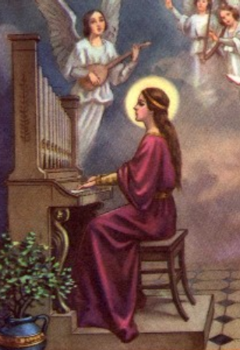
St Cecilia
Cecilia is one of the most famous and most loved of the Roman martyrs. According to legend, she was a young Christian of high rank promised in marriage to a Roman named Valerian. Through her example he was converted, and was martyred along with his brother.
An inscription of the fourth century refers to a church named after her. Her feast has been celebrated at least since 545AD. The legend about her death is very beautiful.
Cecilia refused to sacrifice to the gods. The judge condemned her to be suffocated to death. But God protected her. Then the judge ordered a soldier to kill her with a sword. He struck her three times but did not cut off her head. She fell down, badly wounded, and for three days she remained alive. After receiving Holy Communion she died in 117AD. Cecilia is honoured as the patroness of religious music and musicians. Like any good Christian, she sang in her heart, and sometimes with her voice. She has become a symbol of the Church’s teaching that good music is an important part of the liturgy.
November 22nd
Patron Saint of Musicians

Slide 20
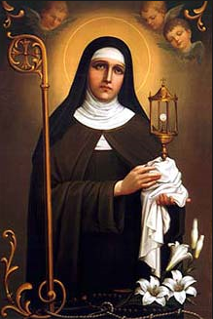
St Clare of Assisi
St. Clare of Assisi was born in Assisi on July 16, 1194. Tradition says her father was a wealthy representative of an ancient Roman family and her mother was a very devout woman. As a young girl, Clare dedicated herself to prayer. At 18-years-old, she heard St. Francis of Assisi preach during a Lenten service and asked him to help her live according to the Gospel.
Clare joined the convent of the Benedictine nuns under Francis' orders. When her father found her and attempted to force her back into his home, she refused and professed that she would have no husband except Jesus. Clare's sister Catarina, who took the name Agnes also joined her.
Overtime, other women joined them, wanting to also be brides of Jesus and live with no money. They became known as the “Order of the Poor Ladies of St Clare." They all lived a simple life of austerity, seclusion from the world, and poverty. St. Clare and her sisters wore no shoes, ate no meat, lived in a poor house, and kept silent most of the time. Their lives consisted of manual labour and prayer. Yet, they were very happy, because Our Lord was close to them all the time.
Clare is often pictured carrying a monstrance or pyx, to commemorate the time she warded off the soldiers at the gates of her convent with the Blessed Sacrament. St. Clare's feast day is celebrated on August 11.
August 11th
Patron Saint of Eye Diseases

Slide 21
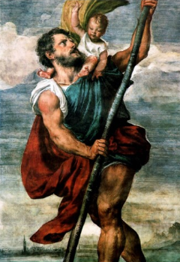
St Christopher
There is a legend that in the land of Canaan in Palestine there lived a very strong man called Offero. He is said to have left his native land looking for adventure. He said, “I will roam through the whole world in search of the greatest kings, and I will be his servant.”
Offero met a hermit who guarded a dangerous passage across a stream, and guided travellers to a place where they could cross safely. The hermit instructed him about our Lord, the greatest King. Offero settled down near the stream and carried travellers across on his shoulders to serve the great King.
One day he carried a little boy on his shoulders. Offero cried out, “Child, I feel as if I were carrying the whole world upon my shoulders.” The little boy answered smiling, “You are carrying more than the world; you are carrying Him Who created heaven and earth.” It is said that the boy Jesus baptised Offero. Since then he has been called Christopher or Christ-bearer.
July 25th
Patron Saint of Travellers

Slide 22
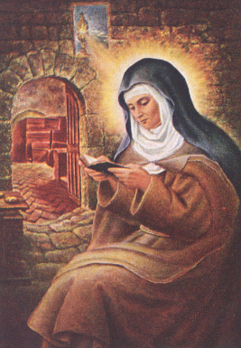
St Colette
Colette was a beautiful woman whose radiant inner strength attracted people. However, her spirituality, her commitment to God, and her heart for souls, not her physical qualities, suited her for her reforming mission.
At seventeen, upon her parents’ death, Colette joined the Franciscan Order. She lived for eight years as a hermit at Corbie Abbey in Picardy. Toward the end of this time, St. Francis appeared to her in a vision and charged her to restore the Poor Clares to their original austerity.
Colette’s first reports to reform convents met vigorous opposition. She then sought the approval of Pope Benedict XIII, who professed her as a Poor Clare and put her in charge of all convents she would reform.
Before her death in 1447, the saint had founded or renewed seventeen convents and several friaries throughout France and Spain. Like Francis and Clare, Colette devoted herself to Christ, spending every Friday meditating on the passion.
At age sixty-six, Colette foretold her death, received the sacrament of the sick, and died.
March 6th
Patron Saint of Family Members

Slide 23
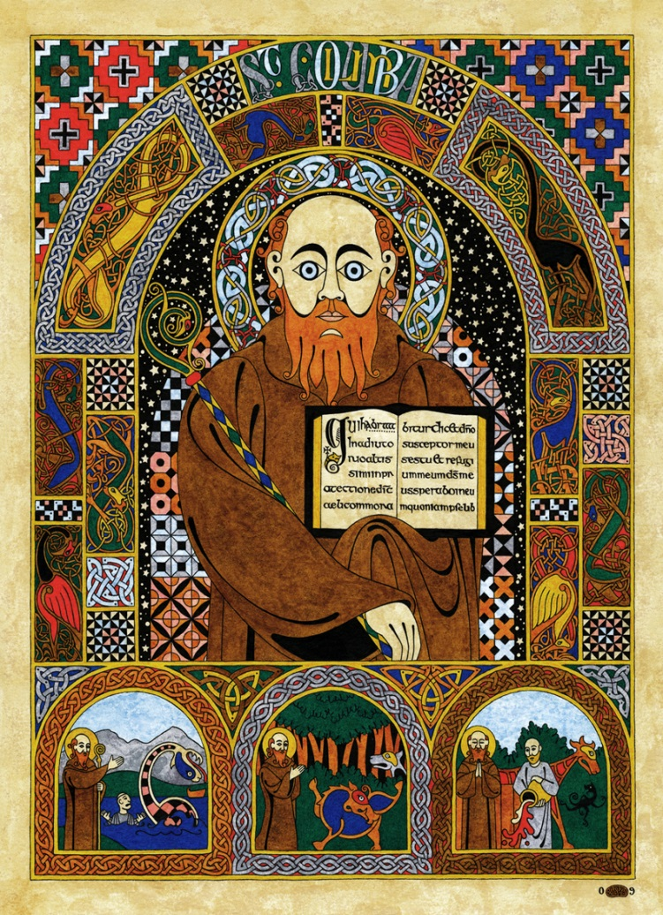
St Columba
In 563, St Columba travelled to Scotland from Ireland. He based himself on the island of Iona. He provided guiding the only centre of literacy in the region, his reputation as a holy man led to his role as a diplomat among the tribes.
There are also many stories of miracles which he performed during his work to convert the Picts, the most famous being his encounter with an unidentified animal that some have equated with the Loch Ness Monster in 565. It is said that he banished a ferocious "water beast" to the depths of the River Ness after it had killed a Pict and then tried to attack Columba's disciple
He was also very energetic in his work as a missionary, and, in addition to founding several churches in the Hebrides, he worked to turn his monastery at Iona into a school for missionaries.
He was a renowned man of letters, having written several hymns and being credited with having transcribed 300 books.
Columba died on Iona and was buried in 597 by his monks in the abbey he created. In 794 the Vikings descended on Iona. Columba's relics were finally removed in 849 and divided between Scotland and Ireland.
June 9th
Patron Saint of Bookbinders

Slide 24
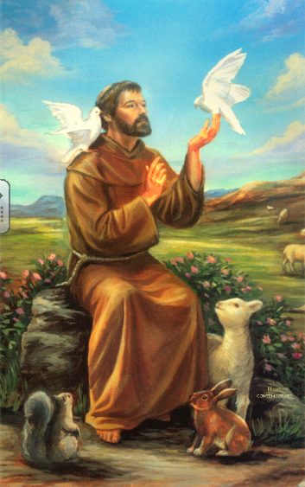
St Francis of Assisi
Francis was born in Assisi, Italy in 1182. He grew up leading a privileged life as the son of a wealthy cloth merchant. Francis loved to learn and sing songs as a boy. Francis went to battle and was captured and taken prisoner. He was held prisoner in a dungeon for a year before his father paid the ransom and he was set free. Over the next few years Francis began to see visions from God that changed his life. When praying in a church, Francis heard God tell him to "repair my church, which is falling in ruins." Francis gave all his money to the church and took a vow of poverty. As Francis lived his life of poverty and preached to people about the life of Jesus Christ, people began to follow him. He had one basic rule which was "To follow the teachings of our Lord Jesus Christ and to walk in his footsteps". The Franciscan Order grew as men joined and made vows of poverty. Francis was known for his love of nature and animals. It is said that one day he was talking to some birds when they began to sing together. Then they flew into the sky and formed the sign of a cross. Francis died in 1226 while singing Psalm 141.
October 4th
Patron Saint of Animals

Slide 25
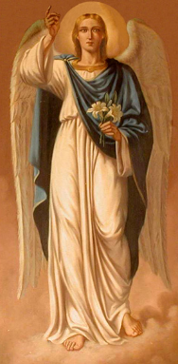
St Gabriel The Archangel
Gabriel is one of the Archangels. The word "angel" means Messenger of God. Angels who deliver messages of lesser importance are just called Angels; and those who proclaim important messages are called Archangels. They are our protectors and we know something about each of the three Archangels from the Bible.
Gabriel's name means "the power of God." He is mentioned in the book of Daniel and more importantly in Luke's Gospel.
This archangel announced to Mary that she was to be the mother of our Saviour. Gabriel announced to Zechariah that he and St Elizabeth would have a son and call him John.
Gabriel is the announcer, the communicator of the Good News.
We can ask him to help us be good communicators as he was.
September 29th
Patron Saint of Messengers

Slide 26
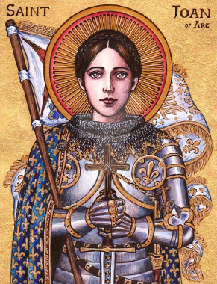
St Joan of Arc
Joan was born in France in 1412. She helped her brothers on the farm and often went to a nearby chapel to pray to Jesus.
When she was seventeen, Joan heard the voice of God calling her to drive the enemies of France from the land. Going to the king, whose army was defeated, she asked for a small army. The king believing that God had sent her to save France, gave her a band of brave soldiers.
Joan went before the soldiers carrying her banner with the words, “Jesus, Mary” The soldiers became filled with courage and drove the British army away.
Joan fell into the hands of the British and remained in prison for nine months. She was asked why she had gone to confession almost every day. She said, “My soul can never be too clean. I firmly believe that I shall surely be saved.”
She was taken to the marketplace of Rouen and burned to death. With her eyes on a crucifix, she cried out, “Jesus, Jesus” through the flames.
May 30th
Patron Saint of Soldiers

Slide 27
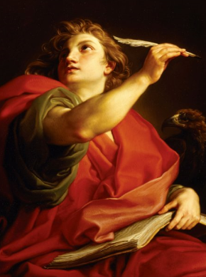
St John the Apostle
Out of the twelve Apostles, Jesus chose three – Peter, James, and John – to be His most faithful companions.
John was the youngest of the twelve. He and his brother James had been followers of John the Baptist. But Jesus saw them one day helping their father mend fishing nets. He called to them, “Come, follow me!” And from that time on they stayed close to Him.
At the Last Supper, John rested his head on the shoulder of Jesus. He stayed with Jesus during His Passion and Death, especially to console Mary. Jesus entrusted His own Mother to his care.
John preached in Palestine for many years. Later, he was taken as a prisoner to Rome. He was thrown into a pot of boiling water, but God kept him from harm.
When he was ninety years old, John wrote his Gospel to prove that Jesus was God as well as man. His symbol is the eagle because he soars above the things of the earth and speaks of the divine nature of Christ.
December 27th
Patron Saint of Love and Friendship

Slide 28
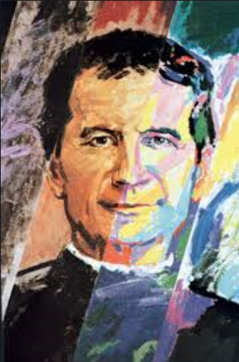
St John Bosco
Don Bosco was born in a village called 'Becchi' in 1815. When he was only two years of age he lost his father and was brought up by his mother, Margaret. Through a series of events in his youth, not least a very powerful dream he had as a young boy, he learned to become a leader for the young people he grew up with, many of whom were very badly behaved.
In order to relate to them he needed to develop certain skills. He learned that by combining entertainment with teaching and praying he could achieve positive results. Entertained by his magical balancing act, the young people would gladly listen to a lesson or pray with John Bosco.
St John Bosco is remembered as a man who dedicated his life to the service of abandoned young people. Over 150 years ago he challenged the way young people were treated in the desperate poverty that existed at that time in the city of Turin, Italy. Others were inspired to follow him in responding to the needs of the young. John Bosco created an order in the Catholic Church, called the Salesians.
After a life of achieving so much for young people, Don Bosco died at dawn on the 31st of January 1888 at the age of 73.
January 31st
Patron Saint of Young People

Slide 29
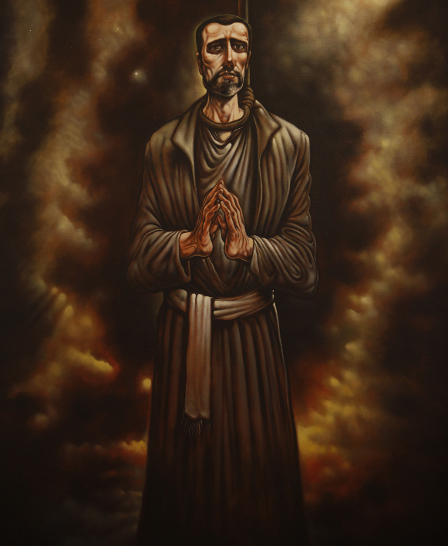
St John Ogilvie
Born in 1579, John Ogilvie belonged to Scottish nobility. Raised a Calvinist, he was educated on the continent. Exposed to the religious controversies of his day and impressed with the faith of the martyrs, he decided to become a Catholic.
In 1596, at age seventeen he was received into the Church. Later John attended a variety of Catholic educational institutions, and eventually he sought admission into the Jesuits.
He was ordained at Paris in 1610 and asked to be sent to Scotland, hoping some Catholic nobles there would aid him given his lineage.
John's work was quite successful in bringing back many people to the Faith, although his work had to be done in secret due to laws against Catholicism. However, some time later he was betrayed by someone posing as a Catholic.
After his arrest he was tortured in prison in an effort to get him to reveal the names of other Catholics, but he refused. After three trials, John was sentenced to death for converting Protestants to the Catholic Faith. The courageous priest was hanged at Glasgow Cross in 1615 at the age of thirty-six.
March 10th
Patron Saint of Soldiers

Slide 30
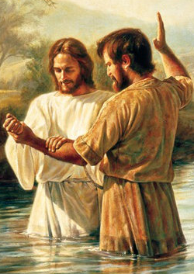
St John the Baptist
John was the son of the priest Zechariah. His mother was Elizabeth, a cousin of the Blessed Virgin Mary. Mary came to spend three months with her to help her before the birth of John. The Angel Gabriel foretold the birth of John during a vision of Zechariah in the Temple, and told him that John would prepare the people for the coming of the saviour.
When John was a young man he lived in the desert for years. At the River Jordan he cried out, “Do penance, for the kingdom of heaven is at hand! I am the voice of one crying in the desert. Make straight the way of the Lord.” Large crowds were baptised by him as a sign of penance and forgiveness of sins.
One day John pointed to Jesus with the words, “Behold the Lamb of God Who takes away the sins of the World!” And when John poured water over the head of Jesus in the Jordan River as a sign of penance, the Holy Spirit appeared in the form of a dove, and the heavenly Father said, “This is My Beloved Son in Whom I am well pleased.” King Herod had John beheaded.
June 24th
Patron Saint of Jordan

Slide 31
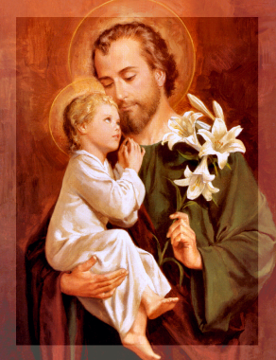
St Joseph
A few verses in Matthew and Luke’s Gospels tell us all we know about St. Joseph. They provide just enough information to demonstrate why he was the divine choice to become the husband of Mary and the foster father of Jesus.
Joseph was genealogically perfect for these roles. A distant descendant of King David, he gave Christ the King his royal lineage. Joseph also came from the right hometown. He was from Bethlehem, the city that Scripture predicted would produce the messiah. As a carpenter, Joseph was poor—Christ’s condition of preference.
Scripture portrays Joseph as open to God, obedient, upright, and, above all, kind. The saint displayed all of these qualities in his handling of Mary’s surprise pregnancy. Imagine the confusion of emotions that must have flooded him when Mary confided that she was going to have a baby by the Holy Spirit!
Joseph was open to God, and in a dream a divine messenger told him to take Mary home as his wife. Joseph did exactly as he was told. He was open to whatever God wanted, and when he sensed the divine will, he obeyed.
March 19th
Patron Saint of Workers

Slide 32
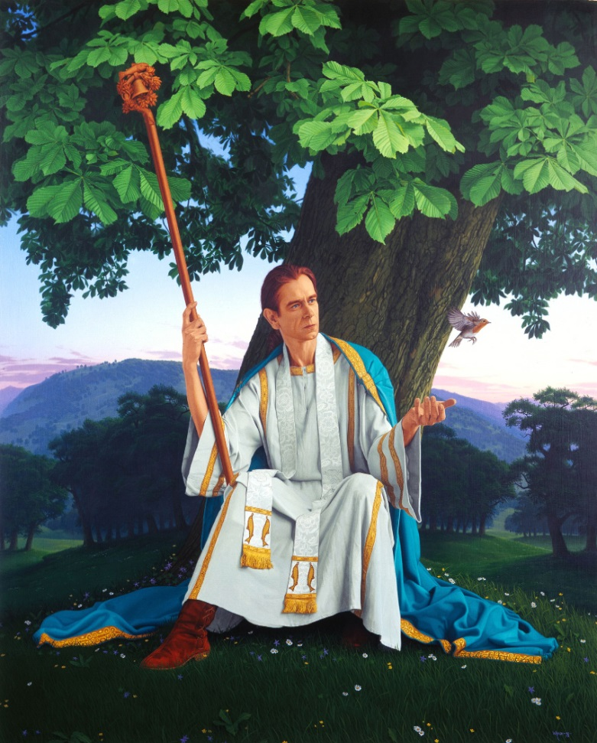
St Kentigern Mungo
St Kentigern was brought up by Saint Serf who was ministering to the Picts in that area. It was Serf who gave him his popular pet-name ‘Mungo’ meaning ‘dear one’. At the age of twenty-five, Mungo began his missionary labours on the Clyde, on the site of modern Glasgow. He built his church across the water from an extinct volcano, next to the Molendinar Burn, where the present medieval cathedral now stands. For some thirteen years, he laboured in the district, living a most austere life in a small cell and making many converts by his holy example and his preaching.
In the Life of Saint Mungo, he performed four miracles in Glasgow. The following verse is used to remember Mungo's four miracles:
Here is the bird that never flew
Here is the tree that never grew
Here is the bell that never rang
Here is the fish that never swam
Mungo's four religious miracles in Glasgow are represented in the city's coat of arms. Glasgow's current motto Let Glasgow Flourish is inspired by Mungo's original call "Let Glasgow flourish by the preaching of the word".
January 13th
Patron Saint of Glasgow

Slide 33
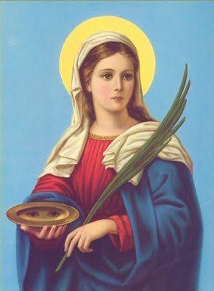
St Lucy
Lucy lived in pagan Sicily about the year 300. At an early age she offered herself to God. The rich young man who wanted to marry her was so angry when she refused that he accused her of being a Christian.
Lucy was led to the governor of her city for trial. Unable to make her give up her faith he asked, “Is the Holy Spirit in you, this God you speak about?” Lucy answered, “They whose hearts are pure are the temples of the Holy Spirit.”
The governor spoke angrily, “But I will make you fall into sin, so that the Holy Spirit will leave you.” She replied, “I will never sin, so that the Holy Spirit will give me a greater reward.”
Nothing could make her commit sin. She said, “You see now that I am the temple of the Holy Spirit, and that He protects me.”
The governor ordered a fire to be lit around her, but Lucy was not harmed. At last, a sword was buried in her heart. She did not die until a priest came to her with Holy Communion.
December 13th
Patron Saint of Blindness

Slide 34
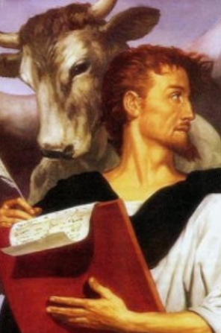
St Luke
Luke was born at Antioch, Syria. He was a Greek by birth and a physician by profession. He was skilled in painting, for he is said to have left many pictures of Jesus and Mary.
Luke was one of the earliest converts to the Faith. Later, he became the companion of Paul on part of the second and third missionary journeys. He attended Paul during his imprisonment in Caesarea and Rome. Paul refers to him as “the most dear physician” and “fellow-labourer.”
Luke is the author of the third Gospel, written before the year 63. He also wrote the “Acts of the Apostles.” His symbol is the ox, the animal of sacrifice, because he begins his Gospel with the history of Zachariah the priest, offering sacrifice to God.
Luke speaks of the priesthood of Christ. He also speaks about the wonderful works of God in beginning His Church and about Paul’s actions and miracles that he himself witnessed.
Tradition tells us that after Paul’s death Luke preached the Faith in Greece and died in Boetia at the age of eighty-four.
October 18th
Patron Saint of Doctors and Surgeons

Slide 35
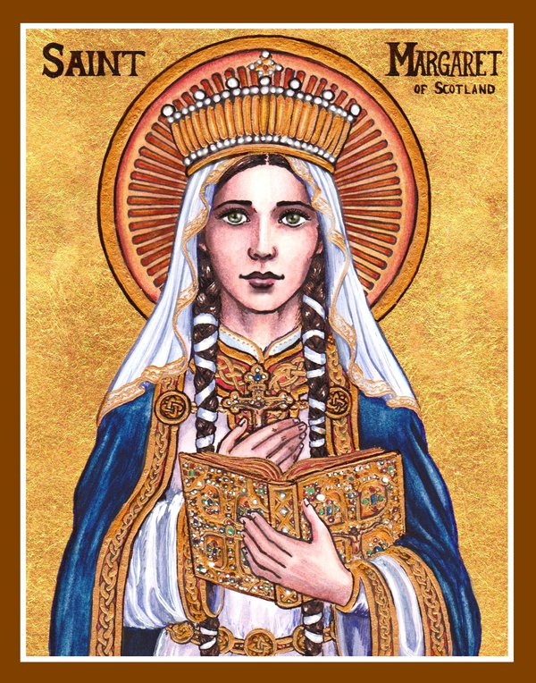
St Margaret Queen of Scots
Margaret was an English princess. She and her mother sailed to Scotland to escape from the king who had conquered their land. King Malcolm of Scotland welcomed them and fell in love with the beautiful princess. Margaret and Malcolm were married before too long.
As Queen, Margaret changed her husband and the country for the better. When he saw how wise his beloved wife was, he listened to her good advice. She softened his temper and led him to practice great virtue. Soon all the princes had better manners, and the ladies copied her purity and devotion.
The king and queen gave wonderful example to everyone by the way they prayed together and fed crowds of poor people with their own hands. They seemed to have only one desire: to make everyone happy and good.
Margaret was a blessing for all the people of Scotland. She worked hard to obtain good teachers, to correct the evil practices, and to have new churches built. She loved to make these churches beautiful for God's glory, and she embroidered the priest's vestments herself.
God sent this holy Queen six sons and two daughters. She loved them dearly and raised them well. The youngest boy became St. David. Her feast day is November 16th.
November 16th
Patron Saint of Fife

Slide 36
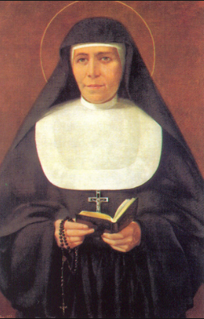
St Mary Mazzarello
As the daughter of peasants in Mornese near Genoa, Mary worked in the fields. She was always fervent in prayer and at seventeen she joined a sodality of the Daughters of Mary Immaculate.
Several years later Mary was stricken with Typhoid and could no longer work in the fields. Then she turned to dressmaking with a friend named Petronella.
The two women felt called to the Christian education of young girls in the same way that Don Bosco reached out to help young boys. So they began teaching young girls in the area.
In 1872, Don Bosco founded the Daughters of Our Lady Help of Christians, also known as the Salesian Sisters. And Mary was appointed head of the congregation.
The community spread quickly and expanded its goals to charitable works as well as teaching.
In Mary’s lifetime thirteen houses were established. Now there are over eight hundred!
Mary died at the motherhouse in Nezza Monferato in 1879 and was canonized by Pope Pius XII in 1951.
May 14th
Patron Saint of Turin

Slide 37
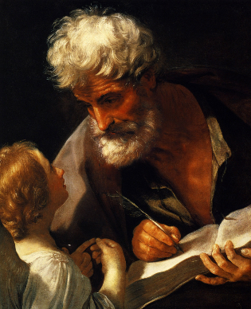
St Matthew the Apostle
Matthew wrote the first Gospel, which speaks of his call to be an Apostle. The Lord called him as he sat at his desk, “Follow Me.” At once Matthew left his work and followed Jesus. The people were surprised to see a tax collector for the Romans become one of the disciples of the Master.
Matthew also tells us of the banquet he gave that Christ attended. Many tax collectors and sinners came and sat down with Jesus and His disciples. Jesus said, “I have come not to call the just, but sinners.”
Matthew wrote his Gospel to convince the Jews that the Messiah had come in the Person of Jesus Christ. His symbol is a young man because he begins his Gospel with Christ’s earthly ancestry and stresses His human and kingly character.
Matthew preached the Gospel among the Hebrews for fifteen years. He is also called the Apostle of Ethiopia. His shrine is at Salerno in Southern Italy
September 21st
Patron Saint of Bankers

Slide 38
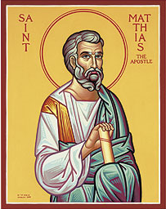
St Matthias the Apostle
From the ‘Acts of the Apostles,’ we learn that Matthias had been one of the companions of our saviour from the day of His baptism by John.
When there was a question of electing an Apostle to take the place of the traitor Judas, Peter spoke, “Of these men who have been in our company all the time that the Lord Jesus moved among us, from John’s baptism until the day that He was taken up from us, of these one must become a witness with us of His Resurrection.”
Two men were proposed: Barsabbas and Matthias, and the latter was chosen by lot. It was after this occurrence that the Holy Spirit descended upon the Apostles, among whom Matthias was numbered.
Matthias preached the Gospel and stressed the value of self-denial. He continually called the people to do penance for their sins.
According to the Eastern Church, Matthias suffered martyrdom in Colchis, which is now called Ethiopia.
May 14th
Patron Saint of Perseverance

Slide 39
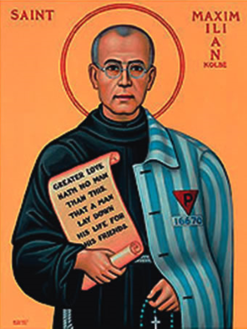
St Maximilian Kolbe
Maximilian was born on January 7, 1894, in Poland and became a Franciscan. He had tuberculosis and, though he got well, remained frail all his life.
He founded a Movement dedicated to Mary Immaculate and spread it through a magazine called “The Knight of the Immaculate.” It helped to form a community of 800 Franciscan men who dedicated themselves to the service of Our Lady.
Maximilian went to Japan and India spreading the Movement. Because of ill health he returned home in 1939. After the Nazi invasion of Poland, he was imprisoned and released for a time. But he was arrested again in 1941 and sent to the concentration camp at Auschwitz.
On July 31, 1941, for one prisoner’s escape, ten men were chosen to die. One was a young husband and father. Father Kolbe offered himself in his place. He died after two weeks of starvation. He was canonized by Pope John Paul II in 1982.
August 14th
Patron Saint of Drug Addictions

Slide 40
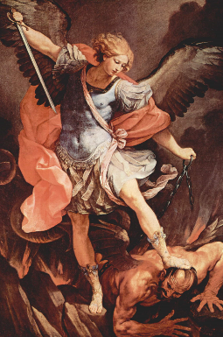
St Michael The Archangel
Michael is one of the Archangels. The word "angel" means Messenger of God. Angels who deliver messages of lesser importance are just called Angels; and those who proclaim important messages are called Archangels. They are our protectors and we know something about each of the three Archangels from the Bible.
Michael's name means "who is like God?" St. Michael is mentioned in three books of the Bible: Daniel, Revelation and the Letter of Jude. In the book of Revelation or the Apocalypse, chapter 12:7-9, we read of a great war that went on in heaven.
Michael and his angels battled with Satan (or the fallen angel Lucifer). Michael who was the leader of God's army became the champion of loyalty to God.
We can ask St Michael to make us strong in our love for Jesus and in our practice of the Catholic religion.
September 29th
Patron Saint of Drug Addictions

Slide 41
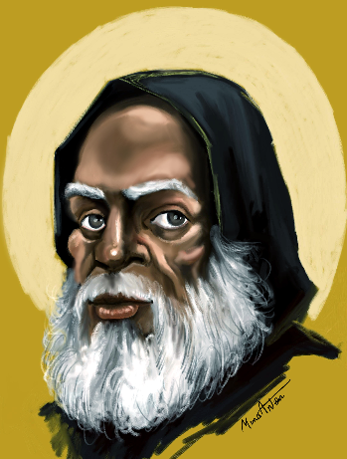
St Moses
Moses was an Ethiopian born into slavery around the year 330. When he came of age, he first went to work in the home of an Egyptian official.
However, he lost his job and began to live an aimless and wandering life. He was seeking God but did not know it.
Moses’ life changed one day when he happened to take refuge among hermits at the monastery of Petra in the Skete desert in Lower Egypt.
He was so impressed with the holy men that he himself became a monk in that monastery. He asked God to forgive the sins of his former life and to keep him from all future evil.
Moses lived as a hermit until he was ordained a priest by Archbishop Theophilus of Alexandria. He became famous for his supernatural gifts.
In 405, he was together with six other monks and was attacked by a group of Bedouins. In imitation of his Divine Master, Moses refused to defend himself and gave up his life in this world.
August 28th
Patron Saint of Africa

Slide 42
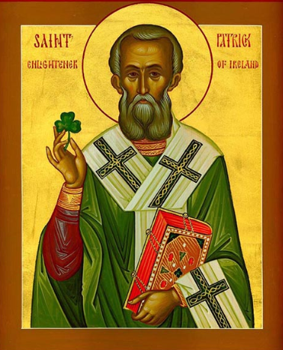
St Patrick
St. Patrick of Ireland is one of the world's most popular saints. He was born in Roman Britain and when he was fourteen or so, he was captured by Irish pirates during a raiding party and taken to Ireland as a slave to herd and tend sheep.
Patrick's captivity lasted until he was twenty, when he escaped after having a dream from God in which he was told to leave Ireland by going to the coast. There he found some sailors who took him back to Britain and was reunited with his family.
A few years after returning home, Patrick saw a vision. The vision prompted him to become a priest. He was ordained a priest and later became a bishop and was sent to take the Gospel to Ireland.
Patrick arrived in Slane, Ireland on March 25, 433. Legend has it that the chieftan of one of the druid tribes, tried to kill him. After an intervention from God, Patrick was able to convert the chieftain and preach the Gospel throughout Ireland. There, he converted many people - eventually thousands - and he began building churches across the country.
He often used shamrocks to explain the Holy Trinity.
March 17th
Patron Saint of Ireland

Slide 43
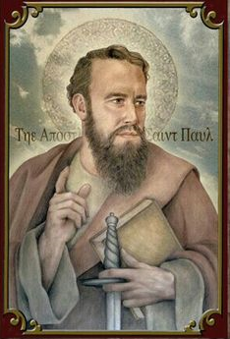
St Paul the Apostle
Saint Paul is one of the most important and influential of all the saints. Many of his writings are contained in the Bible and have influenced the growth and development of the Church since the first century.
St Paul was originally known as Saul. At one point he presided over the persecutions of the early Christians and was present at the martyrdom of St Stephen.
However, Saul experienced a powerful vision that caused him to convert to Christianity while on the road to Damascus. He was duly baptised and took the name Paul.
Paul travelled the world, first to Arabia then back to Damascus. He also visited Jerusalem to see St Peter, the first pope and pay homage to him. During these travels, he preached ceaselessly, often drawing criticism and ire from those who rebuffed his message. Jews, in particular, hated his preaching as they saw him convert people to Christianity from Judaism.
He established several churches in their travels. After establishing his churches, Paul remained in communication with the faithful, often writing letters to answer questions and resolve disputes.
The letters that have survived have become part of the Bible. Paul's writings are important because they provide good advice for how Christians should live.
June 29th
Patron Saint of Missionaries

Slide 44
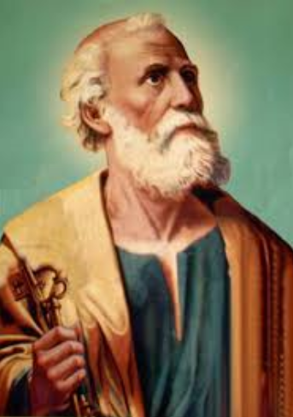
St Peter
June 29th
Patron Saint of Bakers
Simon was a fisherman. His brother Andrew said to him, “I have met Jesus. Come and see Him.” Simon saw and became a follower of Jesus, Who changed his name to Peter, which means ‘rock’.
Jesus picked eleven other Apostles and said, “Follow Me, and I will make you fishers of people.” He meant that He would send them to do His work of bringing people to God.
One day, Jesus said to them, “Who do you think I am?” Peter answered, “You are Christ, the Son of God.” Our Lord was pleased and said, “You are Peter, a rock, and I will build My Church upon you. I will give you the keys of the kingdom.” This is the power to help people get to heaven.
After His Resurrection, Jesus said to Peter, “Feed My lambs, feed My sheep.” In this way, our Lord made it clear that Peter was to be the first Pope.
Peter was crucified, head downward, in Rome, because he considered himself unworthy to die as Jesus had done.

Slide 45
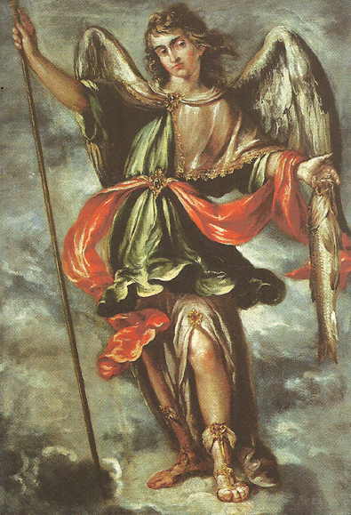
St Raphael
The Archangel
September 29th
Patron Saint of
Doctors and Nurses
Raphael is one of the Archangels. The word "angel" means Messenger of God. Angels who deliver messages of lesser importance are just called Angels; and those who proclaim important messages are called Archangels. They are our protectors and we know something about each of the three Archangels from the Bible.
Raphael's name means "God has healed." We read the touching story of Raphael's role in the Bible's book of Tobit. He was also the Angel mentioned in John 5:1-4 as the power behind the healing at the sheep pool.
He brought protection and healing to the blind Tobit. At the very end of the journey, when all was completed, Raphael revealed his true identity. He called himself one of the seven who stands before God's throne.
We can ask St. Raphael to protect us in our travels, even for short journeys, like going to school. We can also ask him to help when illness strikes us or someone we love.

Slide 46
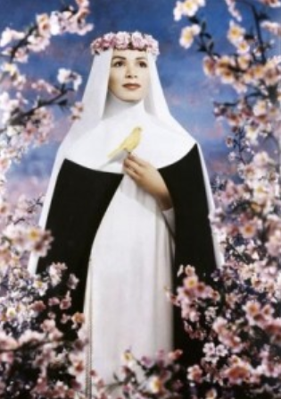
St Rose
of Lima
August 23rd
Patron Saint of Florists
Rose was born in Peru, South America. She was very obedient to her parents. She did all she was told to do with a happy smile for the love of Jesus. She always tried to help people.
Rose was very beautiful. Her mother wanted her to wear beautiful clothes, but Rose would say, “Mother only beauty of the soul is important.”
A rich young man wanted to marry Rose. He offered her a beautiful home and many servants, but she refused. She loved Jesus with all her heart and wanted to serve God.
When her parents became poor, Rose went out every day to work, and at night did sewing, to help her parents.
Rose visited the homes of the poor and brought them food. She offered all her sufferings and good works to God for sinners. Our Lord often appeared to her as a little child to tell her how pleased he was with her kind deeds.
Rose died when she was only thirty-one years of age. She is the first saint of the Americas.

Slide 47
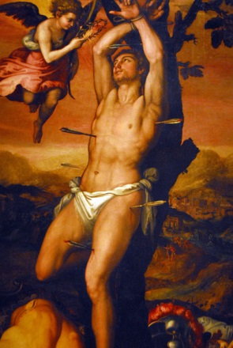
St Sebastian
St Sebastian came from southern France and he was educated in Milan. He joined the Roman Army in 283 AD, to be of service to other Christians who were being persecuted by the Romans. He was promoted to serve in the Praetorian Guard to protect Emperor Diocletian.
As well as helping many Christians in need, St Sebastian converted many non believers to Christianity. This led to his discovery by Emperor Diocletian in 286. The Emperor, who was already infamous for ordering the deaths of hundreds of Christians, scolded Sebastian and ordered him to be killed by having him tied to a stake on a training field and used as target practice.
Archers riddled his body with arrows. Believed to be dead, the archers left his body for retrieval and burial. He was recovered by Irene of Rome who discovered that Sebastian was still alive, so she hid him and nursed him back to health.
Once well, Sebastian found and confronted Diocletian and proceeded to criticise him loudly and publically for his persecution of the Christians.
Diocletian, surprised that Sebastian was still alive, was immediately taken aback, but ordered his former guard to be beaten to death with clubs, then thrown into the sewers.
January 20th
Patron Saint of Soldiers

Slide 48
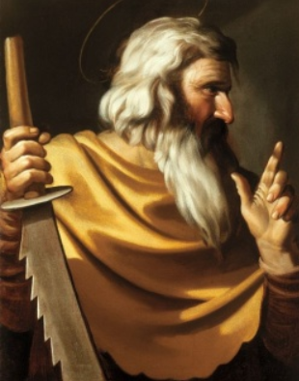
St Simon
October 28th
Patron Saint of Sawers
Simon was one of the twelve men called by Jesus to be Apostles. He was known as the Canaanean and also the Zealot. This was to distinguish him from Peter (who was originally called Simon) and from Simeon, the brother of James the Less.
The expression Canaanean means the same as the Greek “Zelots,” a title some say was given to him because of his great zeal. Others say it was given to him because he belonged to a sect (among the Jews) called Zealots.
Simon proclaimed the Gospel in Egypt. He is then believed to have travelled to Carthage, Spain, and even Britain. He brought the Gospel to the peoples of those countries.
According to a Western tradition, Simon also joined Jude on missionary journeys to Syria, Mesopotamia, and Persia. So the Church celebrates the feasts of these two Apostles on the same day.
Simon is usually pictured with a saw, the instrument of his martyrdom.

Slide 49
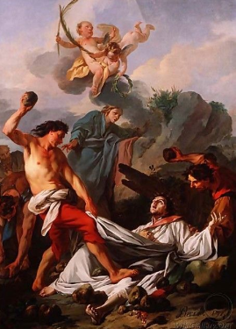
St Stephen
The Apostles told the disciples to choose seven med who lived a holy life to help in the care of the poor. These men were called deacons, and Stephen was named first of the deacons. The Apostles ordained them deacons by praying and placing their hands upon them.
Stephen was very holy and brave, and worked great wonders among the people. But some of the Jews accused him of talking against God and Moses. Stephen talked with great wisdom before the court of the Jews. People said there was a halo around his head and his face looked like that of an angel as he spoke bravely of Jesus.
The Jews became very angry. But Stephen being full of the Holy Spirit, looking up to heaven said, “I see the heavens opened and the Son of Man standing on the right hand of God”.
The angry people dragged him outside of the city and stoned him to death. But Stephen forgave his murderers, saying “Lord, lay not this sin against them. Lord Jesus, receive my spirit.” He died as the first martyr.
December 26th
Patron Saint of Altar Servers

Slide 50
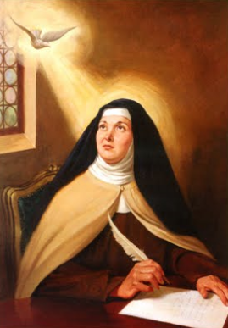
St Teresa of Avila
Teresa was the daughter of noble parents in Spain. When she was only seven years of age she and her little brother liked to read stories from the lives of saints. One of their games was playing ‘hermit’ in their father’s garden.
When Teresa was still quite young, she became crippled by disease and was unable to walk. She prayed to St Joseph, who cured her.
Teresa lost her mother when she was twelve. She begged the Mother of God to be her mother. Five years after her mother’s death she joined the Carmelite Order. She built many new convents.
By a life of prayer, work, and sacrifice Teresa brought many souls to Jesus. Her many writings show her great love of God. She wrote,
“Let nothing trouble you, let nothing make you afraid. All things pass away. God never changes. Patience obtains everything. God alone is enough.”
She died on October 4th, 1582 after she had a vision of Jesus and many saints.
October 15th
Patron Saint of Headache Sufferers

Slide 51
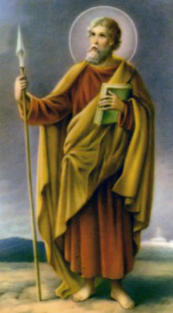
St Thomas
July 3rd
Patron Saint of India
Thomas was a man of great courage and self sacrifice. When Jesus told His disciples that He would return to Judea to visit His friend Lazarus, the Apostles knew that people would try to stone Him. But Thomas said to his companions, “Let us also go, that we may die with Him.”
After the Resurrection, the Apostles said to Thomas “We have seen the Lord.” But he said, “Unless I see in His hands the print of the nails, and put my finger into the place of the nails, and put my hand into His side, I will not believe.”
After eight days, Thomas was with the Apostles. Jesus appeared and stood before Thomas and said, “Bring here your finger, and see My hands: and bring here your hand, and put it into My side; and be not unbelieving, but believing.”
Thomas answered, “My Lord and my God!”
After the Ascension, Thomas preached in Parthia. He is called the Apostle on the Indies where he was martyred.

Slide 52
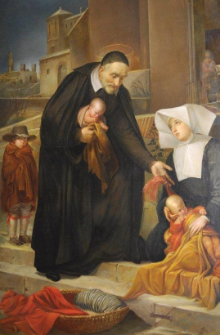
St Vincent de Paul
Vincent was born in France in 1576. When he was still a young priest, he was captured by Turkish pirates who sold him into slavery.
For two years he had to work hard for his masters who bought him. However, he converted his last master to Catholicism and was set free.
Vincent was sent to work in a parish near Paris. He was a very great friend of the poor. He started groups to look after them. The women took care of the sick and cooked meals for them. Men gave food and clothes to the needy.
Vincent started the Order of the Daughters of Charity who worked for the poor and sick. He built homes for the poor, the sick, the aged, and the abandoned children. He also started the Congregation of the Mission, a society of priests and missionaries called the Vincentians.
Vincent died in Paris at the age of eight four. The St Vincent de Paul Society (SSVP) continues his work for the poor.
September 27th
Patron Saint of Charitable Societies

Slide 53
References
Holy Spirit Interactive: Kids Zone. 2016. A saint a day. [ONLINE] Available at: http://www.holyspiritinteractive.net/kids/saints/default.asp [Accessed 23 May 2016]
Lovasik, Rev. L (1982) Book of Saints: Part 1-12. New Jersey: Catholic Book Publishing Corp.
Loyola Press: A Jesuit Ministry. 2016. Saints stories for all ages. [ONLINE] Available at: http://www.loyolapress.com/saints-stories-for-kids.htm?cId=115673# [Accessed 23 May 2016].
Roman Catholic Saints. 2016. Roman Catholic saints and heroes!. [ONLINE] Available at: http://www.roman-catholic-saints.com/ [Accessed 23 May 2016].

