Slide 1
St. Andrew
Our Patron Saint

Slide 2
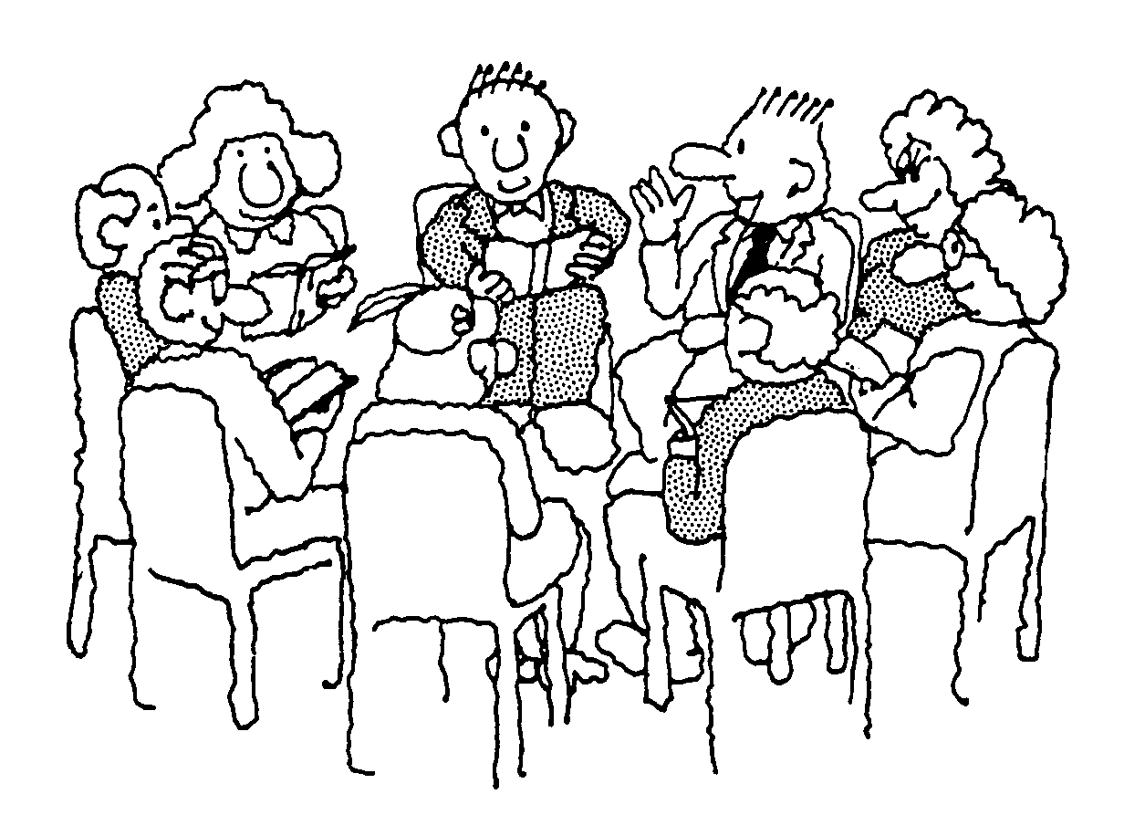
What do you know about
St. Andrew?
Talk to your partner

Slide 3
Andrew is the Patron Saint of:

Slide 4
Andrew was born at Bethsaida, near the Sea of Galilee
Andrew was the brother of Simon Peter
He was a follower of John the Baptist and then became the first apostle of Jesus
Andrew introduced his brother, Simon Peter, to Jesus
He became one of the disciples of Jesus
When Jesus wished to feed the five thousand in the desert it was Andrew who pointed out the little boy with the five loaves and fishes

Slide 5
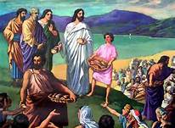
Matthew 14 – Jesus feeds the 5000

Slide 6
Close your eyes
Imagine you are there:
What do you hear?
What do you smell?
How do you feel?

Slide 7
All sing:
When Christ our Lord to Andrew cried: “Come, thou, and follow me,”
Click on score for printable version
the fisher left his net beside the Sea of Galilee. To teach the truth the Master taught, to tread the path he trod was all his will and thus he brought unnumbered souls to God.

Slide 8
When Andrew’s hour had come, and he was doomed, like Christ to die, he kissed his cross exultingly, and this his noble cry: “O noble cross! O precious wood! I long have yearned for thee; uplift me to my only good who died on thee for me.”

Slide 9
Now Let Us Pray:
Dear St. Andrew, you were a friend of Jesus, help us to be good friends and to love the way that Jesus wants us to.
Lord, hear us
Dear Saint Andrew you were on of the first people to believe in Jesus, help us to show great faith. Lord , hear us

Slide 10
Dear Saint Andrew, you showed great courage in following Jesus, help us to be true followers of Jesus.
Lord, hear us
Dear Saint Andrew, look after our country, our school, parish and families.
Lord, hear us

Slide 11
The Scottish flag:
Why does our flag have this design?
We celebrate St. Andrew’s day on the 30th November

Slide 12
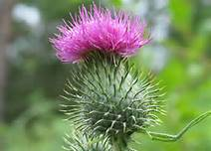
All sing:
O flower of Scotland When will we see your like again That fought and died for Your wee bit hill and glen And stood against him Proud Edward's army And sent him homeward Tae think again The hills are bare now And autumn leaves lie thick and still O'er land that is lost now Which those so dearly held And stood against him Proud Edward's army And sent him homeward Tae think again

Slide 13
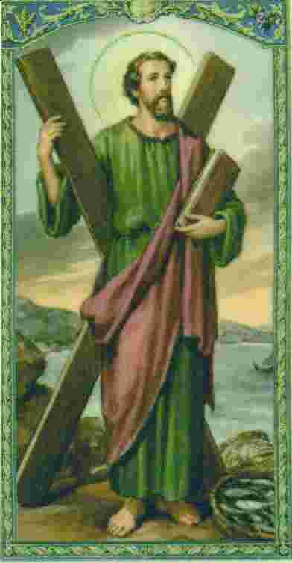
Final Prayer:
O glorious St. Andrew, you were the first to recognize and follow the Lamb of God. With your friend, St. John, you remained with Jesus for that first day, for your entire life, and now throughout eternity. As you led your brother, St. Peter, to Christ and many others after him, draw us also to Him. Teach us to lead others to Christ solely out of love for Him and dedication in His service. Help us to learn the lesson of the Cross and to carry our daily crosses without complaint so that they may carry us to Jesus. Amen.

