Slide 1

The music you are listening to is a famous Scottish folk tune called
“ Speed Bonny boat”

Slide 2
Primary 4
St Andrew’s Day Assembly
Patron Saint of Scotland
Feast Day November 30th

Slide 3
Oh when the saints
Go marching in
Oh when the saints go marching in
I want to be in that number
When the saints go marching in

Slide 4
Oh when the band
Begins to play
Oh when the band begins to play
I want to be in that number
When the band begins to play

Slide 5
Oh when Saint Andrew
He followed Jesus
Oh when Saint Andrew followed Jesus
He wanted to be an apostle
When Saint Andrew followed Jesus

Slide 6
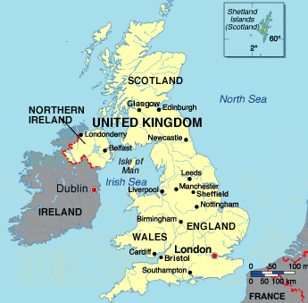
We are proud of where we live
Scotland

Slide 7
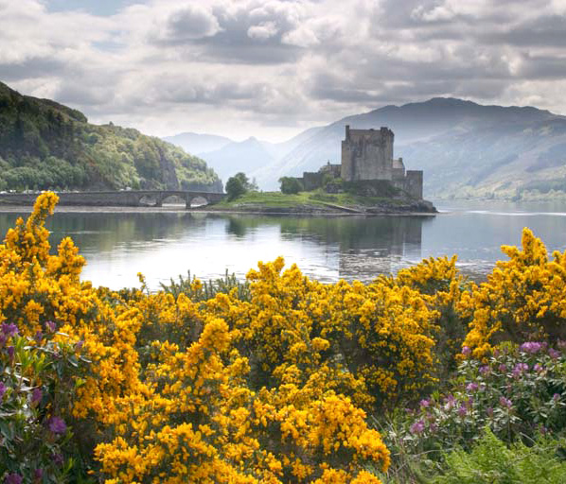
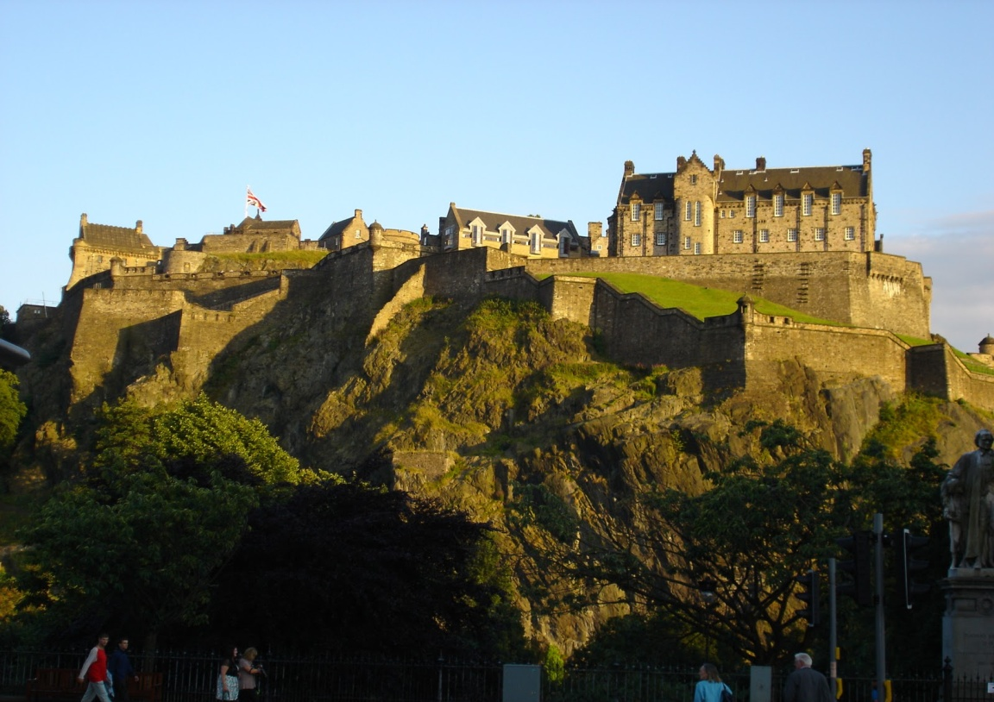
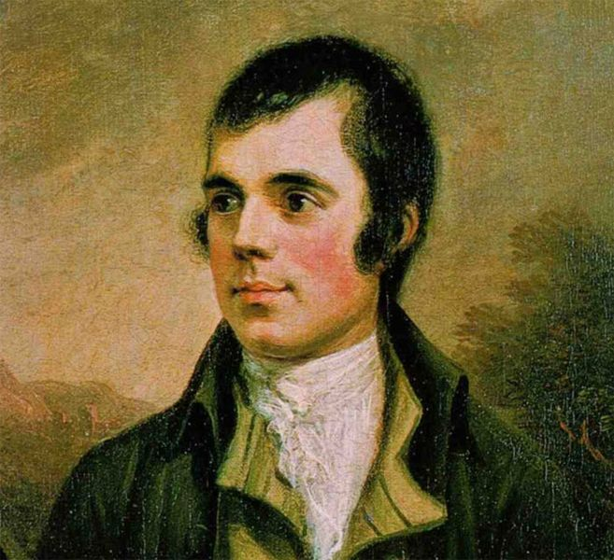
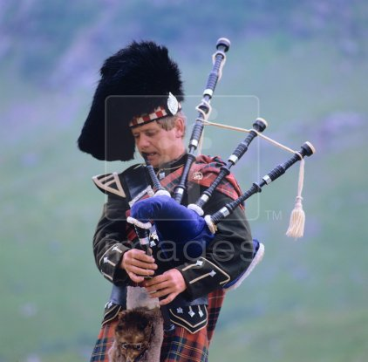
Scenery?
Capital city?
Glasgow
Edinburgh
music
Robert Burns
bagpipes
Our favourite poet

Slide 8
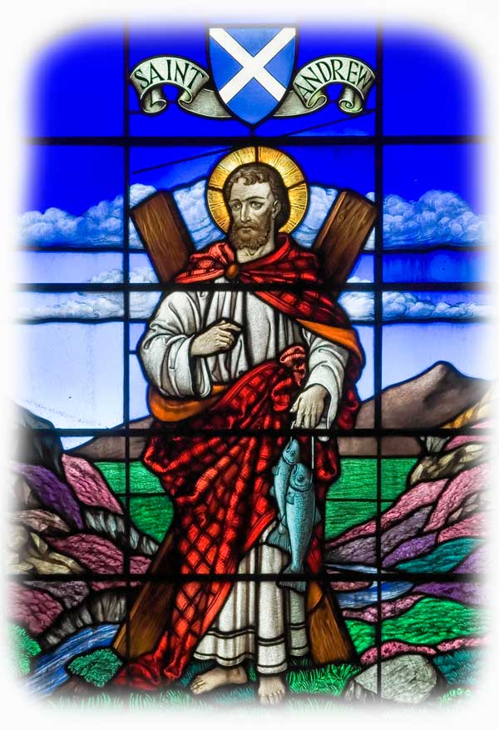
St Andrew
Patron Saint of Scotland
As part of our preparation
for confirmation we had to choose a Saint whom we admired and who would help us make the right choices.
I chose St Andrew.

Slide 9
We were sealed with the Gift of the Holy Spirit.

Slide 10

The Story of St Andrew’s

Slide 11
Response
Hear our prayer

Slide 12
St Andrew’s faith gave him the strength and courage to carry on the message of God.

Slide 13
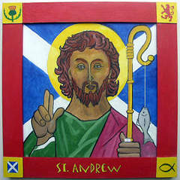
St Andrew

