Slide 1
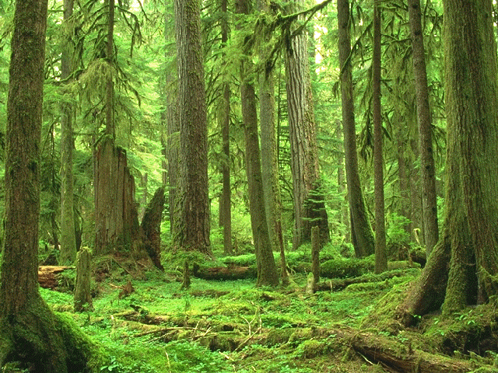
Stewardship

Slide 2
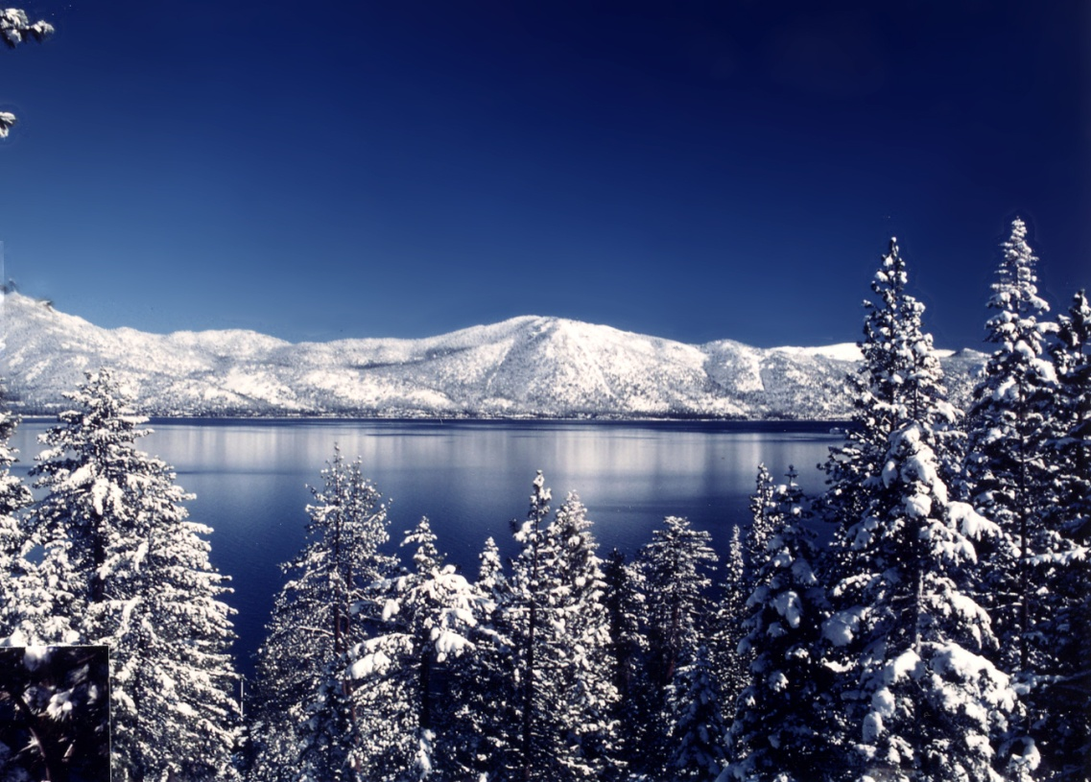
By the end of this lesson you will
Understand what ‘Stewardship’ is.
Understand the responsibilities put upon
us by God.
Know ways in which we can protect and
care for our natural world.

Slide 3
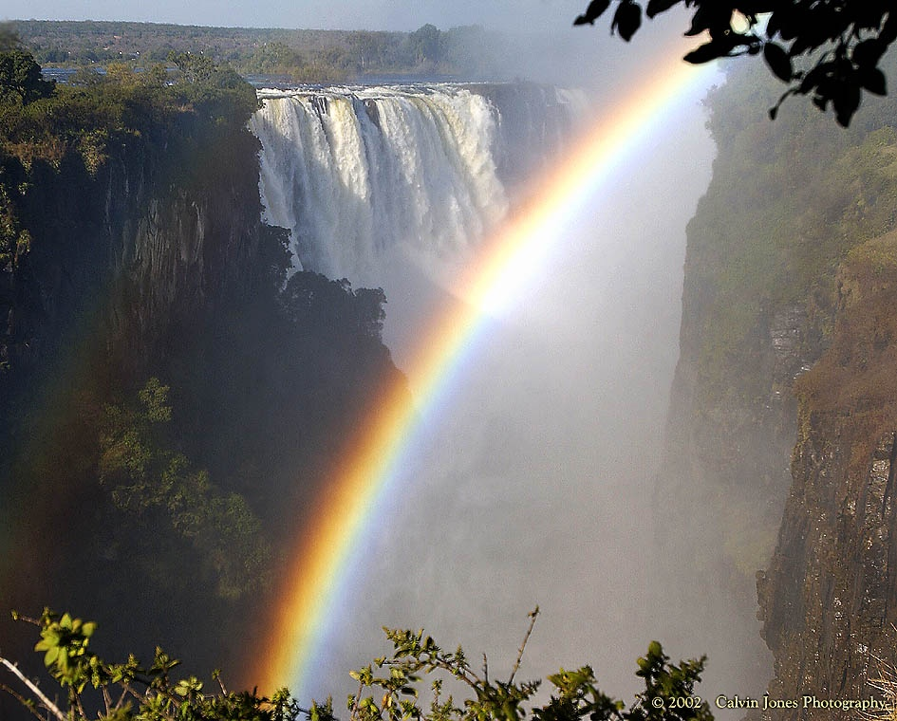
What is ‘Stewardship’
Please pick the definition you believe to be true and write it in your book.
a) Stewardship is when you carry out actions which help
destroy the planet.
b) Stewardship is when you look after the planet and respect
everything on it to protect animals, plants and the future
of the human race.
c) Stewardship is the idea that the planet will eventually be
destroyed due to climate change.

Slide 4
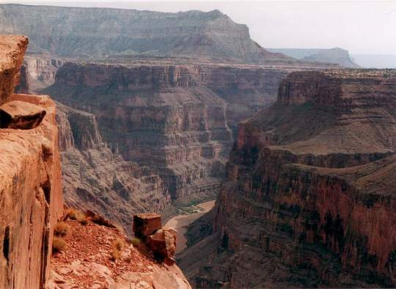
Key Christian beliefs
God created the universe.
Everything created belongs to God, not us.
God gave human beings the responsibility to care for it.
When we meet God in the afterlife we will be asked to account for how well we have looked after this gift.

Slide 5
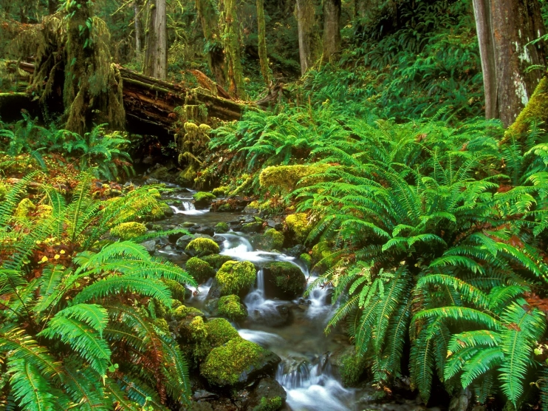
Genesis 1
So God created Human beings, making them to be like himself.
He created the male and female, blessed them, and said, ‘have many children, so that your descendents will live all over the earth and bring it under their control. I am putting you in charge of the fish, the birds, and all the wild animals.
I have provided all kinds of grain and all kinds of fruit for you to eat; but for all the wild animals and birds I have provided grass and leafy plants for food ‘ – and it was done… the Lord God placed the man in the Garden of Eden to cultivate it and guard it.

Slide 6
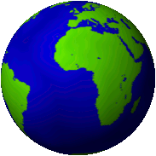
What’s Gone Wrong?
What has gone wrong in the world.
Can you think how man has not responded to God’s call for us to be ‘stewards’ of the Earth?

Slide 7
Discuss the Following Topics
Environment
Suffering
Stewardship
Drought
Global Warming
Climate change
Famine
Pollution
Acid rain
Deforestation
Protecting
Respect
Caring

Slide 8
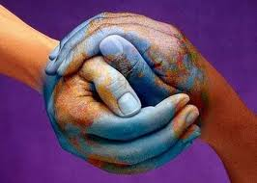
What can we do?
Discuss with your partner ways in which we can protect and care for our natural world.
Create a mind map in your jotter.
We can recycle our waste.
How can we help to protect and care for our natural world.

