Slide 1
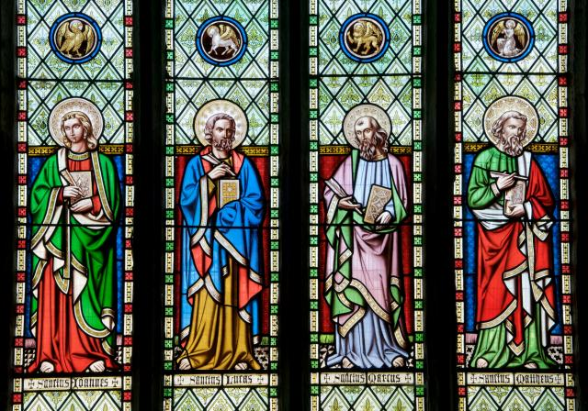
The Four Evangelists

Slide 2
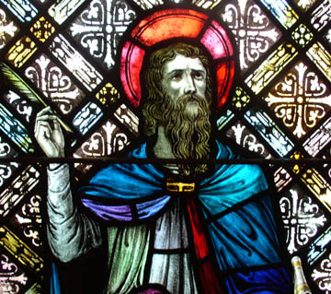
MATTHEW Saint Matthew was Jewish, like Jesus, but he worked for the Roman government as a tax collector. That made him very unpopular with his fellow Jews. One day, he was at work when Jesus passed by. Jesus called him, saying, “Follow me.” And without a moment’s hesitation, Matthew did!
Matthew Fact File
The first Gospel was written by Matthew.
In images, Matthew is often shown writing his gospel.
His symbol is an angel, because the first story he tells in his gospel is about how an angel
appeared to Joseph in a dream.
His Gospel tends to be written toward the Jewish readers. He concentrates heavily on the fact
that Jesus did all of the things that the Old Testament said he would do.
Task
Using a Bible find and read the first passage in Matthew’s Gospel about Joseph’s dream. Discuss any questions about the passage as a class.

Slide 3
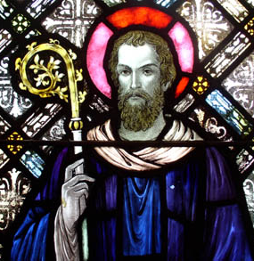
MARK Saint Mark was a young boy when he became a follower of Jesus. Though he was not one of the twelve apostles, he was a disciple of Jesus and an eyewitness of many of the things Jesus did. Mark’s Gospel is the shortest of the four. It’s a fast-paced, exciting telling of Jesus’ story. Mark writes almost like a newspaper reporter, telling all the facts.
Mark Fact File
The Second Gospel was written by Mark.
In art, Mark is shown with a lion, because his Gospel begins with John the Baptist, preaching in the
wilderness.
Mark wrote much of the Gospel with the Roman empire in mind. He wanted all people to know the
joy of Jesus Christ.
True to his nature, he ended up being an important person in the spread of the word. He travelled
long and far throughout the world to spread the word of Jesus Christ.
Task
Mark was born and raised in Jerusalem. After the resurrection he travelled to Cyprus. He returned to Jerusalem and made passage to Rome with the apostle Peter. From there he went to Egypt and then onto Babylon before spreading the word in Africa and Libya. Use a map to locate the places Mark visited.

Slide 4
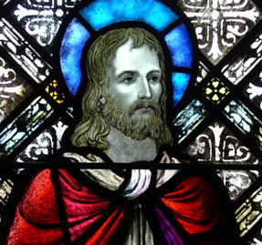
LUKE Saint Luke’s gospel is longer and more detailed than Matthew’s or Mark’s. In Luke’s Gospel, we learn a lot about Mary. There are also a lot of great stories that we don’t hear anywhere else, like the story of the Good Samaritan. It is thought that Saint Luke was a physician, because he has so many stories about Jesus’ power to heal sick people.
Luke Fact File
The Third Gospel was written by Luke.
In art, Luke is shown with an ox, because his Gospel begins with Zechariah, the father of John the
Baptist, offering sacrifice in the temple at Jerusalem.
Luke was a very strong follower of Jesus. He was very important in spreading the word to the Greeks.
Task
Use a Bible to source three stories about times when Jesus healed people.

Slide 5
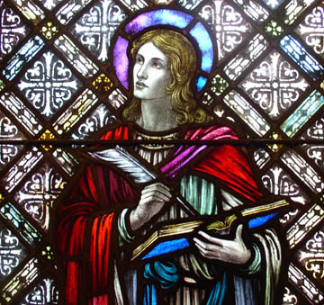
JOHN John’s gospel tells the story of Jesus in a different way from the others. He doesn’t tell the Christmas story as the others do; instead, he begins his gospel with a beautiful poem about what happened at Christmas: the word became flesh, and dwelt among us. John doesn’t tell the story of the Last Supper; but he is the only one to tell about Jesus’ washing his disciples’ feet on the night before he was crucified. John was thought to be the youngest apostle, so in art he is shown as a young man, without a beard, in contrast to the others.
John Fact File
The Fourth Gospel was written by John.
His symbol is an eagle, because his writing “soars” to the mystical heights of heavenly things, and
doesn’t spend much time on the ground!
John's love for Jesus Christ is very evident on the pages, as is Jesus' love for mankind.
Task
Read the opening lines of the Gospel of John and discuss what they mean.

Slide 6
Each of these men gave wonderful accounts of Jesus Christ. All four tell about the way Jesus Christ lived, died, and was resurrected into heaven to be with God. What an honour it must have been to tell the story of Jesus!
How well did you listen and participate.
Work with your shoulder partner to complete the Evangelist Worksheet.

