Slide 1
The Sacred Heart of Jesus

Slide 2
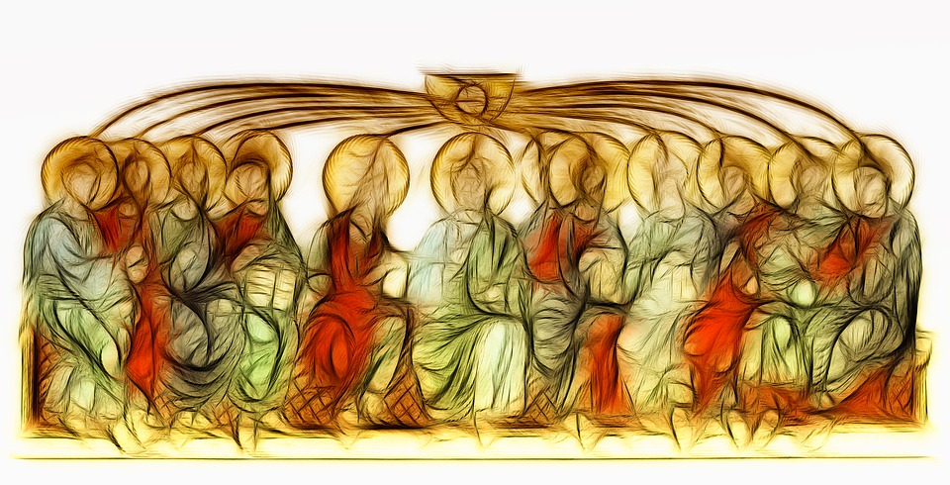
Image from: saintclementparish.com – all rights reserved
The Feast of the Sacred Heart of Jesus is celebrated nineteen days after Pentecost Sunday.
Notes:
The Month of June is dedicated to the Sacred Heart of Jesus. Just as we honour Mary in the month of May, through the prayers that we say and the hymns that we sing, we honour the Sacred Heart of Jesus in June. The Feast of the Sacred Heart of Jesus is usually celebrated in June as it falls 19 days after Pentecost Sunday.

Slide 3
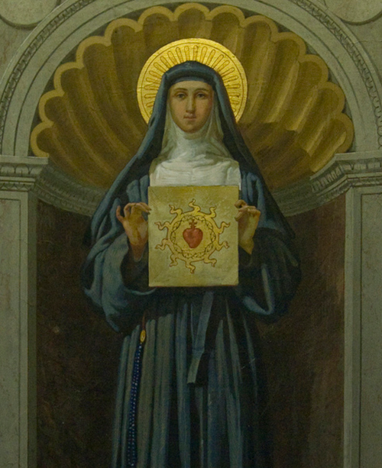
We can learn more about the Sacred Heart of Jesus through the visions of Saint Margaret Mary Alacoque and the
twelve promises Jesus made to anyone who practised devotions to
His Sacred Heart.
Notes:
While some saints referenced the Heart of Jesus in their writings centuries earlier, in 1673, a French Visitandine (Visitation) nun named Margaret Mary Alacoque had visions of Jesus, wherein he asked the Church to honor His Most Sacred Heart. In particular, Jesus asked the faithful to “receive Communion on the First Fridays, for nine consecutive months.” The request was connected to a specific promise made to all who venerated and promoted devotion to the Sacred Heart. After Margaret Mary’s death, the First Friday practice steadily spread in the Church but it greatly increased in popularity when Margaret Mary was canonized a saint in 1920 by Pope Benedict XV.
2. Why nine consecutive months?
The number nine is traditionally associated with a novena and finds its origin in the nine days that the apostles spent in prayer before Pentecost. A novena provides an extended amount of time for preparation and interior renewal.
We can learn more about the Sacred Heart of Jesus through the 12 promises that were given to St Margaret Mary.

Slide 4
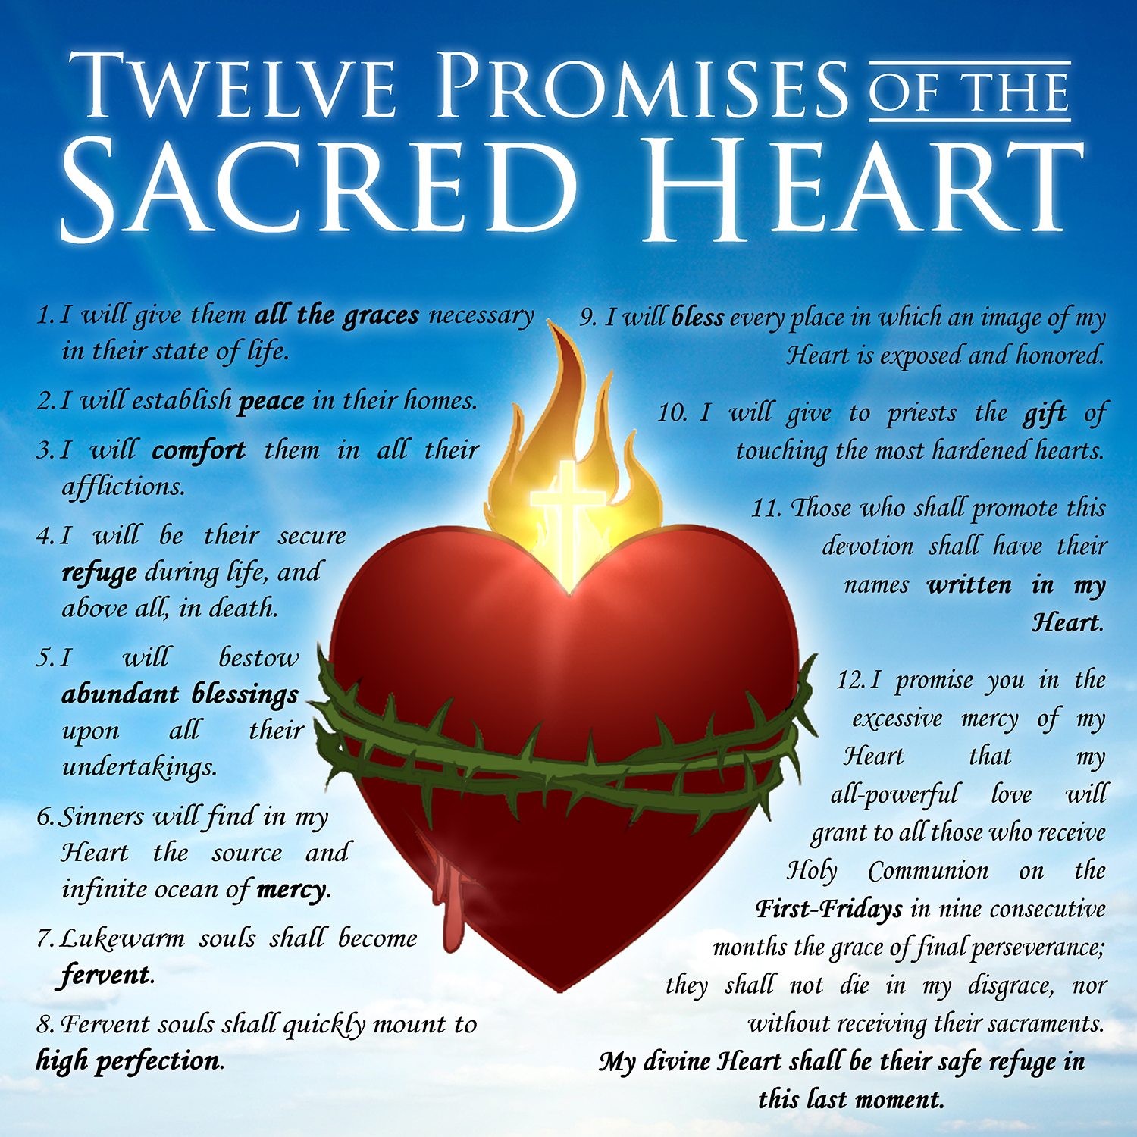

Slide 5
The image of the Risen Lord with his heart exposed illustrates the humanity and divinity of Jesus.
Notes:
Let’s look at the image of the Sacred Heart more closely

Slide 6
Images of the Sacred Heart
The Sacred Heart
The image of the heart helps
us to understand that through
incarnation, Christ became
man, fully human and fully
divine.
Jesus told Margaret Mary
about the blessings of grace,
peace, mercy, faith and love
within His sacred heart.

Slide 7
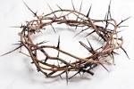
Images of the Sacred Heart
The Crown of Thorns.
The crown of thorns reminds us of the humility
of Jesus. During His sorrowful passion, He was
mocked, and a crown of thorns was placed upon
His head. Christ suffered for our sake and our
salvation.
Notes:
You will see on the images of the Sacred Heart, that the crown of thorns is wrapped around the heart…

Slide 8
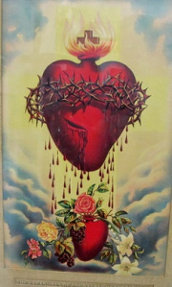
Images of the Sacred Heart
The wound
The pierced, wounded heart and precious blood
of Christ remind us that He experienced pain,
exhaustion and death. His blood was shed for
all, so that sins may be forgiven.

Slide 9
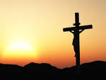
Images of the Sacred Heart
The Cross
The image of the cross mounted on top of the Sacred
Heart is a sign of faith, hope and love. God loves us
so, that he gave his only Son, so that everyone who
believes in him may have eternal life.
Christ died for our sins and our salvation. He rose
from the dead and ascended into heaven. Christ will
come again in glory and His kingdom will have no end.

Slide 10
Images of the Sacred Heart
The Flames
The flames represent the love Christ has for all.
A love so great, it burns within His heart and
the flames spread beyond it.

Slide 11
Images of the Sacred Heart
The Light radiating from the Sacred Heart
Divine light radiates from the Sacred Heart.
Jesus is, ‘The Light of the World’. He guides our
way and is our example. Those who follow
Christ, will never walk in darkness. He is our
light and our Help.

Slide 12
Sacred Heart of Jesus, have mercy on me! May the Sacred Heart of Jesus be everywhere loved! Amen
Notes:
During this month of June let us make a special effort to pray to the Sacred Heart of Jesus.

