Slide 1
Why Does God Allow Suffering?

Slide 2
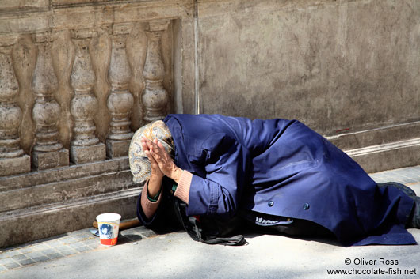
In our world it’s easy to forget that God exists!

Slide 3
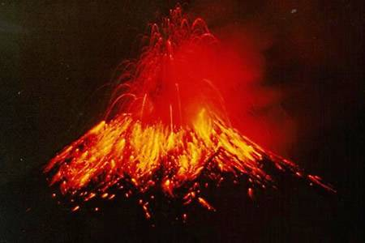
Our world can be a frightening place!

Slide 4
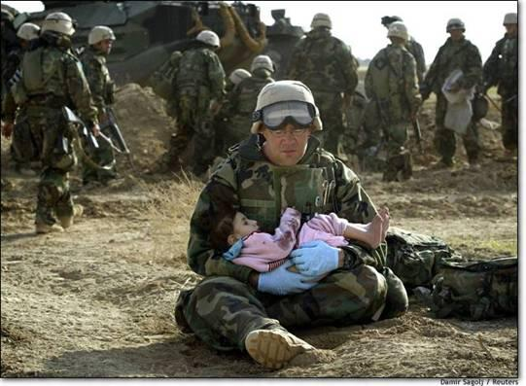
At times we just don’t understand why God allows innocent people to suffer!

Slide 5
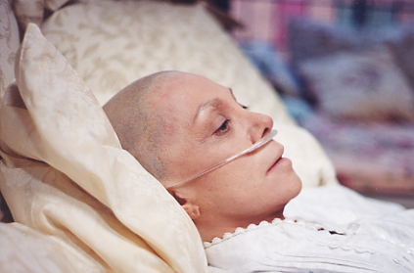
Why can’t he take away illness and pain?

Slide 6
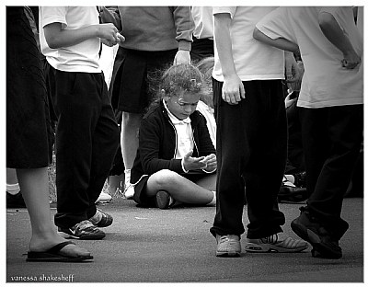
Loneliness…

Slide 7
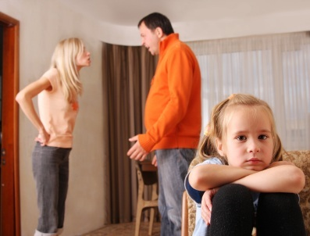
Fear.

Slide 8
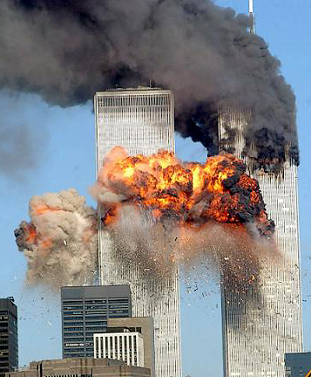
Hatred.

Slide 9
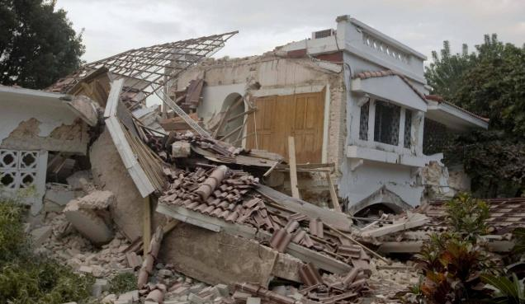
Disaster.

Slide 10
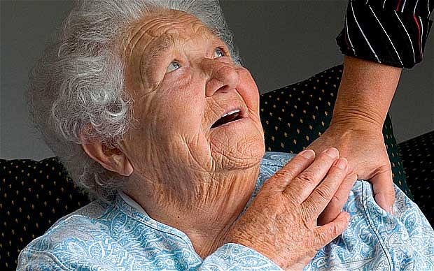
Doesn’t God know we suffer?

Slide 11
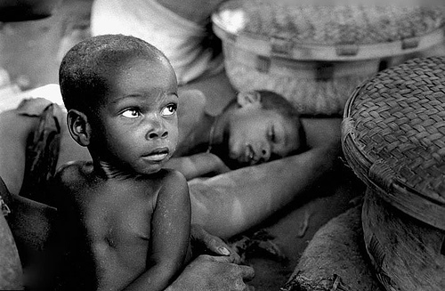
Can’t he stop our suffering?

Slide 12
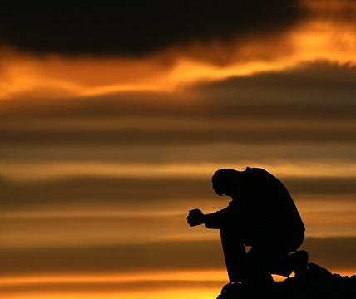
Sometimes we only turn to God in times of need, times of pain.
It is easy to blame God for all the suffering.

Slide 13
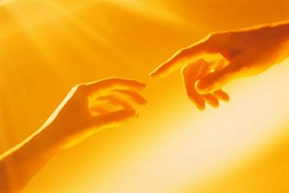
When he created us he gave us the gift of ‘Free Will’.

Slide 14
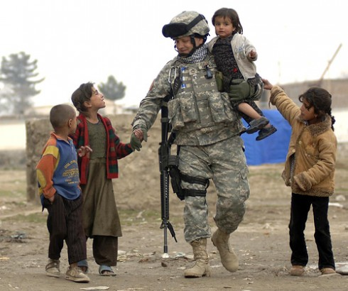
A response of protection in the face of conflict .

Slide 15
A response of care in the face of illness.

Slide 16
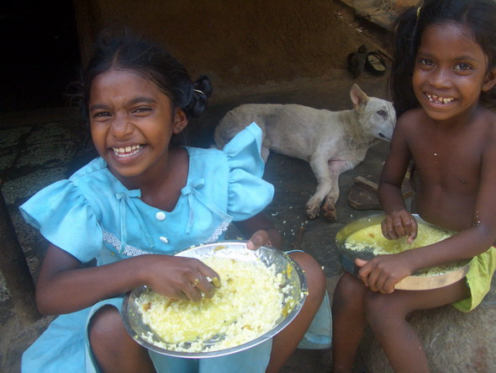
A response of compassion in the face of poverty.

Slide 17
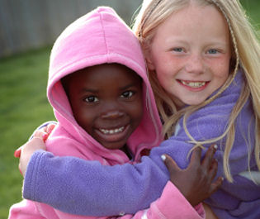
A response of friendship in the face of difference.

Slide 18
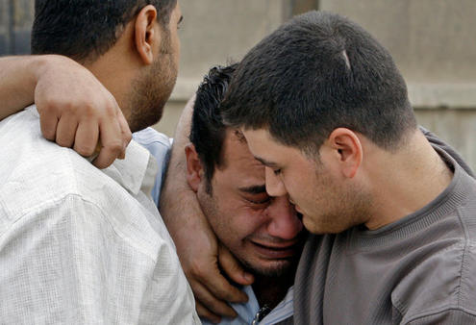
A response of support to those who are lost and in despair.

Slide 19
A Response of
Love…..

